Slide 1
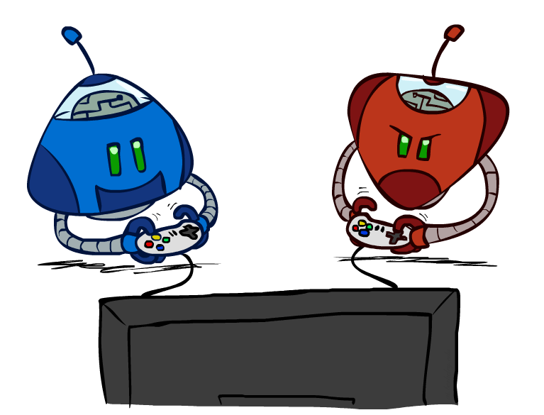
CSCE-420: Artificial Intelligence
Adversarial Search
Instructor: Guni Sharon
Based on slides by: Pieter Abbeel, Dan Klein

Slide 2
Announcements
Assignment 1 is available, due by Feb 10, EoD
Quiz 3 is available on Canvas, due by Feb 6, EoD
Contest 1: Multi-Agent Pacman, due by Feb 17, EoD

Slide 3
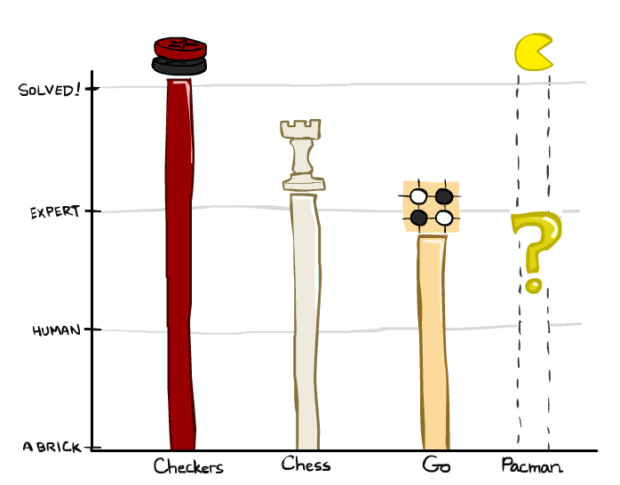
Game Playing State-of-the-Art
Checkers: 1950: First computer player. 1994: First computer champion: Chinook ended 40-year-reign of human champion Marion Tinsley using complete 8-piece endgame. 2007: Checkers solved!
Chess: 1997: Deep Blue defeats human champion Gary Kasparov in a six-game match. Deep Blue examined 200M positions per second, used very sophisticated evaluation and undisclosed methods for extending some lines of search up to 40 ply. Current programs are even better, if less historic.
Go: In go, b > 300! Classic programs use pattern knowledge bases, but big recent advances use Monte Carlo (randomized) expansion methods with heuristic based on deep learning. See AlphaGo by DeepMind. In March 2016, it beat Lee Sedol in a five-game match, the first time a computer Go program has beaten a 9-dan professional without handicap.

Slide 4

Video of Demo Mystery Pacman

Slide 5
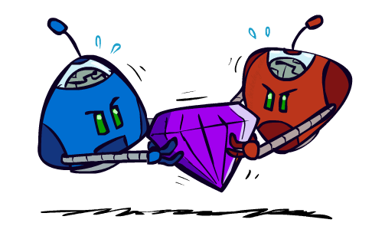
Adversarial Games

Slide 6
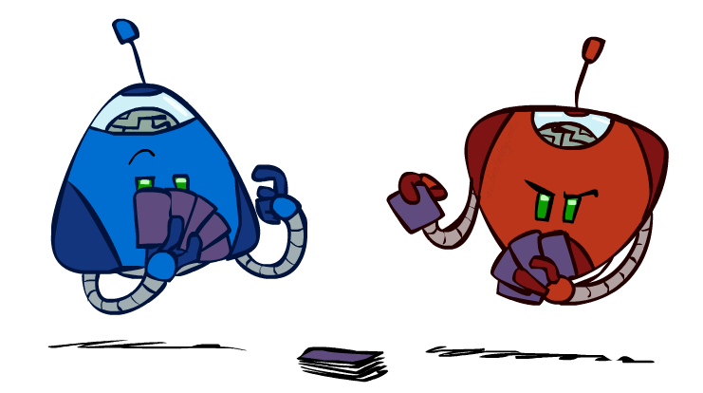
Types of Games
Many different kinds of games!
Axes:
  Deterministic or stochastic?
  One, two, or more players?
  Zero sum?
  Perfect information (can you see the state)?
Want algorithms for calculating a strategy (policy) which recommends a move from each state

Slide 7
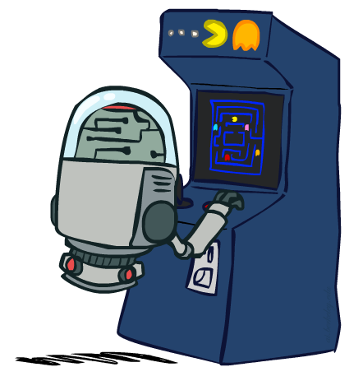
Deterministic Games
Many possible formalizations, one is:
  States: S (start at s₀)
  Players: P={1...N} (usually take turns)
  Actions: A (may depend on player / state)
  Transition Function: SxA → S
  Terminal Test: S → {T,F}
  Terminal Utilities: S → R
Solution for a player is a policy: S → A

Slide 8
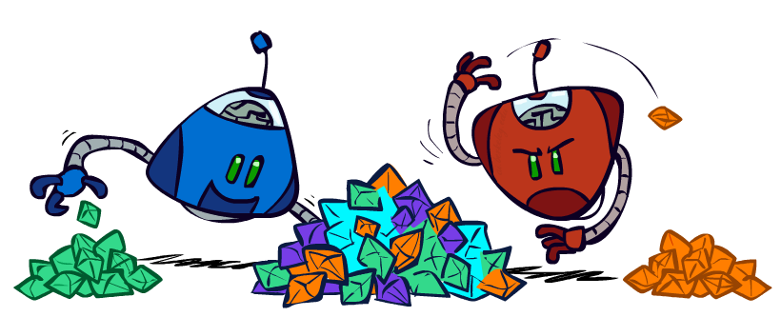
Zero-Sum Games
Zero-Sum Games
  Agents have opposite utilities (values on outcomes)
  For two agents, a single value that one maximizes and the other minimizes
  Adversarial, pure competition
General Games
  Agents have independent utilities (values on outcomes)
  Cooperation, indifference, competition, and more are all possible
  More later on non-zero-sum games

Slide 9
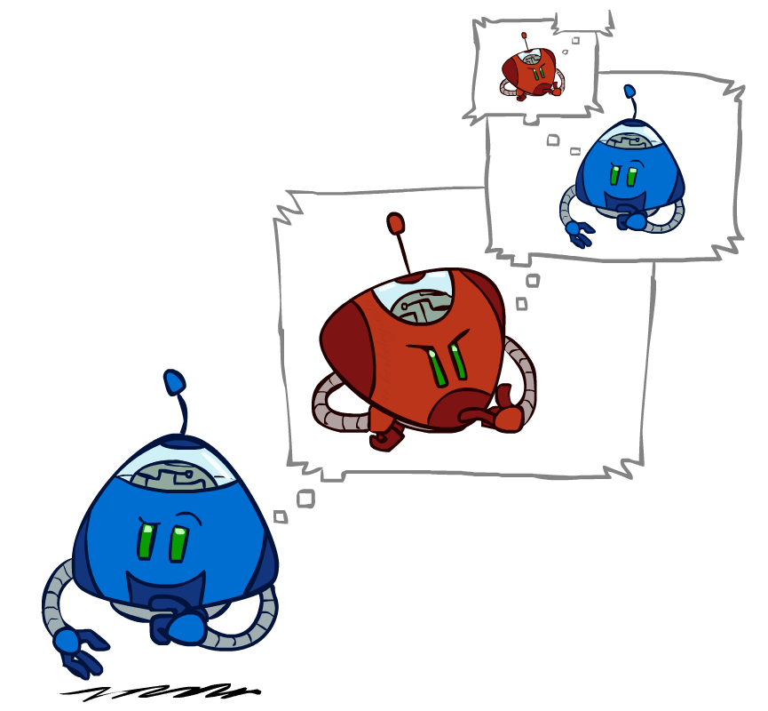
Adversarial Search

Slide 10
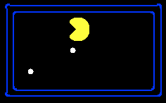
Single-Agent Trees
8
2
0
…
2
6
…
4
6

Slide 11
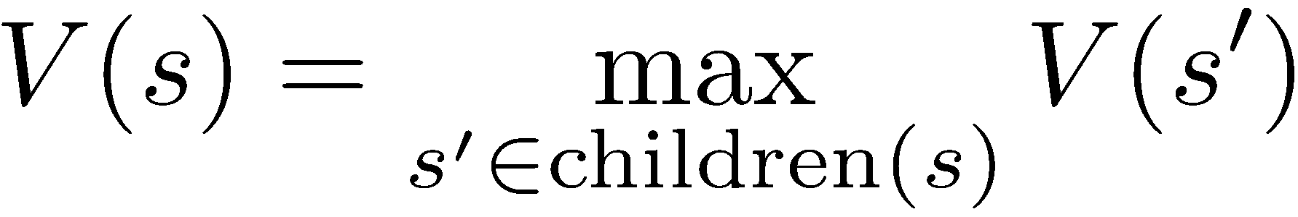
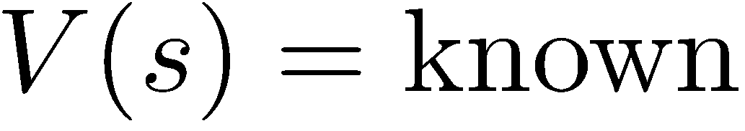
Value of a State
Value of a state: The best achievable outcome (utility) from that state
Non-Terminal States:
8
2
0
…
2
6
…
4
6
Terminal States:

Slide 12

Adversarial Game Trees
-20
-8
…
-18
-5
…
-10
+4
-20
+8

Slide 13
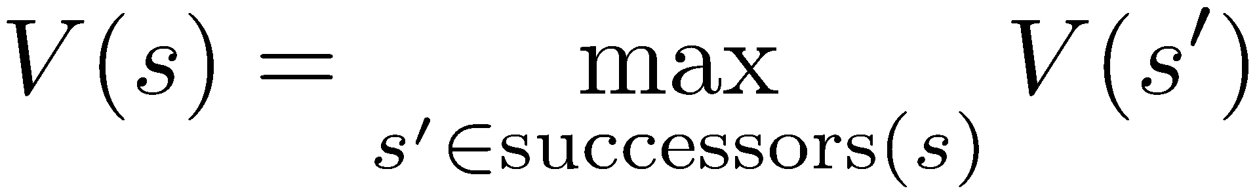
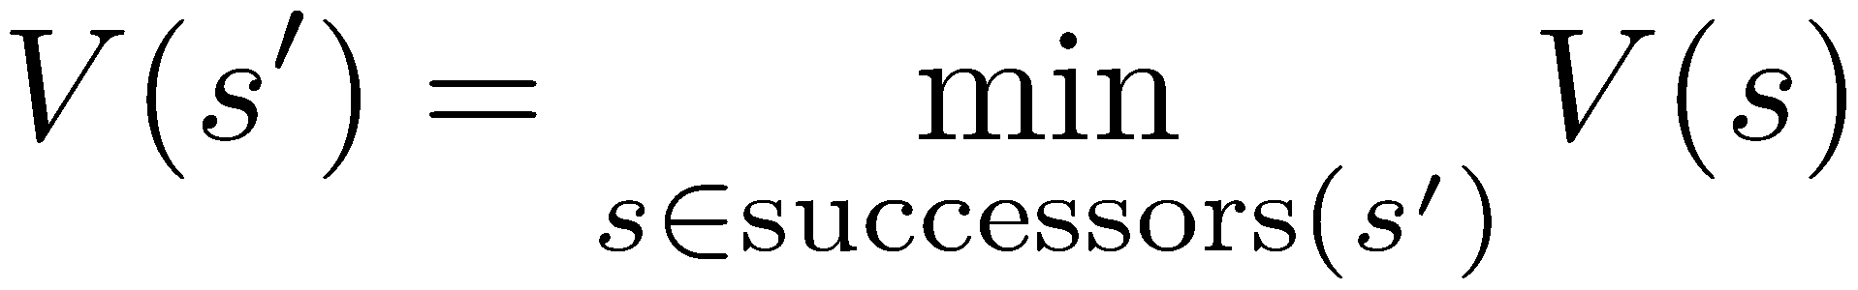
Minimax Values
States Under Agent’s Control:
States Under Opponent’s Control:
-8
-5
-10
+8
Terminal States:

Slide 14

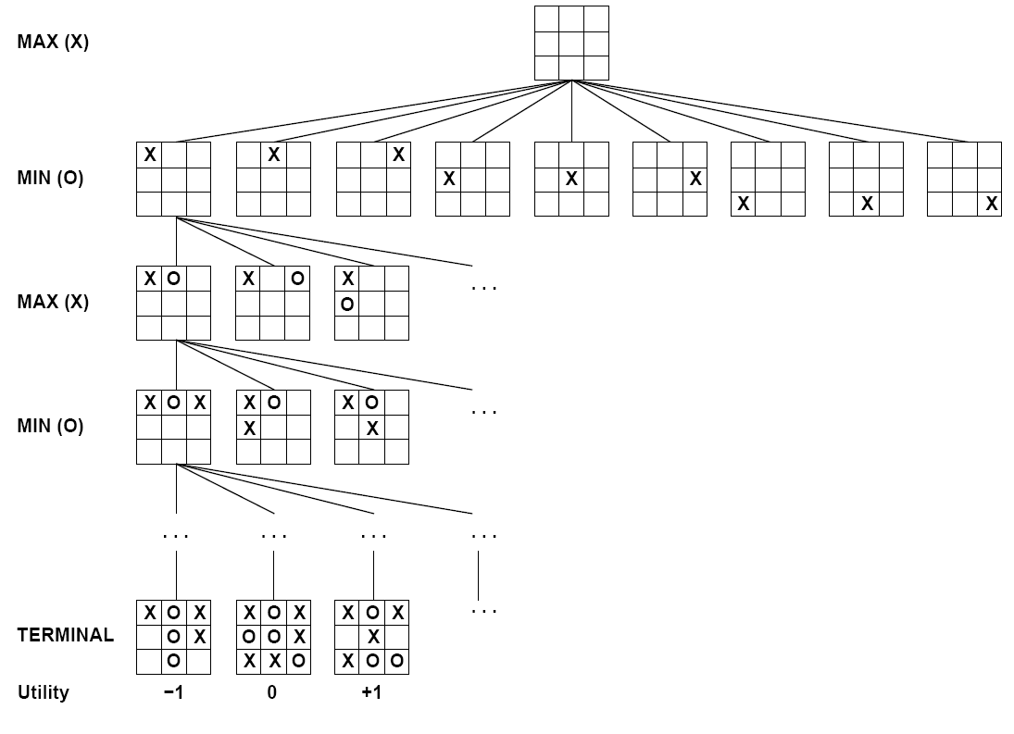

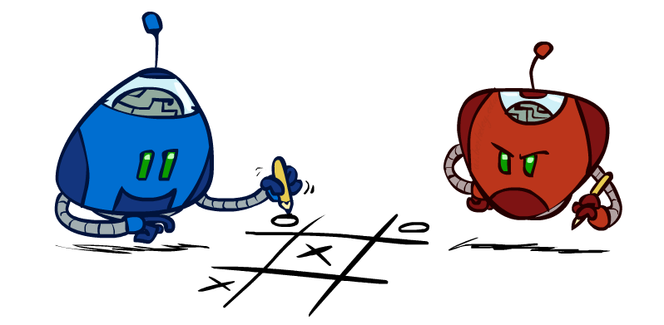
Tic-Tac-Toe Game Tree

Slide 15
Adversarial Search (Minimax)
Deterministic, zero-sum games:
  Tic-tac-toe, chess, checkers
  One player maximizes result
  The other minimizes result
Minimax search:
  A state-space search tree
  Players alternate turns
  Compute each node’s minimax value: the best achievable utility against a rational (optimal) adversary
Minimax values:
computed recursively
5
max
2
5
min
8
2
5
6
Terminal values:
part of the game

Slide 16
Minimax Implementation
def max-value(state):
  initialize v = -∞
  for each successor of state:
    v = max(v, min-value(successor))
  return v
def min-value(state):
  initialize v = +∞
  for each successor of state:
    v = min(v, max-value(successor))
  return v

Slide 17
Minimax Implementation (Dispatch)
def value(state):
  if the state is a terminal state: return the state’s utility
  if the next agent is MAX: return max-value(state)
  if the next agent is MIN: return min-value(state)
def max-value(state):
  initialize v = -∞
  for each successor of state:
    v = max(v, value(successor))
  return v
def min-value(state):
  initialize v = +∞
  for each successor of state:
    v = min(v, value(successor))
  return v
Notes:
Pick an order for two reasons: sequential processor and pruning

Slide 18
Minimax Example
3
12
8
2
4
6
14
5
2

Slide 19
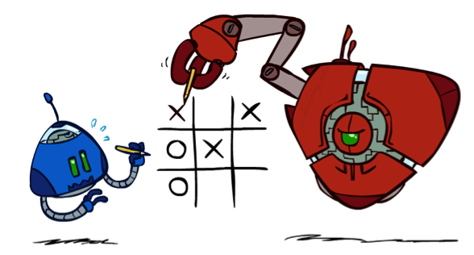
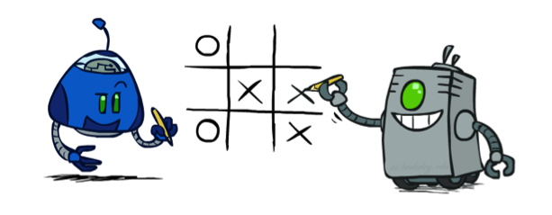
Minimax Properties
max
min
10
10
9
100
Optimal against a perfect player. Otherwise?
[Demo: min vs exp (L6D2, L6D3)]

Slide 20
Video of Demo Min vs. Exp (Min)

Slide 21
Video of Demo Min vs. Exp (Exp)

Slide 22
Minimax Efficiency
How efficient is minimax?
  Just like (exhaustive) DFS
  Time: O(b^{m})
  Space: O(bm)
Example: For chess, b ≈ 35, m ≈ 100
  Exact solution is completely infeasible
    There are between 10⁷⁸ to 10⁸² atoms in the observable universe
  But, do we need to explore the whole tree?

Slide 23

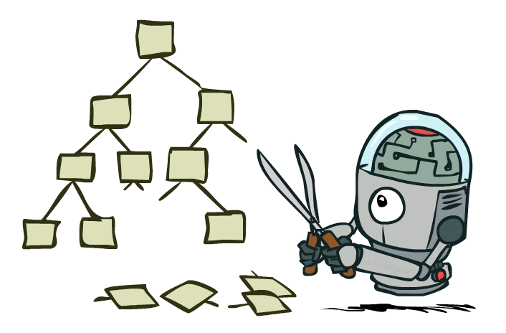
Look deeper only where it matters: Game Tree Pruning

Slide 24
Minimax Example
3
12
8
2
4
6
14
5
2

Slide 25
Minimax Pruning
3
12
8
2
14
5
2

Slide 26
Alpha-Beta Pruning
General configuration (MIN version)
  We’re computing the MIN-VALUE at some node n
  We’re looping over n’s children
  Who cares about n’s value? MAX
  Let α be the best known outcome that MAX can enforce
  If n becomes worse than α, MAX will avoid it, so we can stop considering n’s other children (it’s already bad enough that it won’t be played)
MAX version is symmetric
MAX
MIN
a
MAX
MIN
n

Slide 27
Alpha-Beta Implementation
  α: MAX’s best known outcome
  β: MIN’s best known outcome
def max-value(state, α, β):
  initialize v = -∞
  for each successor of state:
    v = max(v, value(successor, α, β))
    if v ≥ β return v
    α = max(α, v)
  return v
def min-value(state , α, β):
  initialize v = +∞
  for each successor of state:
    v = min(v, value(successor, α, β))
    if v ≤ α return v
    β = min(β, v)
  return v
Notes:
Pick an order for two reasons: sequential processor and pruning

Slide 28
Alpha-Beta Pruning Properties
This pruning has no effect on minimax value computed for the root!
Values of intermediate nodes might be wrong
  Important: children of the root may have the wrong value
  Requires some bookkeeping for choosing an action (who was pruned)
Good child ordering improves effectiveness of pruning
With “perfect ordering”:
  Time complexity drops to O(b^{m/2})
  Doubles solvable depth!
  Full search of, e.g. chess, is still hopeless…
max
min
10
10
0

Slide 29
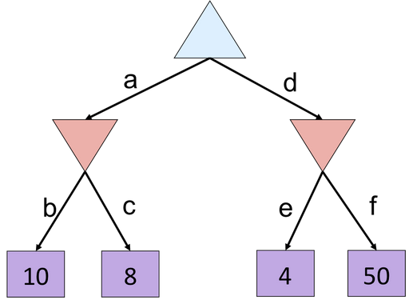
Alpha-Beta Quiz
  α: MAX’s best known outcome
  β: MIN’s best known outcome
def max-value(state, α, β):
  initialize v = -∞
  for each successor of state:
    v = max(v, value(successor, α, β))
    if v ≥ β return v
    α = max(α, v)
  return v
def min-value(state , α, β):
  initialize v = +∞
  for each successor of state:
    v = min(v, value(successor, α, β))
    if v ≤ α return v
    β = min(β, v)
  return v

Slide 30
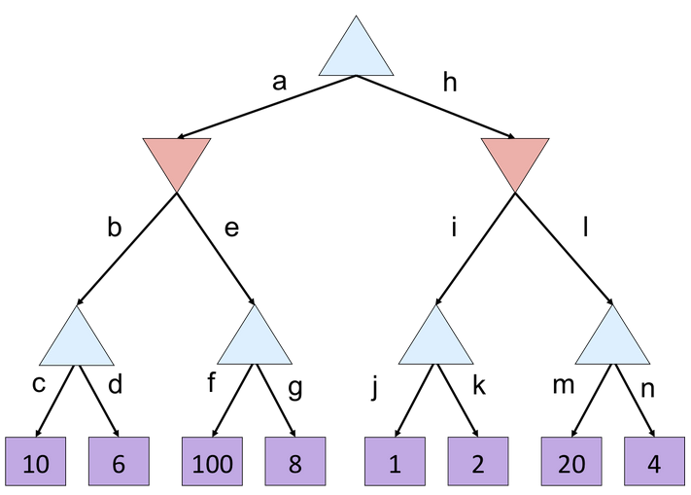
Alpha-Beta Quiz 2
  α: MAX’s best known outcome
  β: MIN’s best known outcome
def max-value(state, α, β):
  initialize v = -∞
  for each successor of state:
    v = max(v, value(successor, α, β))
    if v ≥ β return v
    α = max(α, v)
  return v
def min-value(state , α, β):
  initialize v = +∞
  for each successor of state:
    v = min(v, value(successor, α, β))
    if v ≤ α return v
    β = min(β, v)
  return v

Slide 31
Resource Limits
Problem: In realistic games, cannot search to leaves!
Solution: Depth-limited search
  Instead, search only to a limited depth in the tree
  Replace terminal utilities with an evaluation function for non-terminal positions
Example:
  Suppose we have 100 seconds, can explore 10K nodes/sec
  So can check 1M nodes per move
  α-β reaches about depth 8 – decent chess program
Evaluation function -> Guarantee of optimal play is gone
Use iterative deepening for an anytime algorithm
max
4
-2
4
min
-1
-2
4
9
?
?
?
?

Slide 32
Video of Demo Thrashing (d=2)
[Demo: thrashing d=2, thrashing d=2 (fixed evaluation function) (L6D6)]

Slide 33
Why Pacman Starves
A danger of replanning agents!
  He knows his score will go up by eating the dot now
  He knows his score will go up just as much by eating the dot later
  There are no point-scoring opportunities after eating the dot (within the horizon, two here)
  How can we solve address issue?

Slide 34
Video of Demo Thrashing -- Fixed (d=2)
[Demo: thrashing d=2, thrashing d=2 (fixed evaluation function) (L6D7)]

Slide 35
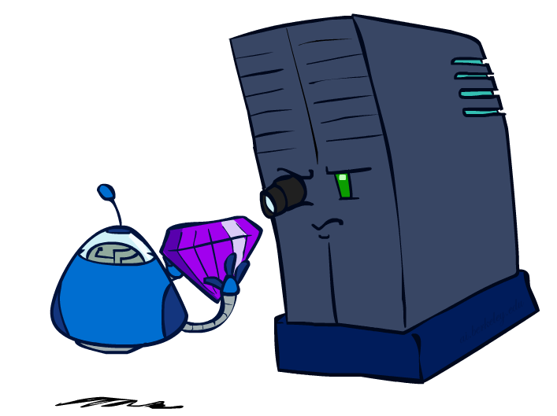
Evaluation Functions

Slide 36
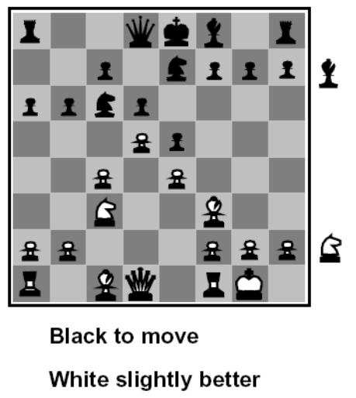
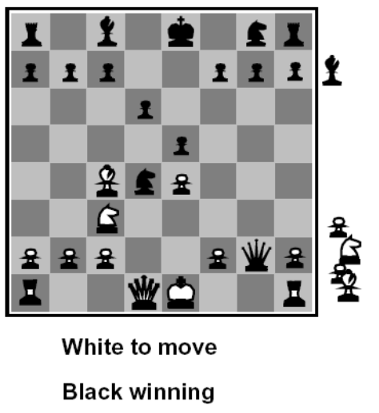
Evaluation Functions
Evaluation functions score non-terminals in depth-limited search
Ideal function: returns the actual minimax value of the position
In practice: typically weighted linear sum of features:
e.g. f₁(s) = (num white queens – num black queens), etc.

Slide 37
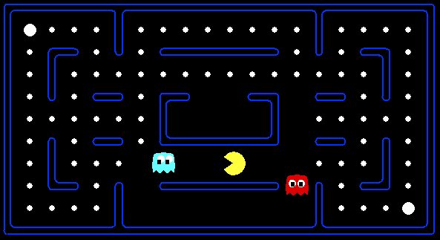




Evaluation for Pacman
Is this outcome good or bad?
Suggest an evaluation function.

Slide 38
Adversaries can also look ahead. Depth matters

Slide 39
Video of Demo Smart Ghosts (Coordination) – Zoomed In

Slide 40
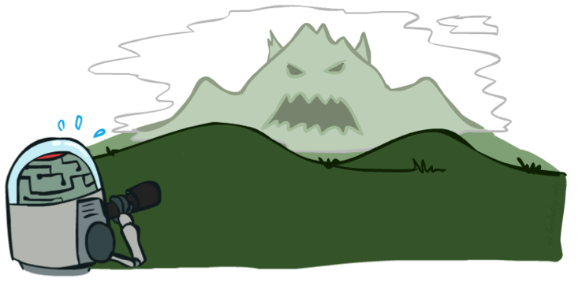

Depth Matters
Evaluation functions are always imperfect
The deeper in the tree the evaluation function is buried, the less the quality of the evaluation function matters
An important example of the tradeoff between complexity of evaluation and complexity of looking deeper

Slide 41
Video of Demo Limited Depth (2)

Slide 42
Video of Demo Limited Depth (10)

Slide 43
Synergies between Evaluation Function and Alpha-Beta?
Alpha-Beta: amount of pruning depends on expansion ordering
  Evaluation function can provide guidance to expand most promising nodes first (which later makes it more likely there is already a good alternative on the path to the root)
    (somewhat similar to role of A* heuristic, CSPs filtering)
Alpha-Beta: safe pruning from evaluation bounds
  Value at a min-node will only keep going down
  Once value of min-node lower than better option for max along path to root, can prune
  Hence: IF evaluation function provides upper-bound on value at min-node, and upper-bound already lower than better option for max along path to root
  THEN can prune

Slide 44
What did we learn?
Planning in an environment with other players
How would the other players react to my actions?
Check all possibilities by spanning a search tree
What if the tree is too big to search over?
  Use alpha-beta pruning to cut irrelevant subtrees
  Limit the search depth and evaluate intermediate states
Tip for home contest 3, check out:
  Monte-Carlo Tree Search (MCTS)
  Upper Confidence bounds applied to Trees (UCT)

