Slide 1
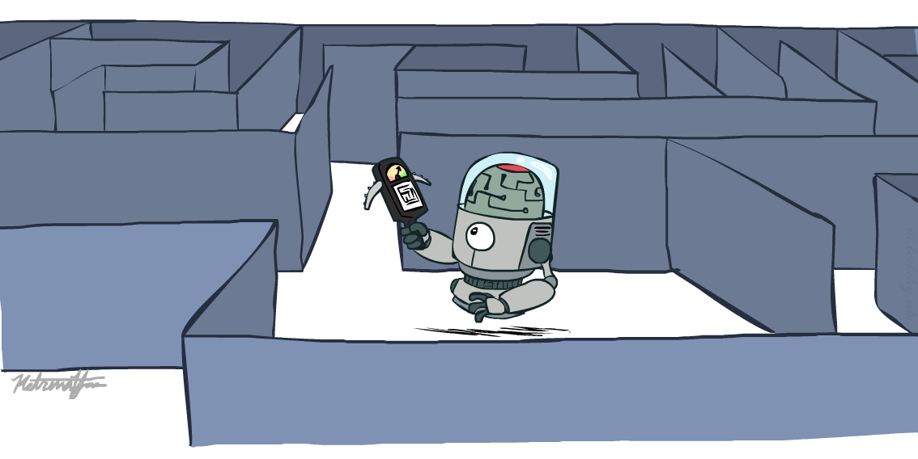
CSCE-420: Artificial Intelligence
Informed search
Instructor: Guni Sharon
Based on slides by: Pieter Abbeel, Dan Klein

Slide 2
Announcements
Assignment 0 due is overdue
Quiz1, Quiz2 are overdue
Quiz 3 is available on Canvas, due by Feb 6, EoD
Assignment 1 is available, due by Monday Feb 10, EoD
Contest 1: Multi-Agent Pacman, due by Feb 17, EoD

Slide 3

Today
Informed Search
  Heuristics
  Greedy Search
  A* Search
Duplicate detection

Slide 4
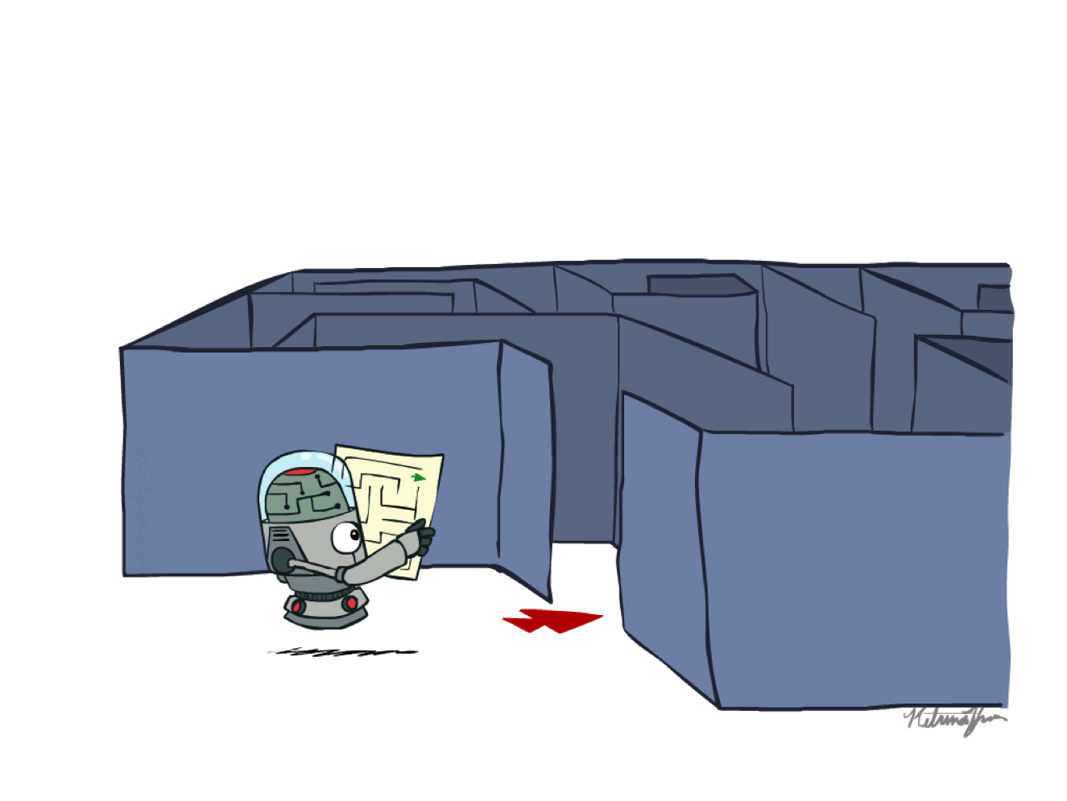
Recap: Search

Slide 5
Recap: Search
Search problem:
  States (configurations of the world)
  Actions and costs
  Successor function (world dynamics)
  Start state and goal test
Search tree:
  Nodes: represent plans for reaching states
  Plans have costs (sum of action costs)
Search algorithm:
  Systematically builds a search tree
  Chooses an ordering over OPEN (unexplored nodes)
  Optimal: finds least-cost plans

Slide 6
Example: Pancake Problem
Cost: Number of pancakes flipped
Notes:
Gates, W. and Papadimitriou, C., "Bounds for Sorting by Prefix Reversal.", Discrete Mathematics. 27, 47-57, 1979.

Slide 7
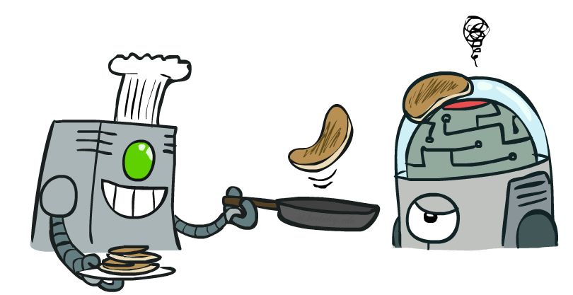
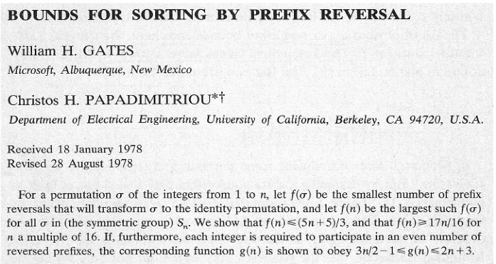
Example: Pancake Problem
Notes:
Gates, W. and Papadimitriou, C., "Bounds for Sorting by Prefix Reversal.", Discrete Mathematics. 27, 47-57, 1979.

Slide 8
Example: Pancake Problem
State space graph with costs as weights
4
2
3
2
3
4
3
4
2
3
2
2
4
3
Notes:
A* expanded 8100 ; Path cost = 33
UCS expanded 25263 . Path cost = 33
Greedy expanded 10 . Path cost = 41
[0, 7, 5, 3, 2, 1, 4, 6]
(7, 0, 5, 3, 2, 1, 4, 6)
(6, 4, 1, 2, 3, 5, 0, 7)
(3, 2, 1, 4, 6, 5, 0, 7)
(1, 2, 3, 4, 6, 5, 0, 7)
(5, 6, 4, 3, 2, 1, 0, 7)
(6, 5, 4, 3, 2, 1, 0, 7)
(0, 1, 2, 3, 4, 5, 6, 7)

Slide 9
General Tree Search
Tree-Search(start,goal)
OPEN = {start}
while OPEN not empty:
u = OPEN.extract()
if u is goal:
return solution
else:
OPEN.add(u.get_successors())
return ‘no solution’
Action: flip top two
Cost: 2
Action: flip all four
Cost: 4
Path to reach goal:
Flip four, flip three
Total cost: 7
Notes:
You know exactly where you came from and how you got there, but you have no idea where you’re going. But, you’ll know it when you see it.

Slide 10
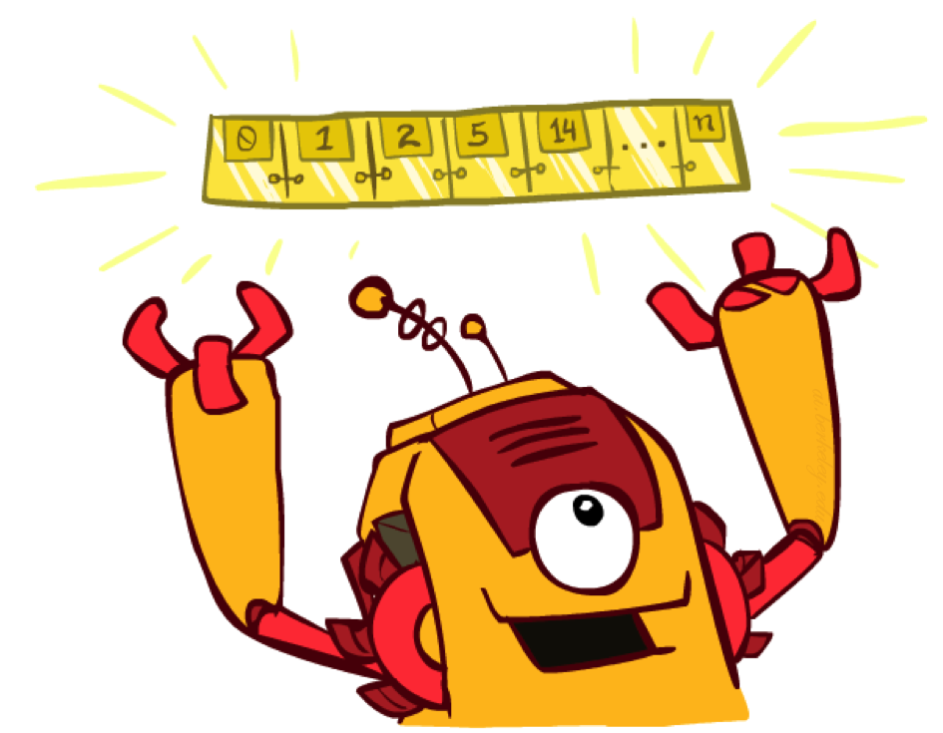
The One Queue
All these search algorithms are the same except for OPEN.extract() strategies
  Conceptually, all open lists are priority queues (i.e. collections of nodes with attached priorities)
  Practically, for DFS and BFS, you can avoid the log(n) overhead from an actual priority queue, by using stacks and queues
  Can be coded generally and take a variable queuing object

Slide 11
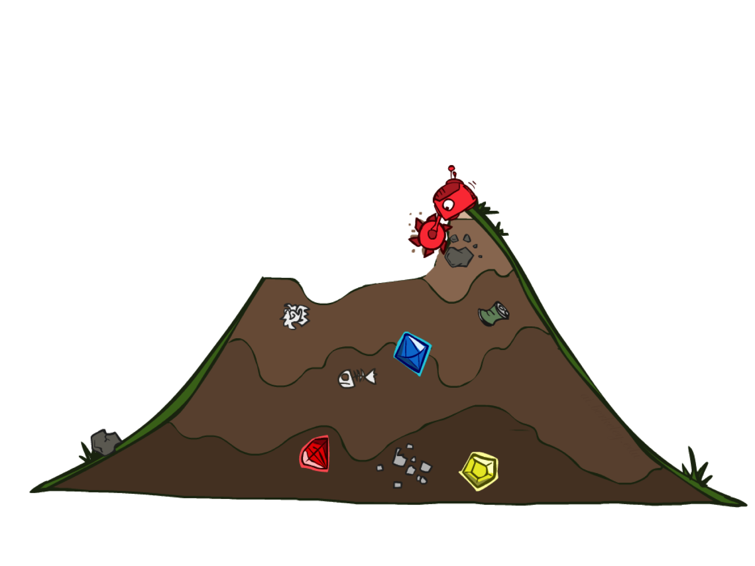
Uninformed Search

Slide 12
Uniform Cost Search
Strategy: expand lowest path cost
The good: UCS is complete and optimal!
The bad:
  Explores options in every “direction”
  No information about goal location
c ≤ 1
…
c ≤ 2
c ≤ 3
Start
Goal

Slide 13

Video of Demo Contours UCS Empty

Slide 14
Video of Demo Contours UCS Pacman Small Maze

Slide 15

Informed Search

Slide 16
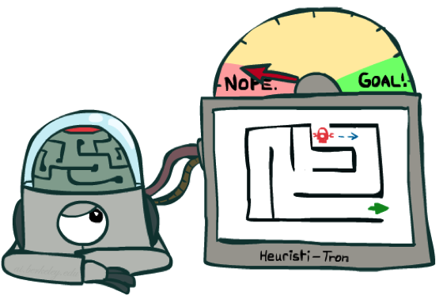
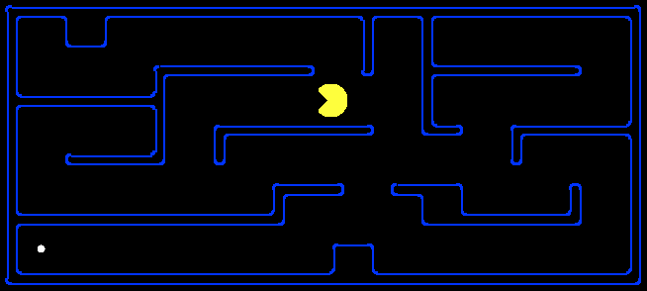
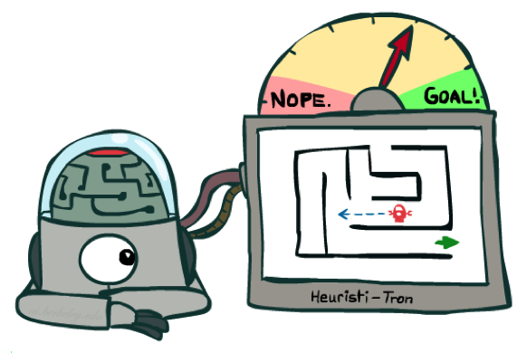
Search Heuristics
A heuristic is:
  A function that estimates how close a state is to a goal
  Designed for a particular domain
  Examples: Manhattan distance for pathfinding
10
5
11.2

Slide 17
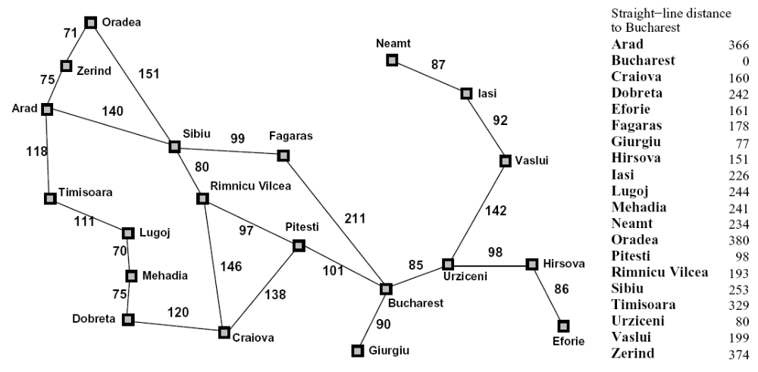
Example: Heuristic Function
h(x)

Slide 18
Example: Heuristic Function
Heuristic: the number of the largest pancake that is still out of place
f
3
h(x)
e
4
h
3
d
4
j
3
S
0
c
4
a
4
k
3
i
4
S
4
l
2
b
3
Notes:
A* expanded 8100 ; Path cost = 33
UCS expanded 25263 . Path cost = 33
Greedy expanded 10 . Path cost = 41
[0, 7, 5, 3, 2, 1, 4, 6]
(7, 0, 5, 3, 2, 1, 4, 6)
(6, 4, 1, 2, 3, 5, 0, 7)
(3, 2, 1, 4, 6, 5, 0, 7)
(1, 2, 3, 4, 6, 5, 0, 7)
(5, 6, 4, 3, 2, 1, 0, 7)
(6, 5, 4, 3, 2, 1, 0, 7)
(0, 1, 2, 3, 4, 5, 6, 7)

Slide 19
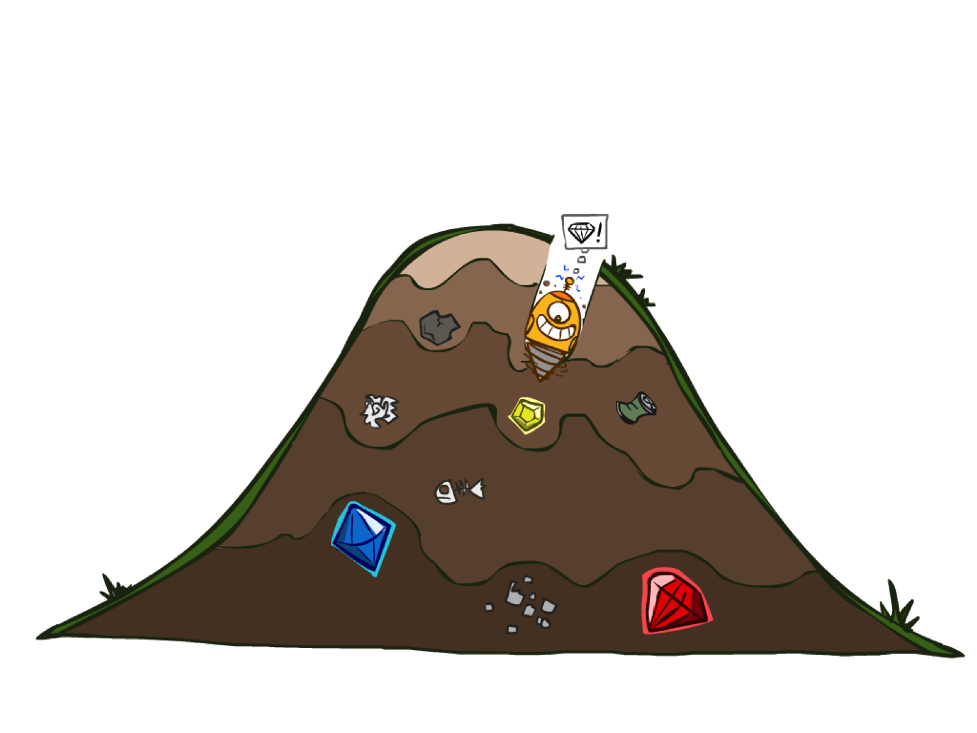
Greedy Search

Slide 20

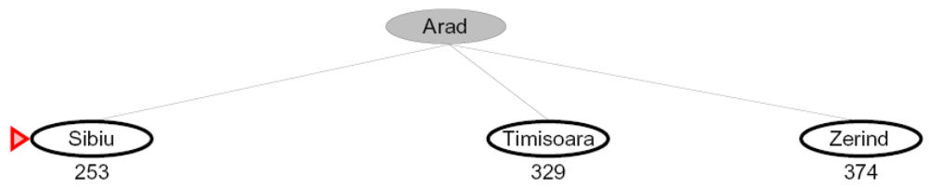
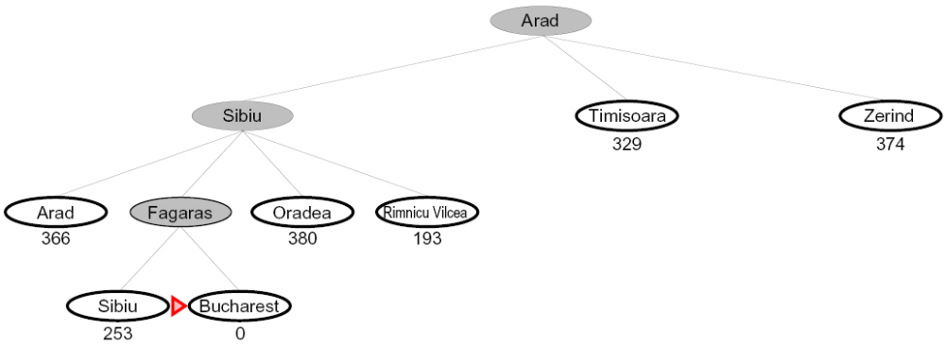
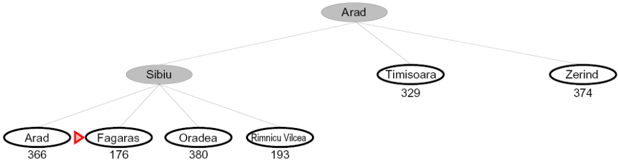

Greedy Search
Expand the node that seems closest…
What can go wrong?

Slide 21
Greedy Search
b
Strategy: expand a node that you think is closest to a goal state
  Heuristic: estimate of distance to nearest goal for each state
A common case:
  Best-first takes you straight to a suboptimal goal
Worst-case: like a badly-guided DFS
…
b
…
Notes:
For any search problem, you know the goal. Now, you have an idea of how far away you are from the goal.

Slide 22
Video of Demo Contours Greedy (Empty)

Slide 23
Video of Demo Contours Greedy (Pacman Small Maze)

Slide 24
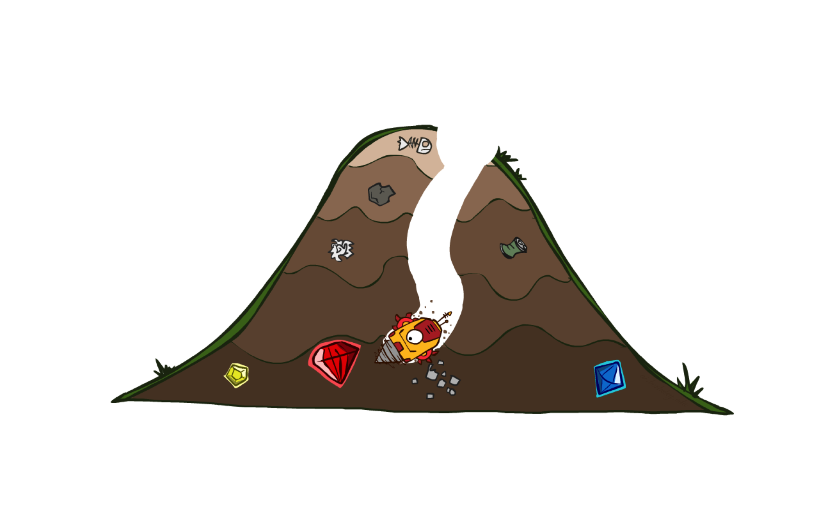
A* Search

Slide 25
Combining UCS and Greedy
Uniform-cost orders by path cost, or backward cost g(n)
Greedy orders by goal proximity, or forward cost h(n)
A* Search orders by the sum: f(n) = g(n) + h(n)
g = 0 h=6
8
S
g = 1 h=5
e
h=1
a
1
1
3
2
g = 2 h=6
g = 4 h=2
g = 9 h=1
S
a
d
G
b
d
e
h=6
1
h=5
h=2
h=0
g = 3 h=7
1
g = 6 h=0
g = 10 h=2
c
b
c
G
d
h=7
h=6
g = 12 h=0
G

Slide 26
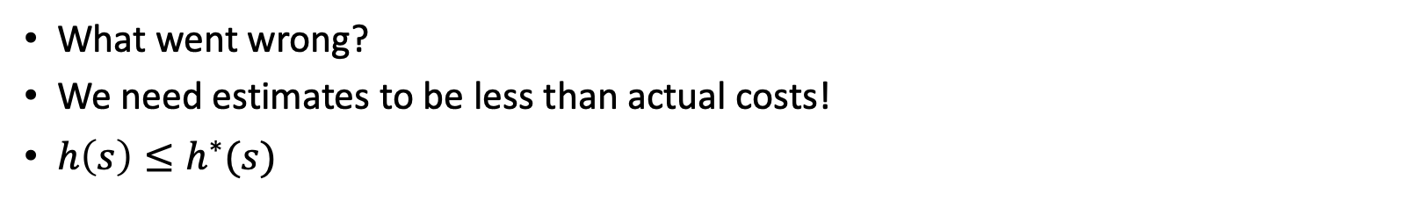
Is A* Optimal?
h = 6
1
A
3
S
h = 7
G
h = 0
Tree-Search(start,goal)
OPEN = {start}
while OPEN not empty:
u = OPEN.extract()
if u is goal:
return solution
else:
OPEN.add(u.get_successors())
return ‘no solution’
5
What went wrong?
We need estimates to be less than actual costs!
$h\left(s\right)≤h^{∗}(s)$

Slide 27
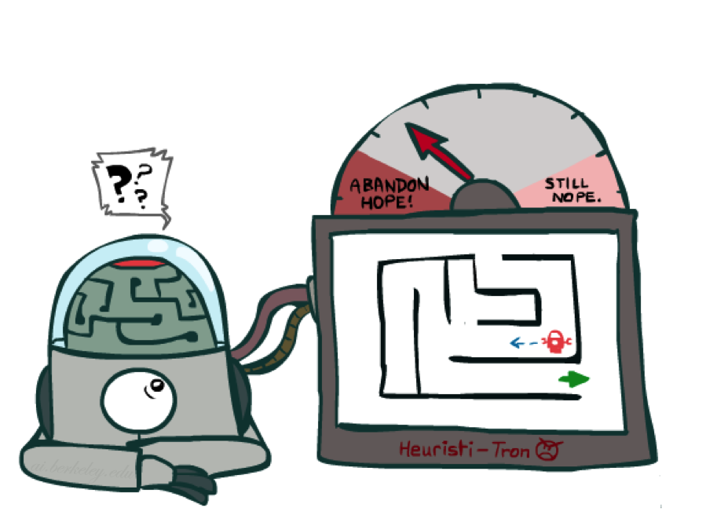
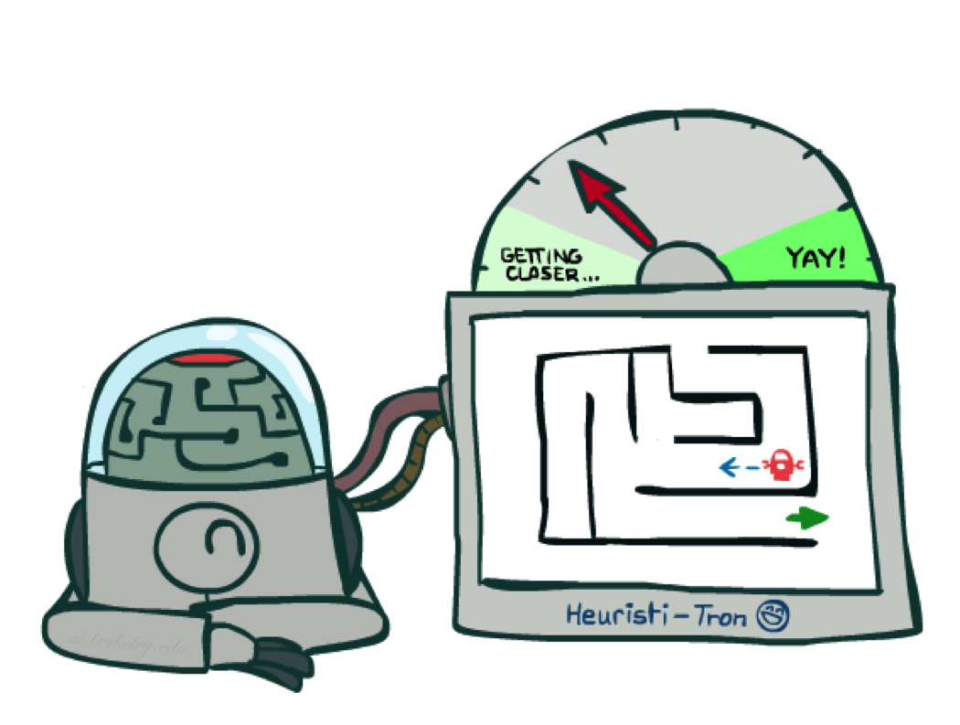
Idea: Admissibility
Inadmissible (pessimistic) heuristics break optimality by trapping good plans on the fringe
Admissible (optimistic) heuristics slow down bad plans but never outweigh true costs

Slide 28

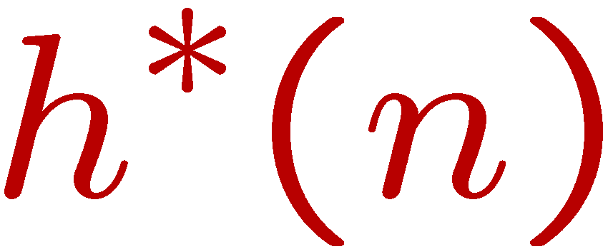
Admissible Heuristics
A heuristic h is admissible (optimistic) if:
where is the true cost to a nearest goal
Examples:
Coming up with admissible heuristics is usually the biggest hurdle when using A* in practice.
4
15

Slide 29
When should A* terminate?
Should we stop when we discover a goal?
No: only stop when we dequeue a goal
h = 2
A
2
2
S
h = 3
h = 0
G
2
B
3
h = 1

Slide 30

Optimality of A* Tree Search
Tree-Search(start,goal)
OPEN = {start}
while OPEN not empty:
u = OPEN.extract() # Minimal f-value = g + h
if u is goal:
return solution
else:
OPEN.add(u.get_successors())
return ‘no solution’

Slide 31


Optimality of A* Tree Search
Assume:
A is an optimal goal node
B is a suboptimal goal node
h is admissible
Claim:
A will be expanded before B
…

Slide 32

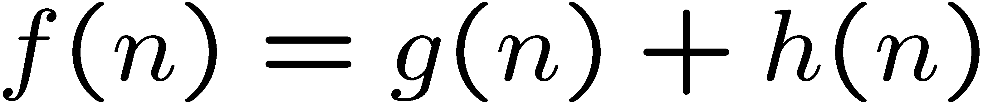
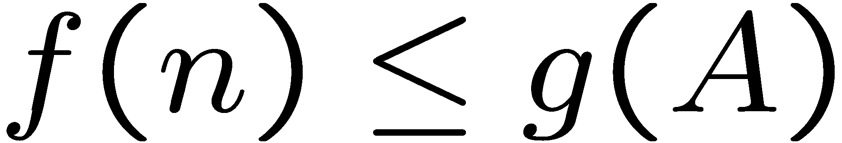
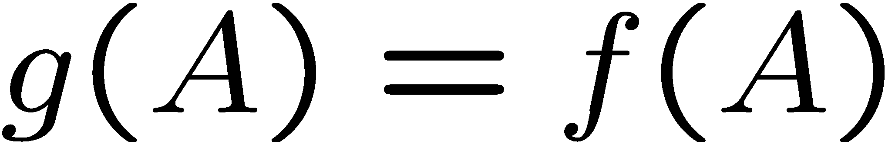
Optimality of A* Tree Search: Blocking
Proof:
Imagine B is in OPEN
Some ancestor n of A is in OPEN too (maybe A) such that n is on the optimal path to A
Claim: n will be expanded before B
  f(n) is less or equal to f(A)
…
Definition of f-cost
n is on the optimal path and h is admissible
h = 0 at a goal

Slide 33
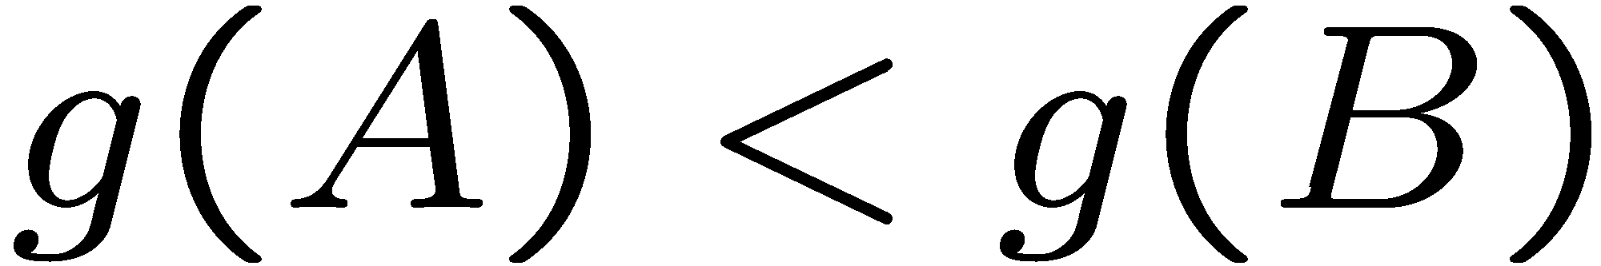
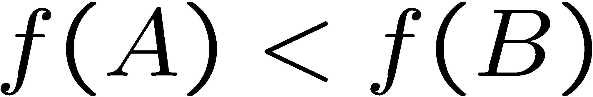
Optimality of A* Tree Search: Blocking
Proof:
Imagine B is in OPEN
Some ancestor n of A is in OPEN too (maybe A!) such that n is on the optimal path to A
Claim: n will be expanded before B
  f(n) is less or equal to f(A)
  f(A) is less than f(B)
…
B is suboptimal
h = 0 at a goal

Slide 34

Optimality of A* Tree Search: Blocking
Proof:
Imagine B is in OPEN
Some ancestor n of A is in OPEN too (maybe A!) such that n is on the optimal path to A
Claim: n will be expanded before B
  f(n) is less or equal to f(A)
  f(A) is less than f(B)
  n expanded before B
All ancestors of A along the optimal path expanded before B
A expanded before B
A* search is optimal
…

Slide 35
UCS vs A* Contours
Uniform-Cost
A*
b
b
…
…

Slide 36
UCS vs A* Contours
Uniform-cost expands equally in all “directions”
A* expands mainly toward the goal, but does hedge its bets to ensure optimality
Start
Goal
Start
Goal

Slide 37
Quiz– UCS, Greedy, or A*

Slide 38
Quiz– UCS, Greedy, or A*

Slide 39
Quiz– UCS, Greedy, or A*

Slide 40
Quiz– UCS, Greedy, or A*

Slide 41
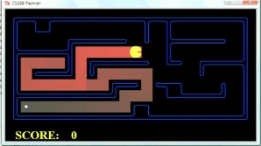
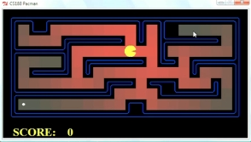
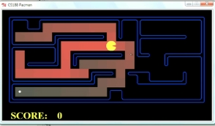
Comparison
Greedy
Uniform Cost
A*

Slide 42
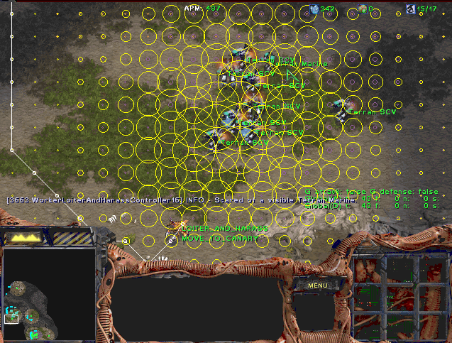
A* Applications
Video games
pathfinding/routing problems
Resource planning problems
Robot motion planning
Language analysis
Machine translation
Speech recognition
…

Slide 43
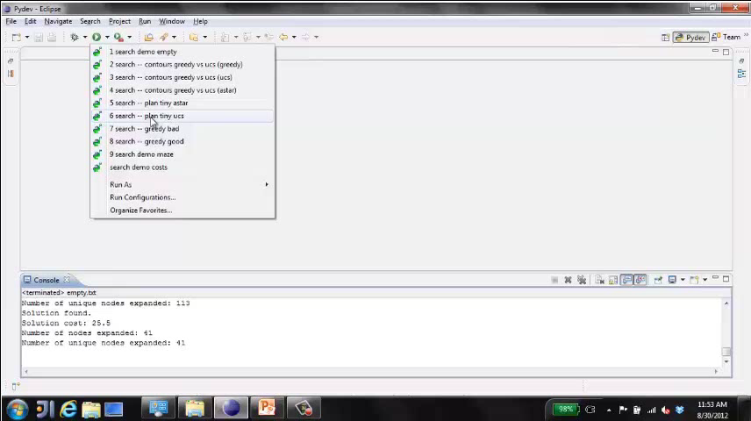
Video of Demo Pacman (Tiny Maze) – UCS / A*

Slide 44
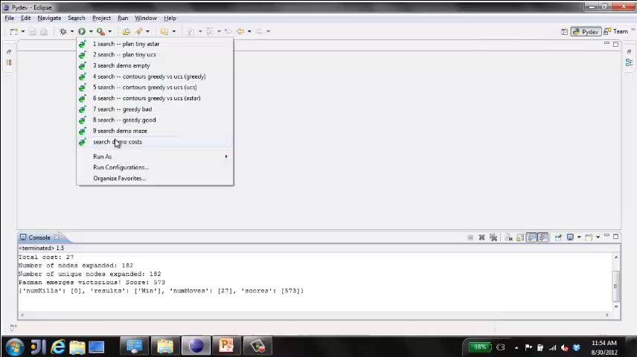
Quiz: which algorithm is used (UCS, BFS, DFS, Greedy, A*)

Slide 45

Creating Heuristics

Slide 46
Creating Admissible Heuristics
Most of the work in solving hard search problems optimally is in coming up with admissible heuristics
Often, admissible heuristics are solutions to relaxed problems, where new actions are available
Inadmissible heuristics are often useful too
366
15

Slide 47
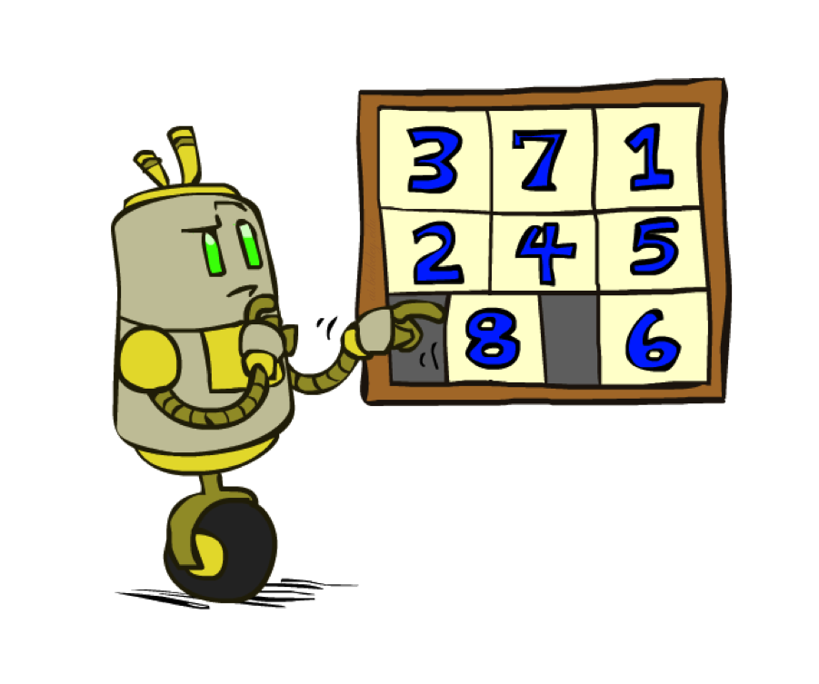
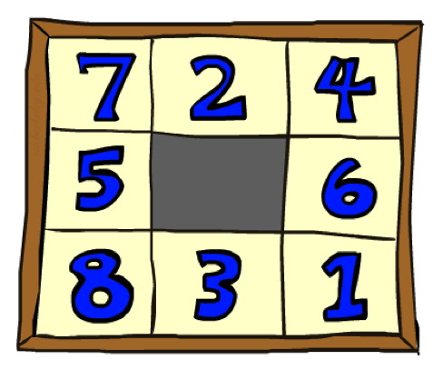
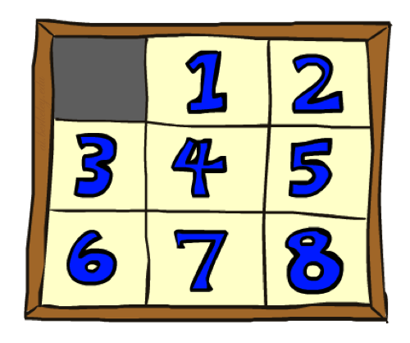
Example: 8 Puzzle
Start State
Actions
Goal State
What are the states?
How many states?
What are the actions?
Branching factor?
Action costs?

Slide 48
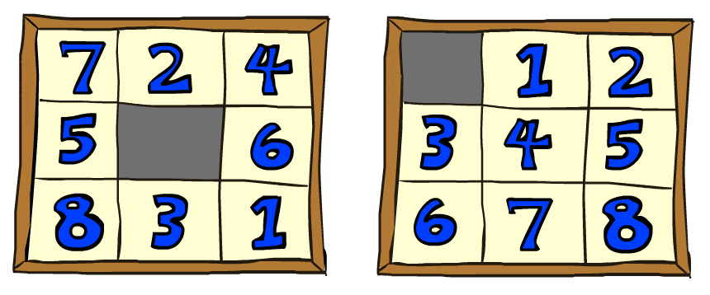
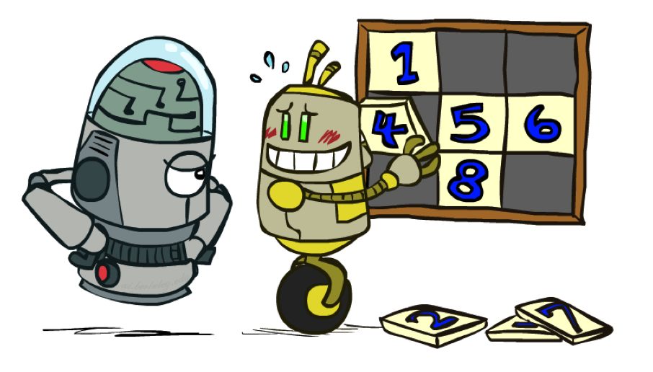
8 Puzzle I
Heuristic: Number of tiles misplaced
Why is it admissible?
h(start) =
This is a relaxed-problem heuristic
8
Start State
Goal State
 | Average nodes expanded when the optimal path has…
 | …4 steps | …8 steps | …12 steps
UCS | 112 | 6,300 | 3.6 x 10⁶
TILES | 13 | 39 | 227
Statistics by Andrew Moore

Slide 49
8 Puzzle II
What if we had an easier 8-puzzle where any tile could slide any direction at any time, ignoring other tiles?
Total Manhattan distance
Why is it admissible?
h(start) =
Start State
Goal State
 | Average nodes expanded when the optimal path has…
 | …4 steps | …8 steps | …12 steps
TILES | 13 | 39 | 227
MANHATTAN | 12 | 25 | 73
3 + 1 + 2 + … = 18

Slide 50
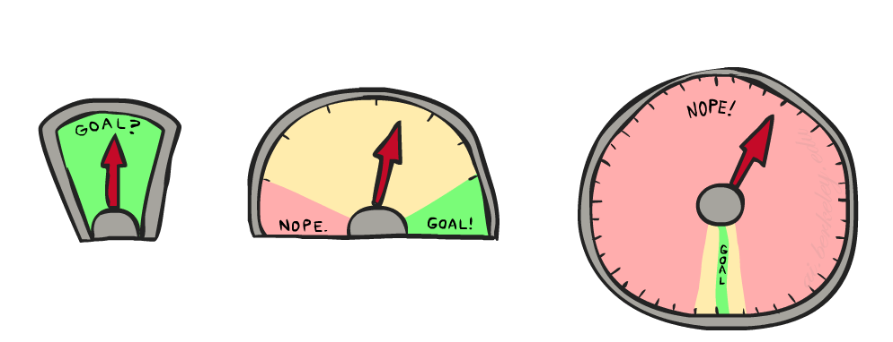
8 Puzzle III
How about using the actual cost as a heuristic?
  Would it be admissible?
  Would we save on nodes expanded?
  What’s wrong with it?
With A*: a trade-off between quality of estimate and computation per node
  As heuristics get closer to the true cost, you will expand fewer nodes but usually do more work per node to compute the heuristic itself

Slide 51
Semi-Lattice of Heuristics

Slide 52







Trivial Heuristics, Dominance
Dominance: h_{a} ≥ h_{c} if
Heuristics form a semi-lattice:
  Max of admissible heuristics is admissible
Trivial heuristics
  Bottom of lattice is the zero heuristic (what does this give us?)
  Top of lattice is the exact heuristic
Notes:
Semi-lattice: x <= y <-> x = x ^ y

Slide 53
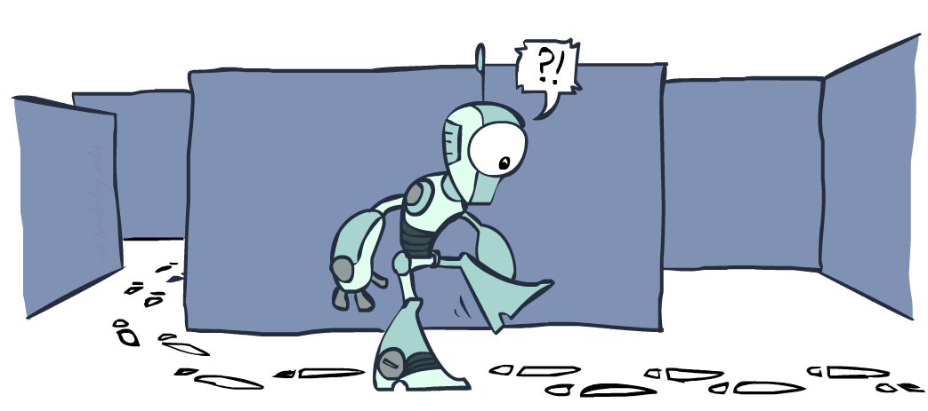
Duplicate detection

Slide 54
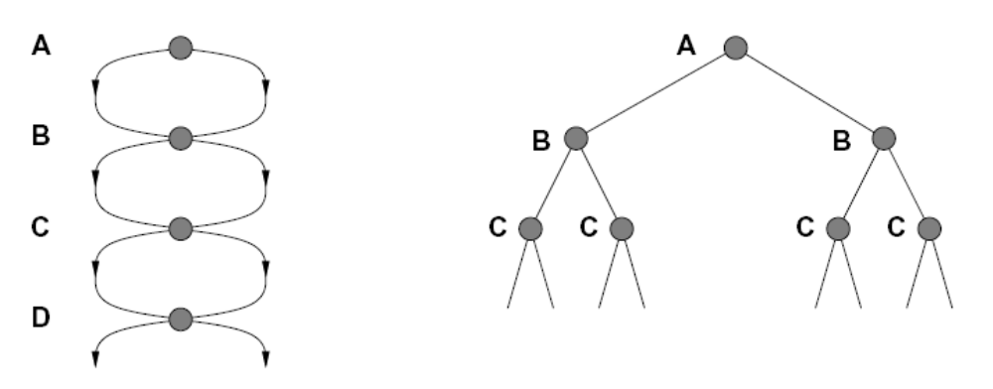
Tree Search: Redundant Work!
Failure to detect repeated states can cause exponentially more work.
State Graph
Search Tree

Slide 55
Duplicate detection
In BFS, for example, we shouldn’t bother expanding the circled nodes (why?)
S
d
e
p
b
c
e
h
r
q
a
a
h
r
p
q
f
p
q
f
q
c
G
q
c
G
a
a

Slide 56
Duplicate detection
Idea: never expand a state twice
How to implement:
  Tree search + set of expanded states (“closed list”)
  Expand the search tree node-by-node, but…
  Before expanding a node, check to make sure its state has never been expanded before
  If not new, skip it, if new add to closed set
Important: store the closed list as a set, not a list
Can duplicate detection wreck completeness? Why/why not?
How about optimality?

Slide 57
A* Duplicate detection Gone Wrong?
A
1
S (0+2)
S
1
C
h=4
h=1
h=2
1
A (1+4)
B (1+1)
2
B
3
C (2+1)
C (3+1)
h=1
G
G (5+0)
G (6+0)
h=0
State space graph
Search tree

Slide 58
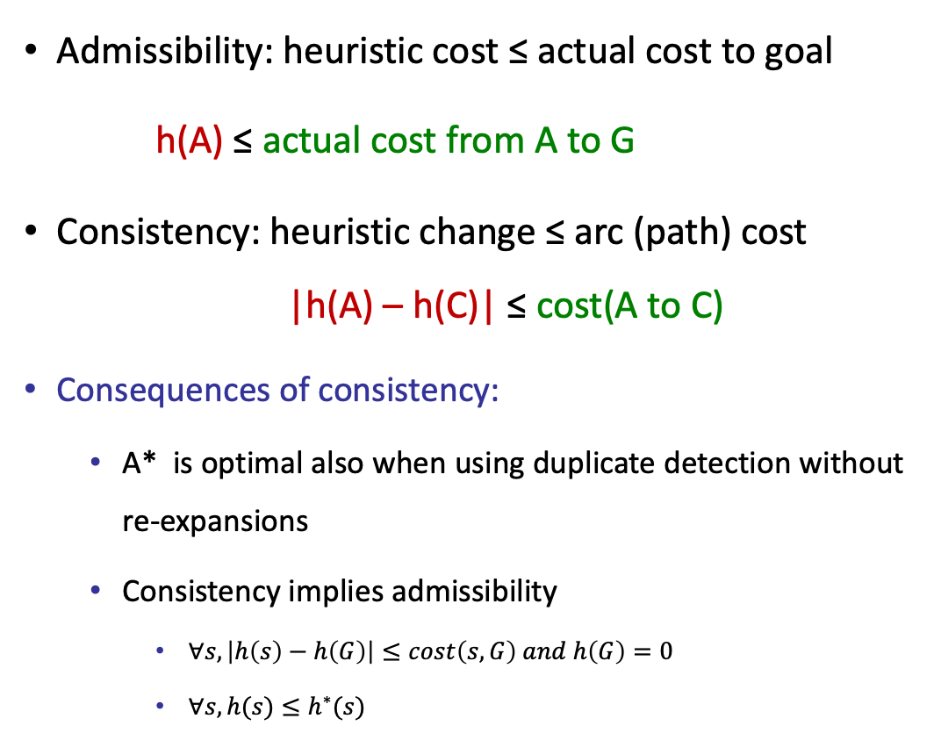
Consistency of Heuristics
Admissibility: heuristic cost ≤ actual cost to goal
h(A) ≤ actual cost from A to G
Consistency: heuristic change ≤ arc (path) cost |h(A) – h(C)| ≤ cost(A to C)
Consequences of consistency:
  A* is optimal also when using duplicate detection without re-expansions
  Consistency implies admissibility
    $∀s, \left|h\left(s\right)−h\left(G\right)\right|≤cost\left(s,G\right) and h\left(G\right)=0$
    $∀s, h(s)≤h^{∗}(s)$
A
1
C
h=4
h=1
h=3
3
Exercise: prove that local consistency implies global consistency (use induction)
G

Slide 59
Optimality of A* + DD
Sketch: consider what A* does with a consistent heuristic:
  Fact 1: In tree search, A* expands nodes in increasing total f value (f-contours)
  Fact 2: For every state s, nodes that reach s optimally are expanded before nodes that reach s suboptimally
  Result: A* search is optimal
…
f ≤ 1
f ≤ 2
f ≤ 3

Slide 60
Optimality of A* + DD
No DD:
  A* is optimal if heuristic is admissible
  UCS is a special case (h = 0)
With DD:
  A* optimal if heuristic is consistent or when allowing re-expansions when encountering lower g
  UCS always optimal (h = 0 is consistent)
Consistency implies admissibility
Admissibility doesn’t necessarily imply consistency

Slide 61

A*: Summary
A* uses both backward costs (n.g) and (estimates of) forward costs (n.h)
  Estimation of the optimal path cost that goes through the node
A* is optimal with admissible heuristics
Heuristic design is key: often use relaxed problems

Slide 62
Tree search with DD
Tree-Search(start,goal)
OPEN = {start}
CLOSED = {}
while OPEN not empty:
u = OPEN.extract() # Minimal f-value = g + h
if u is goal:
return solution(u)
elif u not in CLOSED:
CLOSED.add(u)
OPEN.add(u.get_successors())
return ‘no solution’
Can we avoid duplicates in OPEN and preserve optimality?

Slide 63
Optimality of A* with DD
Consider what A* does:
  Expands nodes in increasing total f value (f-contours)
  Reminder: f(n) = g(n) + h(n) = cost to n + heuristic
  Proof idea: the optimal goal(s) have the lowest f value, so it must get expanded first
…
f ≤ 1
There’s a problem with this argument. What are we assuming is true?
f ≤ 2
f ≤ 3
Nodes are expanded with their true f values
(via the optimal parent)

Slide 64


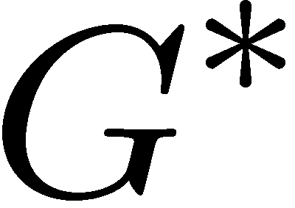

Optimality of A* with DD
Proof:
New possible problem: some n on path to G* isn’t in queue when we need it, because some worse n’ for the same state dequeued and expanded first (disaster!)
Take the highest such n in tree
Let p be the ancestor of n that was on the queue when n’ was popped
f(p) < f(n) because of consistency
f(n) < f(n’) because n’ is suboptimal
p would have been expanded before n’
Contradiction!

Slide 65
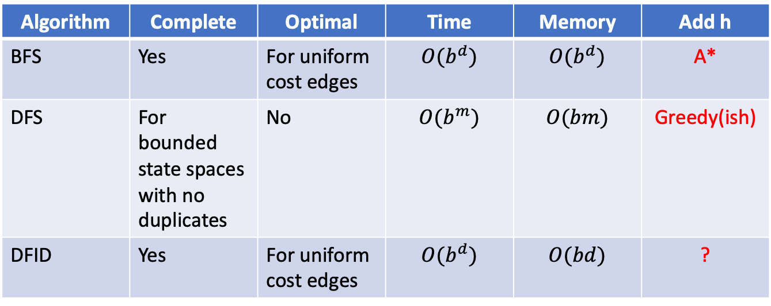
Adding heuristics
Algorithm | Complete | Optimal | Time | Memory | Add h
BFS | Yes | For uniform cost edges | $$O(b^{d})$$ | $$O(b^{d})$$ | A*
DFS | For bounded state spaces with no duplicates | No | $$O(b^{m})$$ | $$O(bm)$$ | Greedy(ish)
DFID | Yes | For uniform cost edges | $$O(b^{d})$$ | $$O(bd)$$ | ?

Slide 66
Depth First Iterative Deepening
bound = 0
Solution = TreeSearch(start,goal,bound)
While no solution:
  TreeSearch(start,goal,bound++)
Where should we add h?
TreeSearch(start,goal,depth)
OPEN = {start} as LIFO
while OPEN not empty:
u = OPEN.extract()
if u.g > depth:
continue
if u is goal:
return solution(u)
else:
OPEN.add(u.get_successors())
return ‘no solution’

Slide 67
Informed Depth First Iterative Deepening
bound = start.h
Solution = TreeSearch(start,goal,bound)
While no solution:
  bound = TreeSearch(start,goal,bound)
TreeSearch(start,goal,depth)
OPEN = {start} as LIFO
next_bound = infinity
while OPEN not empty:
u = OPEN.extract()
if u.g+u.h > depth:
next_bound = min(u.g+u.h, next_bound)
elif u is goal:
return solution(u)
else:
OPEN.add(u.get_successors())
return next_bound

Slide 68
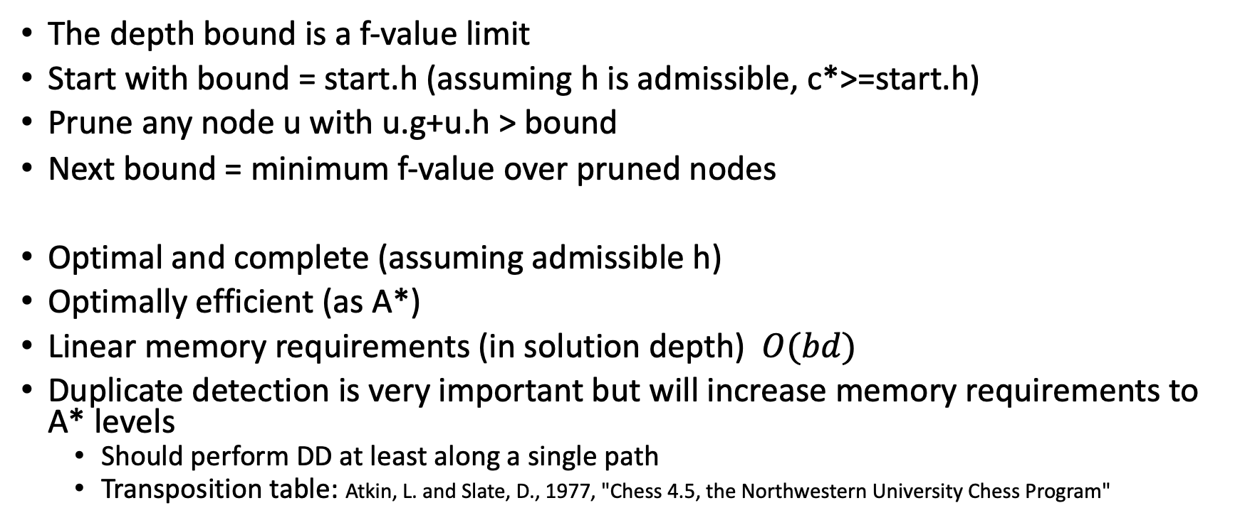
Iterative deepening A* (IDA*)
The depth bound is a f-value limit
Start with bound = start.h (assuming h is admissible, c*>=start.h)
Prune any node u with u.g+u.h > bound
Next bound = minimum f-value over pruned nodes
Optimal and complete (assuming admissible h)
Optimally efficient (as A*)
Linear memory requirements (in solution depth) $O(bd)$
Duplicate detection is very important but will increase memory requirements to A* levels
  Should perform DD at least along a single path
  Transposition table: Atkin, L. and Slate, D., 1977, "Chess 4.5, the Northwestern University Chess Program"

Slide 69
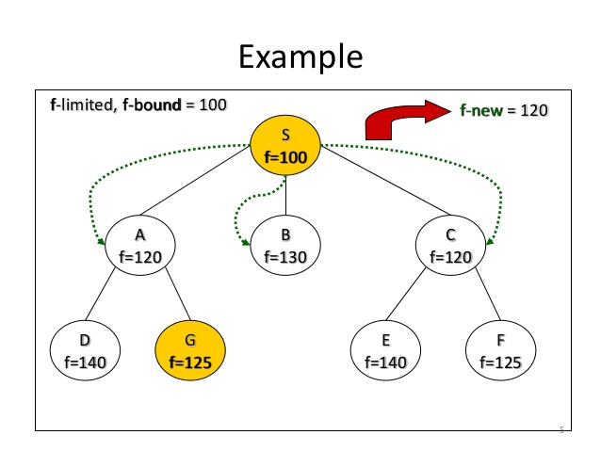
Figure by Hema Kashyap

Slide 70
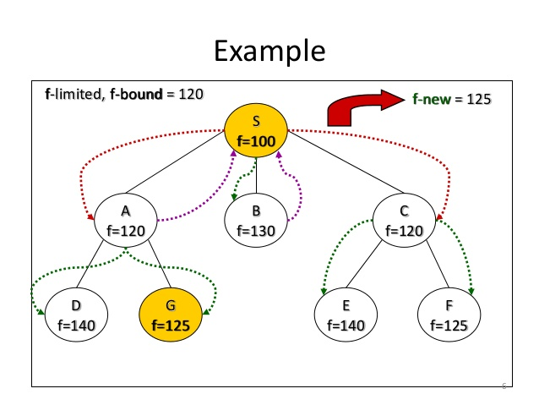
Figure by Hema Kashyap

Slide 71
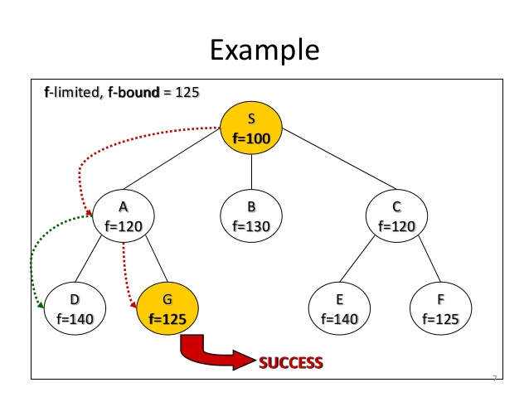
Figure by Hema Kashyap

Slide 72
What did we cover?
Heuristic functions provide an estimate of the remaining cost to the goal
Heuristics can speed up search algorithms significantly
Greedy search (expand nodes with lowest h-val) is suboptimal
A* (expand nodes with lowest f=g+h) is optimal if
  h is admissible
Duplicate detection increases efficiency
  Requires a consistent h to preserve optimality
IDA* results in reduced memory requirements and faster OPEN operations
  Shouldn’t be used in domains with many transpositions

Slide 73
My contributions to informed search
Partial-Expansion A* with Selective Node Generation.
(AAAI-2012)
Online Detection of Dead States in Real-Time Agent-Centered Search.
(SOCS 2013)
The Increasing Cost Tree Search for Optimal Multi-agent Pathfinding.
Artificial Intelligence 195 (2013)
Exponential deepening A* for real-time agent-centered search.
(AAAI-2014)
Enhanced Partial Expansion A*.
Artificial Intelligence Research 50 (2014)
Conflict-based search for optimal multi-agent pathfinding.
Artificial Intelligence 219 (2015)
MM: A Bidirectional Search Algorithm That Is Guaranteed to Meet in the Middle.
Artificial Intelligence, 2017
The (Un)Scalability of Informed Heuristic Function Estimation in NP-Hard Search Problems
Transactions on Machine Learning Research, 2023
Curriculum Generation for Learning Guiding Functions in State-Space Search Algorithms.
SoCS, 2024

