Slide 1
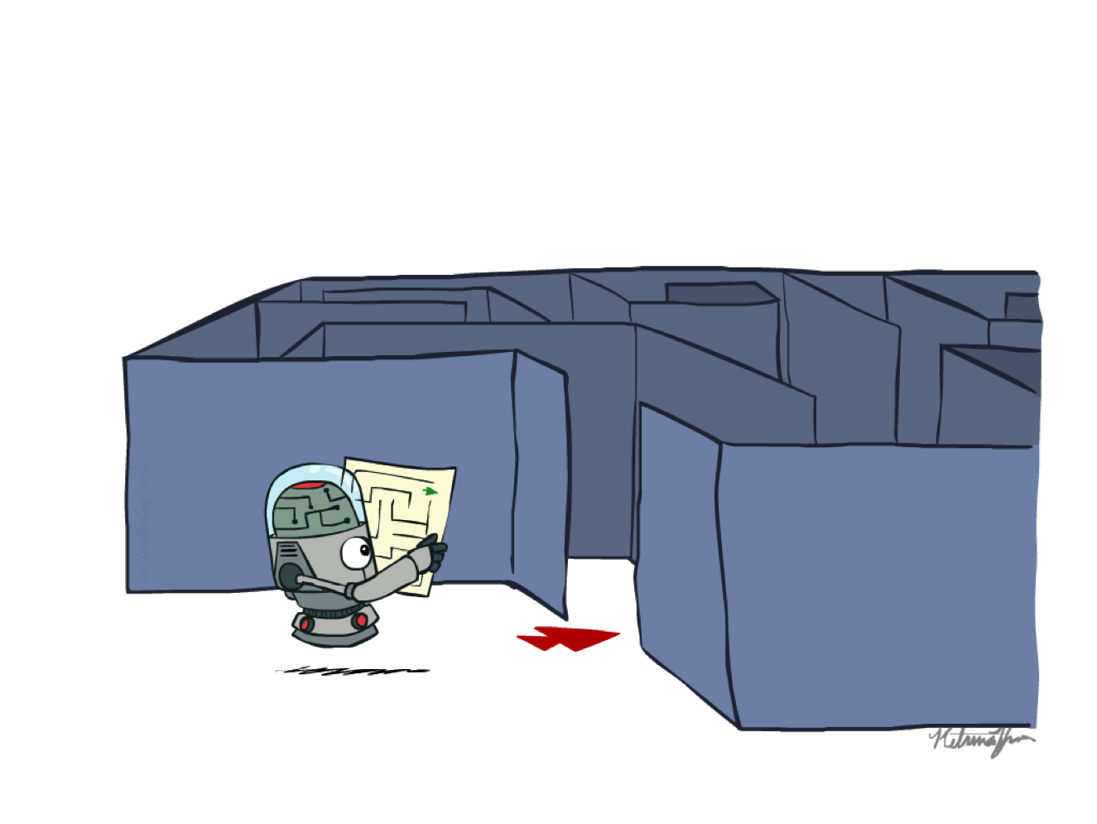
CSCE-420 : Artificial Intelligence
Uninformed search
Instructor: Guni Sharon
Based on slides by: Pieter Abbeel, Dan Klein

Slide 2
Announcements
Project 0: Unix/Python/Autograder Tutorial is due on Jan-24
Complete Quiz1 by Jan-20
Quiz2 will be available after this lecture

Slide 3
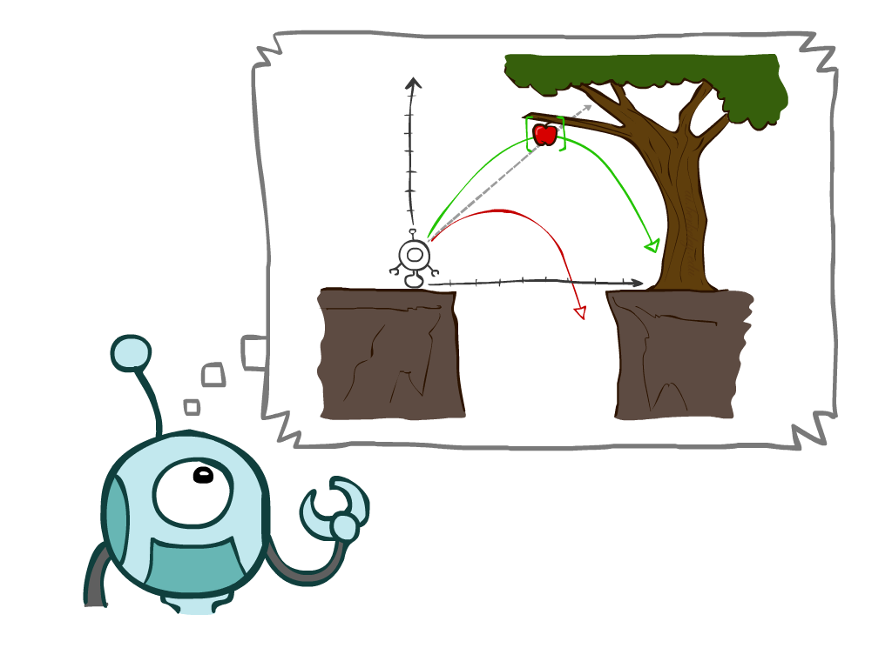
Today
Agents that Plan Ahead
Search Problems
Uninformed Search Methods
  Depth-First Search
  Breadth-First Search
  Uniform-Cost Search
Notes:
General theme in the class:
A goal we have in mind.
A mathematical abstraction to formalize this
Algorithms that operate on these abstractions

Slide 4

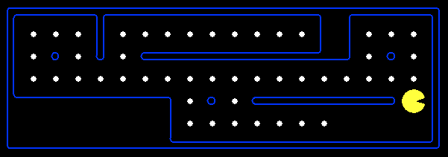
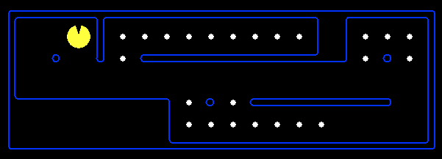
Reflex Agents
Reflex agents:
  Choose action based on current percept (and maybe memory)
  May have memory or a model of the world’s current state
  Do not consider the future consequences of their actions
  Myopic behavior
Can a reflex agent be rational?
Notes:
Examples: blinking your eye (not using your entire thinking capabilities), vacuum cleaner moving towards nearest dirt

Slide 5
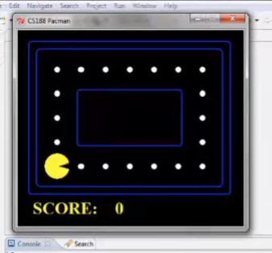
Video of Demo Reflex Optimal

Slide 6
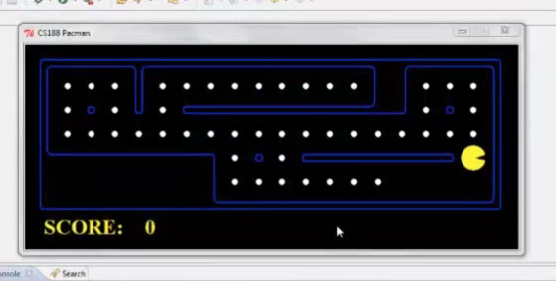
Video of Demo Reflex Odd

Slide 7

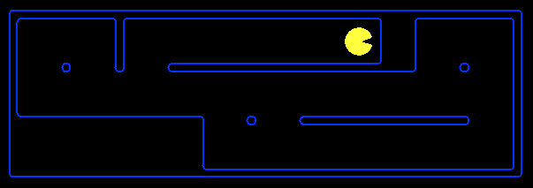
Planning Agents
Planning agents:
  Ask “what if”
  Decisions based on (hypothesized) consequences of actions
  Must have a model of how the world evolves in response to actions
  Must formulate a goal (test)
  Long term planning

Slide 8
Planning options
Full plan: full, start-to-goal plan
Partial planning and replanning: plan until some time horizon. Replan at each time step or once the time horizon is reached

Slide 9
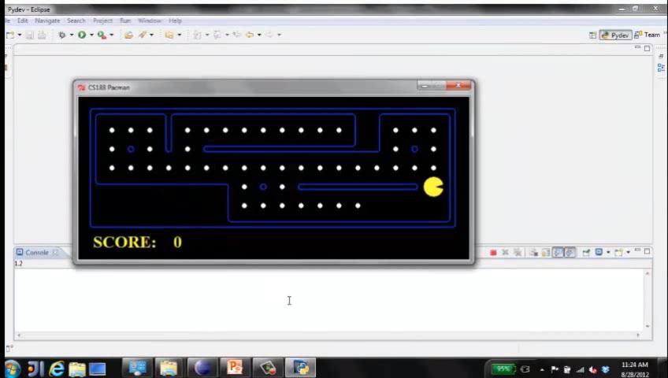
Video of Demo Replanning

Slide 10
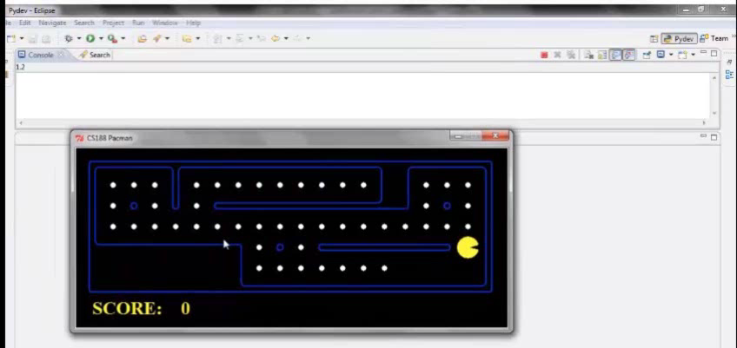
Video of Demo Mastermind

Slide 11

Search Problems

Slide 12

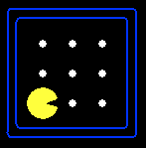





Search Problems
A search problem consists of:
  A state space
  A successor function
  ([state, action] to [next state, cost])
  A start state and a goal condition
A solution is a sequence of actions (a plan) which transforms the start state to a goal state
“N”, 1.0
“E”, 1.0
Notes:
Often comes back on exams
Goal test – sometimes more than one state that satisfies having achieved the goal, for example, “eat all the dots”
Abstraction

Slide 13
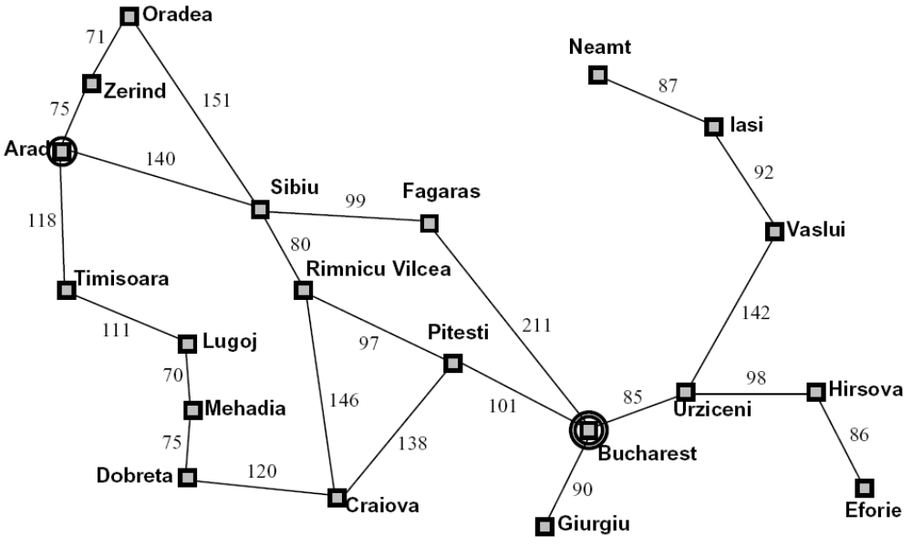
Example: Traveling in Romania
State:
  City
Successor function:
  Roads: Go to adjacent city with cost = distance
Start state:
  Arad
Goal test:
  Is state == Bucharest?
Solution?

Slide 14
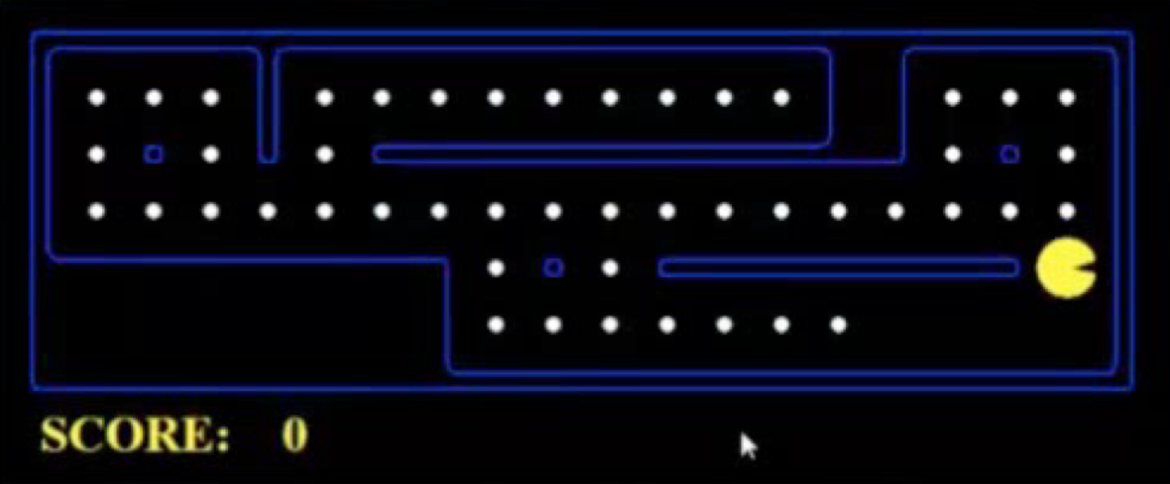
What’s in a State Space?
The world state includes every last detail of the environment
A search state keeps only the details needed for planning (abstraction)
Problem: Pathfinding
  States: (x,y) location
  Actions: NSEW
  Successor: (x+1,y), (x-1,y), (x,y+1), (x,y-1)
  Goal test: is (x,y)=END
Problem: Eat-All-Dots
  States: {(x,y), dot booleans}
  Actions: NSEW
  Successor: update location and possibly a dot boolean
  Goal test: dots all false
Notes:
Wrong example for “eat-all-dots”: (x, y, dot count)

Slide 15
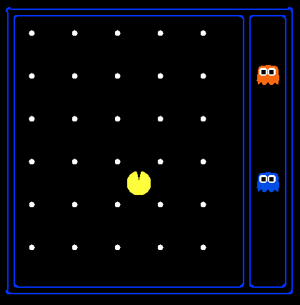
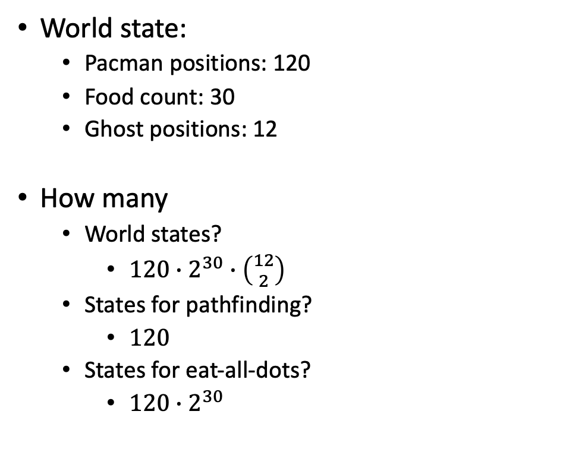
State Space Sizes?
World state:
  Pacman positions: 120
  Food count: 30
  Ghost positions: 12
How many
  World states?
    $120∙2^{30}∙\left({12 \atop 2}\right)$
  States for pathfinding?
    $120$
  States for eat-all-dots?
    $120∙2^{30}$
Notes:
90 * (2^30-1) + 30 * 2^29 = 145 billion
2^29 = 536 870 912

Slide 16
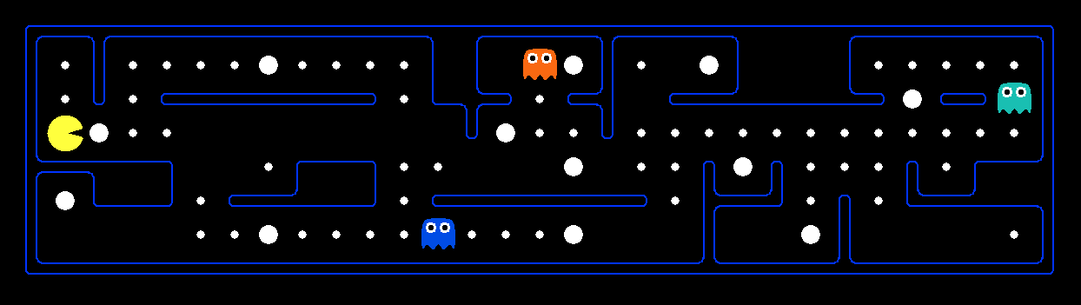
Example: Safe Passage
Problem: eat all dots while keeping the ghosts perma-scared
What does the state space have to specify?
  (Pacman position, dot booleans, power pellet booleans, remaining scared time)
  What about ghosts' position?

Slide 17
State Space Graphs
State space graph: A mathematical representation of a search problem
  Nodes are (abstracted) world configurations
  Arcs represent successors (action results)
  The goal test is a set of goal nodes (maybe only one)
In a state space graph, each state occurs only once!
We can rarely build this full graph in memory (it’s too big), but it’s a useful idea

Slide 18
State Space Graphs
State space graph: A mathematical representation of a search problem
  Nodes are (abstracted) world configurations
  Arcs represent successors (action results)
  The goal test is a set of goal nodes (maybe only one)
In a state space graph, each state occurs only once!
We can rarely build this full graph in memory (it’s too big), but it’s a useful idea
a
G
b
c
e
d
f
S
h
p
q
r
Tiny state space graph for a tiny search problem

Slide 19
Search Trees
This is now / start
“N”, 1.0
“E”, 1.0
Possible futures
A search tree:
  A “what if” tree of plans and their outcomes
  The start state is the root node
  Children correspond to successors
  Nodes show states, but correspond to PLANS that achieve those states
  For most problems, we can never actually build the whole tree
Notes:
Different plans that achieve the same state, will be different nodes in the tree.

Slide 20
State Space Graphs vs. Search Trees
State Space Graph
Each NODE in the search tree is an entire PATH in the state space graph.
Search Tree
S
a
G
d
e
p
b
c
q
b
c
e
h
r
d
e
f
a
a
h
r
p
q
f
S
h
We construct both on demand – and we construct as little as possible.
p
q
f
q
c
G
p
q
r
q
c
G
a
a

Slide 21

Quiz: State Space Graphs vs. Search Trees
Consider this 4-state graph:
How big is its search tree (from S)?
a
S
G
b

Slide 22
Quiz: State Space Graphs vs. Search Trees
Consider this 4-state graph:
How big is its search tree (from S)?
a
s
a
b
S
G
b
G
a
G
b
a
G
b
G
…
…
Important: Lots of repeated structure in the search tree!

Slide 23
Search Example: Romania

Slide 24
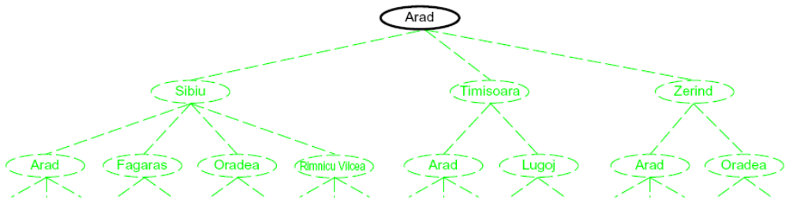
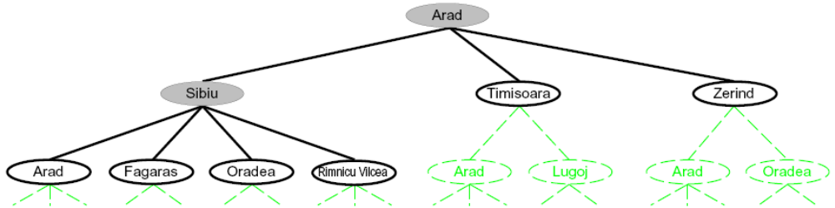
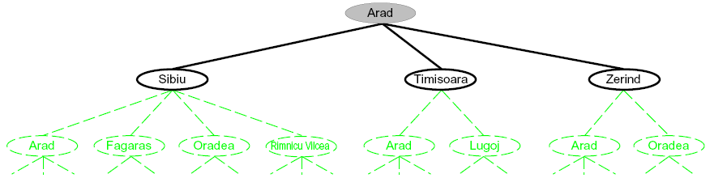
Searching with a Search Tree
Search:
  Expand out potential plans (tree nodes)
  Maintain a fringe of partial plans under consideration
  Try to expand as few tree nodes as possible

Slide 25
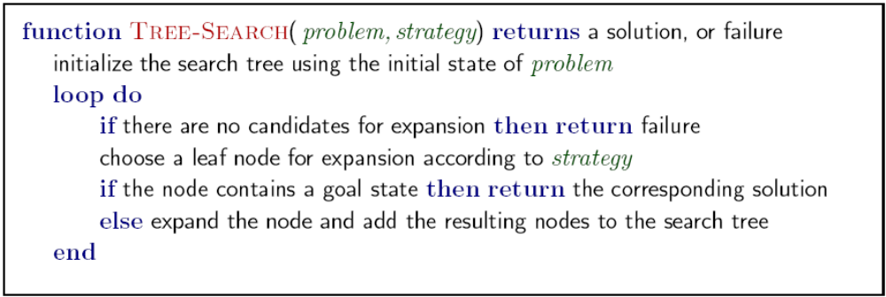
General Tree Search
Tree-Search(start,goal)
OPEN = {start}
while OPEN not empty:
u ← OPEN.extract()
if u is goal:
return solution
else:
OPEN.add(u.get_successors())
return ‘no solution’
Important ideas:
  OPEN
  extract()
  Duplicates?
Central question: which open nodes to explore? - extract()

Slide 26
Example: Tree Search
a
G
b
c
d
e
f
S
h
p
q
r
Notes:
Left: show tree
Right: fringe

Slide 27
Example: Tree Search
a
G
b
c
e
d
e
d
f
f
S
h
p
r
q
r
S
s
s → d
s → e
s → p
d
e
p
b
c
e
h
r
q
a
a
h
r
p
q
f
p
q
f
q
c
G
f
q
c
G
a
G
a

Slide 28
Example: Tree Search
a
G
b
c
e
d
e
d
f
f
S
h
p
r
q
r
S
s
s → d
s → e
s → p
s → d → b
s → d → c
s → d → e
d
e
p
b
c
e
h
r
q
e
a
a
h
r
p
q
f
p
q
f
q
c
G
f
q
c
G
a
a

Slide 29
Example: Tree Search
a
G
b
c
e
d
e
d
f
f
S
h
p
r
q
r
S
s
s → d
s → e
s → p
s → d → b
s → d → c
s → d → e
s → d → e → h
s → d → e → r
d
e
p
b
c
e
h
r
q
a
a
h
r
p
q
f
r
p
q
f
q
c
G
f
q
c
G
a
a

Slide 30
Example: Tree Search
a
G
b
c
e
d
e
d
f
f
S
h
p
r
q
r
S
s
s → d
s → e
s → p
s → d → b
s → d → c
s → d → e
s → d → e → h
s → d → e → r
s → d → e → r → f
s → d → e → r → f → c
s → d → e → r → f → G
d
e
p
b
c
e
h
r
q
a
a
h
r
p
q
f
p
q
f
q
c
G
q
c
G
a
a

Slide 31
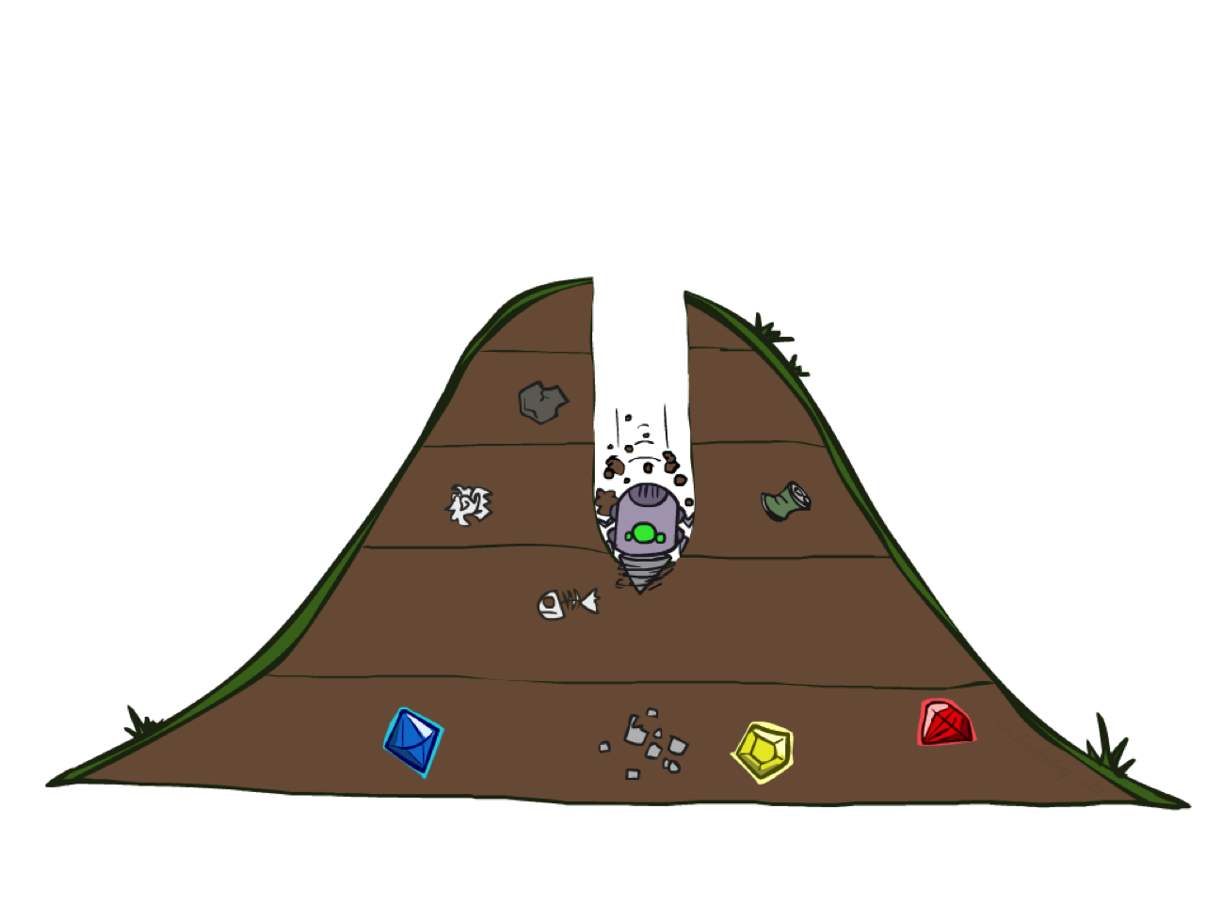
Depth-First Search

Slide 32
Depth-First Search
Strategy: expand a deepest node first
Implementation: OPEN is a LIFO stack
a
G
a
c
b
c
b
e
d
e
d
f
f
S
h
h
p
p
r
q
r
q
S
d
e
p
b
c
e
h
r
q
a
a
h
r
p
q
f
p
q
f
q
c
G
q
c
G
a
a

Slide 33
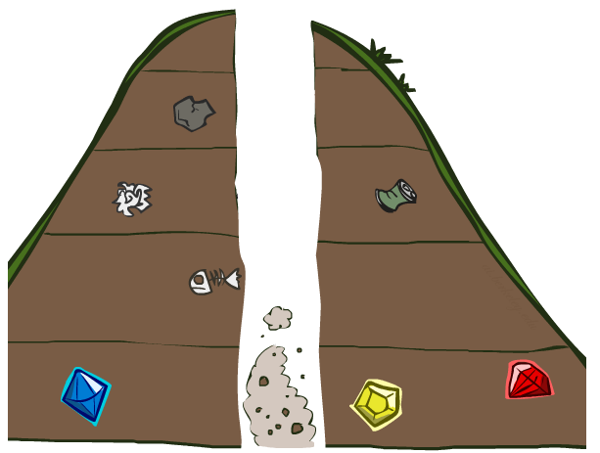
Search Algorithm Properties

Slide 34
Search Algorithm Properties
Complete: Guaranteed to find a solution if one exists?
Optimal: Guaranteed to find the least cost path?
Time complexity
Space complexity
Notation:
  b is the branching factor
  m is the maximum depth
  solutions at various depths
Number of nodes in entire tree?
  1 + b + b² + …. b^{m} = O(b^{m})
1 node
b
…
b nodes
b² nodes
m tiers
b^{m} nodes

Slide 35
Search Algorithm Properties
b
…
d tiers
m tiers
Shallowest solution

Slide 36
Depth-First Search (DFS) Properties
What nodes DFS expand?
  Some left prefix of the tree.
  Could process the whole tree!
  If m is finite, takes time O(b^{m})
How much space does OPEN take?
  Only has siblings on path to root, so O(bm)
    Recursive implementation is O(m)
Is it complete?
  m could be infinite, so only if state space is finite and without cycles (more later)
Is it optimal?
  No, it finds the “leftmost” solution, regardless of depth or cost
1 node
b
…
b nodes
b² nodes
m tiers
b^{m} nodes

Slide 37
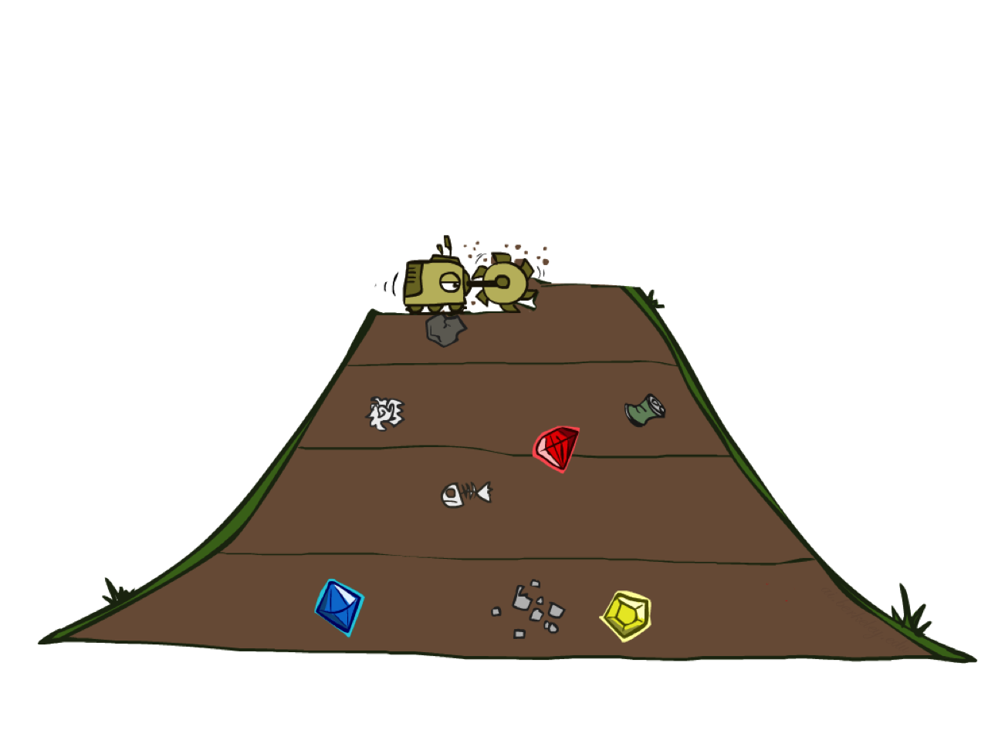
Breadth-First Search

Slide 38
Breadth-First Search
Strategy: expand a shallowest node first
Implementation: OPEN is a FIFO queue
a
G
b
c
d
e
f
S
h
p
q
r
S
d
e
p
Search
Tiers
b
c
e
h
r
q
a
a
h
r
p
q
f
p
q
f
q
c
G
q
c
G
a
a

Slide 39
Breadth-First Search (BFS) Properties
What nodes does BFS expand?
  Processes all nodes above shallowest solution
  Let depth of shallowest solution be d
  Search takes time O(b^{d})
How much space does OPEN take?
  Dominated by the last tier, so O(b^{d})
Is it complete?
  d must be finite if a solution exists, so yes!
Is it optimal?
  Only if edge costs are uniform (more on costs later)
1 node
b
…
b nodes
d tiers
b² nodes
b^{d} nodes
b^{m} nodes

Slide 40
Quiz: DFS vs BFS

Slide 41
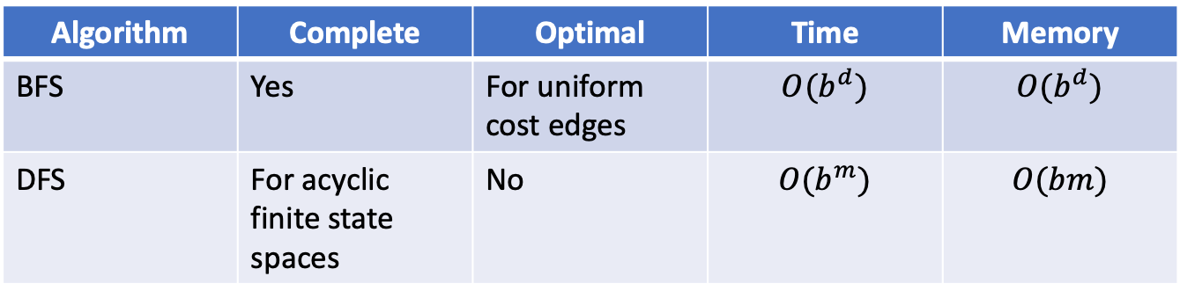
Quiz: DFS vs BFS
Algorithm | Complete | Optimal | Time | Memory
BFS | Yes | For uniform cost edges | $$O(b^{d})$$ | $$O(b^{d})$$
DFS | For acyclic finite state spaces | No | $$O(b^{m})$$ | $$O(bm)$$
1
3
5
7
2
4
6
8

Slide 42

Video of Demo Maze Water DFS/BFS (part 1)

Slide 43
Video of Demo Maze Water DFS/BFS (part 2)

Slide 44
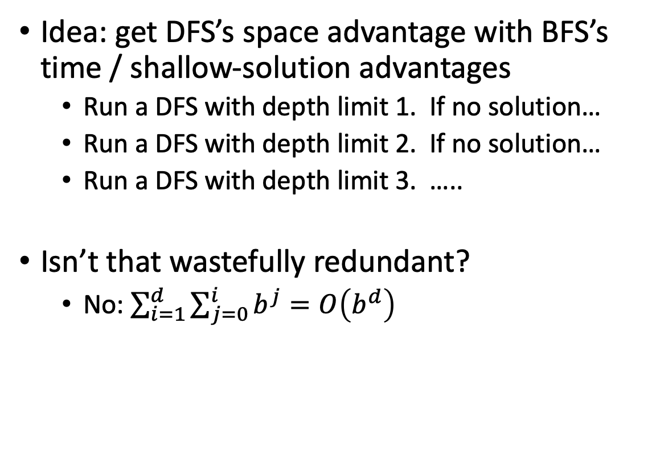
Iterative Deepening
Idea: get DFS’s space advantage with BFS’s time / shallow-solution advantages
  Run a DFS with depth limit 1. If no solution…
  Run a DFS with depth limit 2. If no solution…
  Run a DFS with depth limit 3. …..
Isn’t that wastefully redundant?
  No: $\sum_{i=1}^{d}{\sum_{j=0}^{i}{b^{j}}}=O\left(b^{d}\right)$
b
…

Slide 45
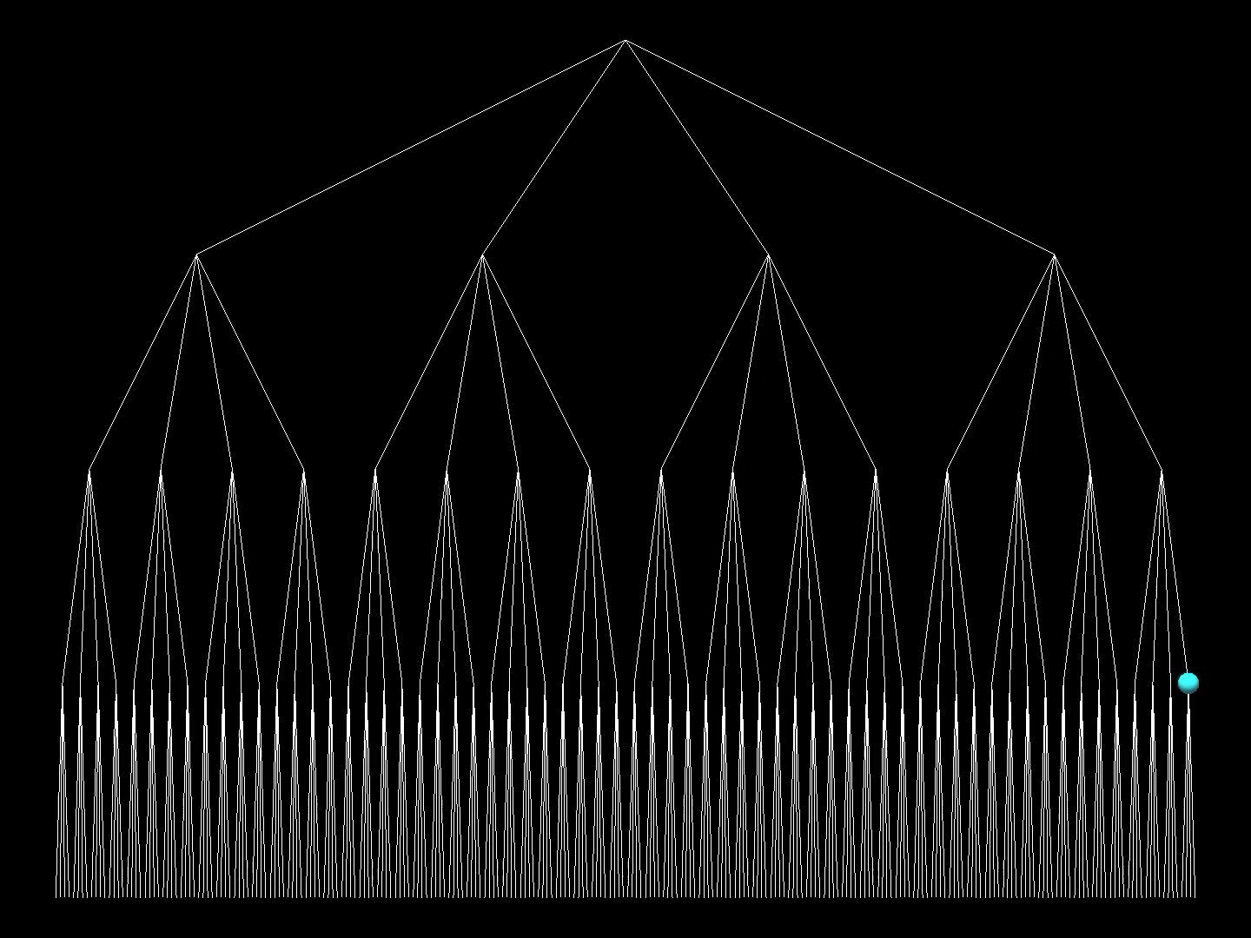

Slide 46
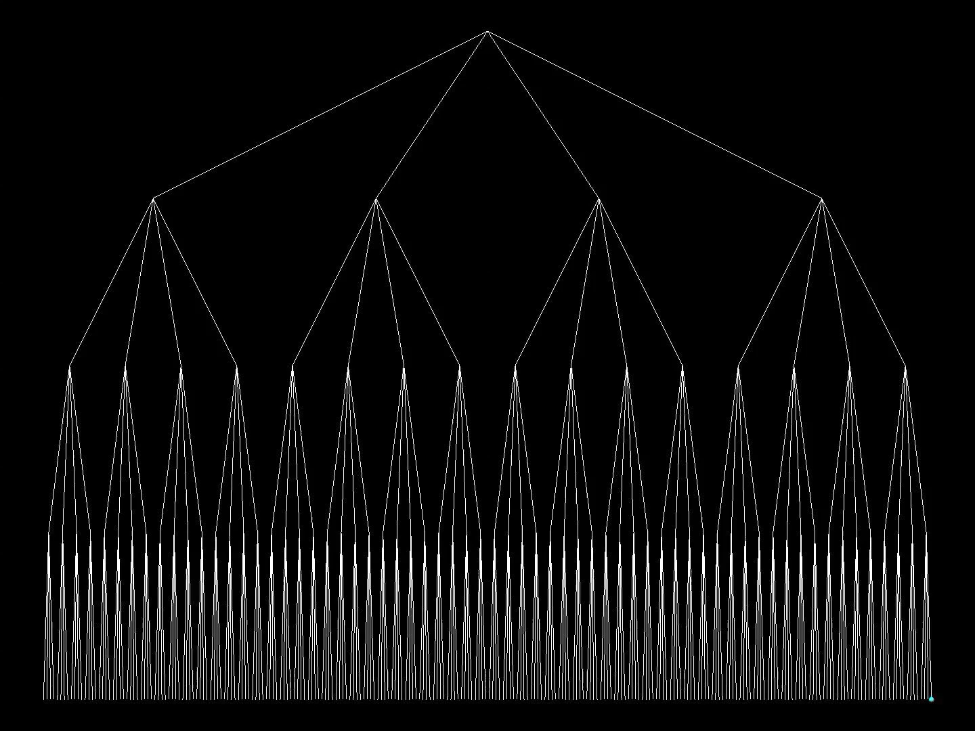

Slide 47
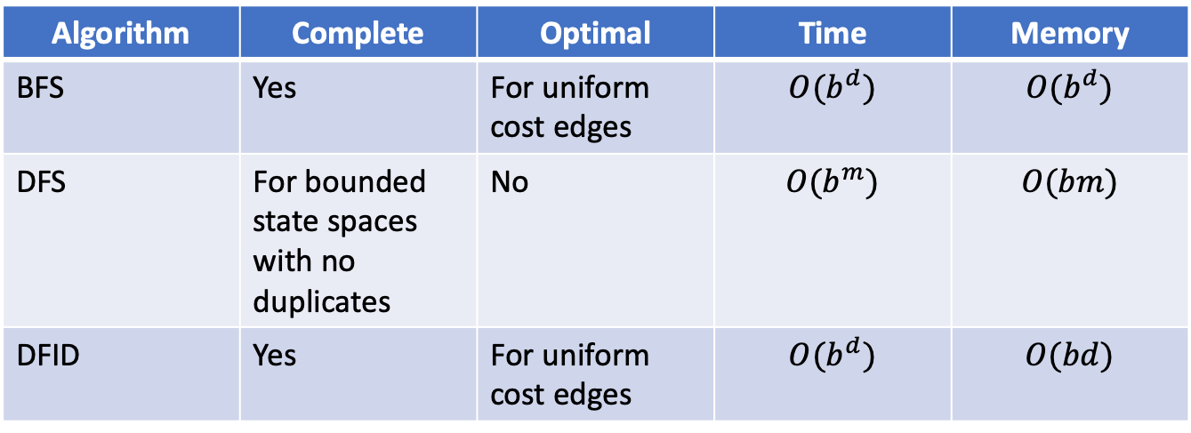
Quiz: DFS vs BFS vs DFID
Algorithm | Complete | Optimal | Time | Memory
BFS | Yes | For uniform cost edges | $$O(b^{d})$$ | $$O(b^{d})$$
DFS | For bounded state spaces with no duplicates | No | $$O(b^{m})$$ | $$O(bm)$$
DFID | Yes | For uniform cost edges | $$O(b^{d})$$ | $$O(bd)$$
?
?
?
?

Slide 48
Cost-Sensitive Search
a
GOAL
2
2
b
c
3
2
1
8
2
e
d
f
3
9
8
2
START
h
1
4
2
p
4
r
15
q
BFS finds the shortest path in terms of number of actions.
It does not find the least-cost path. We will now cover
a similar algorithm which does find the least-cost path.

Slide 49
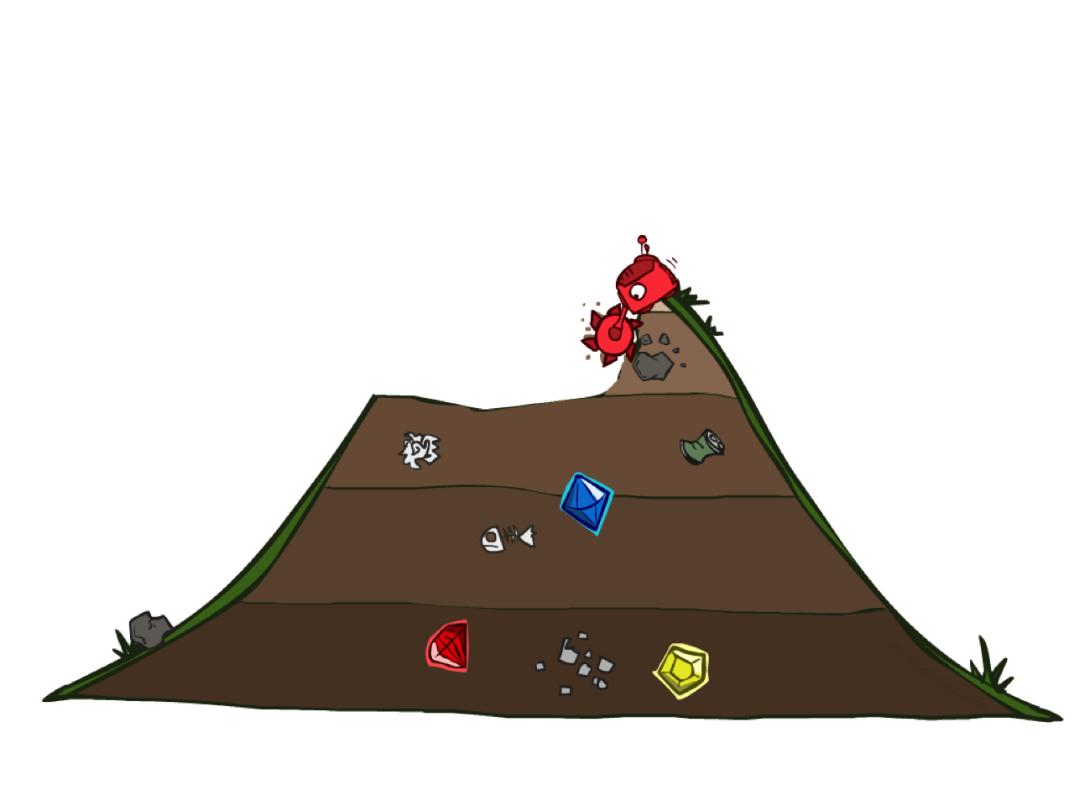
Uniform Cost Search

Slide 50
Uniform Cost Search
2
G
a
Strategy: expand nearest node first:
OPEN is a priority queue (priority: cumulative cost)
b
c
1
8
2
2
e
3
d
f
9
8
2
S
h
1
1
p
q
r
15
0
S
d
3
e
9
p
1
b
4
e
5
h
17
r
11
q
16
c
11
Cost contours
a
6
a
h
13
r
7
p
q
f
p
q
f
8
q
c
G
q
c
a
11
G
10
a

Slide 51
Uniform Cost Search (UCS) Properties
What nodes does UCS expand?
  Processes all nodes with cost less than cheapest solution!
  If that solution costs C* and arcs cost at least ε , then the “effective depth” is O(C*/ε )
  Takes time O(b^{C*/ε}) (exponential in effective depth)
How much space does OPEN take?
  Has roughly the last tier, so O(b^{C*/ε})
Is it complete?
  Assuming optimal solution has a finite cost and non-negative edge costs, yes!
Is it optimal?
  Yes! (Proof next lecture via A*)
  Assuming non-negative edge costs
b
c ≤ 1
…
O(C*/ε ) “tiers”
c ≤ 2
c ≤ 3

Slide 52
Uniform Cost Issues
…
c ≤ 1
Remember: UCS explores increasing cost contours
The good: UCS is complete and optimal!
The bad:
  Explores options in every “direction”
  No information about goal location
We’ll fix that soon!
c ≤ 2
c ≤ 3
Start
Goal

Slide 53
Video of Demo Empty UCS

Slide 54
General Tree Search
Tree-Search(start,goal)
OPEN = {start}
while OPEN not empty:
u ← OPEN.extract()
if u is goal:
return solution
else:
OPEN.add(u.get_successors())
return ‘no solution’
DFS
  OPEN is (LIFO) Stack
BFS
  OPEN is (FIFO) queue
UCS
  OPEN is PQ(cost from start)

Slide 55
Video of Demo Maze with Deep/Shallow Water --- DFS, BFS, or UCS? (part 1)
Notes:
Let students guess which one of the three it is. (This is BFS.)

Slide 56
Video of Demo Maze with Deep/Shallow Water --- DFS, BFS, or UCS? (part 2)
Notes:
Let students guess which one of the three it is. (This is UCS.)

Slide 57
Video of Demo Maze with Deep/Shallow Water --- DFS, BFS, or UCS? (part 3)
Notes:
Let students guess which one of the three it is. (This is DFS.)

Slide 58
Question
Can DFID by adapted to return the optimal solution similar to UCS?
Korf, Richard E. "Depth-first iterative-deepening: An optimal admissible tree search." Artificial intelligence 27.1 (1985): 97-109.

Slide 59

The One Queue
All these search algorithms are the same except for OPEN.extract() strategies
  Conceptually, all OPEN are priority queues (i.e. collections of nodes with attached priorities)
  Practically, for DFS and BFS, you can avoid the log(n) overhead from an actual priority queue, by using stacks and queues
  Can be coded in a general why and take a variable queuing object

Slide 60
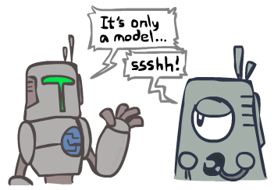
Search and Models
Search operates over models of the world
  The agent doesn’t actually try all the plans out in the real world!
  Planning is all “in simulation”
  Your search is only as good as your model…

Slide 61
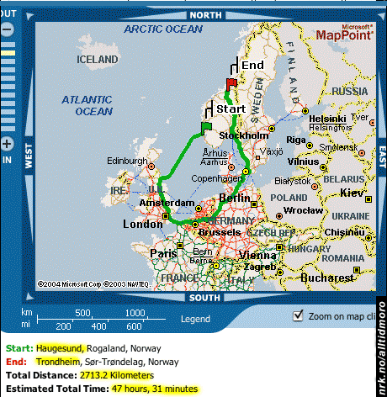
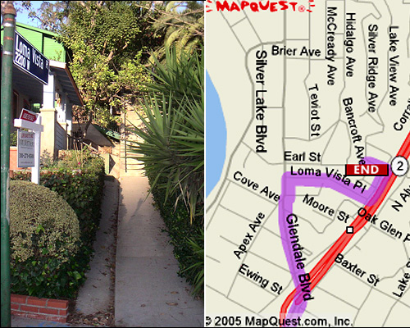

Search Gone Wrong?

Slide 62
What did we learn?
Rational agents should plan ahead
Planning requires a model of the world
Define a state space graph
  Assuming deterministic environment
Search over the affiliated search tree
Exploring strategy:
  LIFO = DFS
  FIFO = BFS
  Priority = UCS
DFID Provides the best of DFS and BFS

