Slide 1
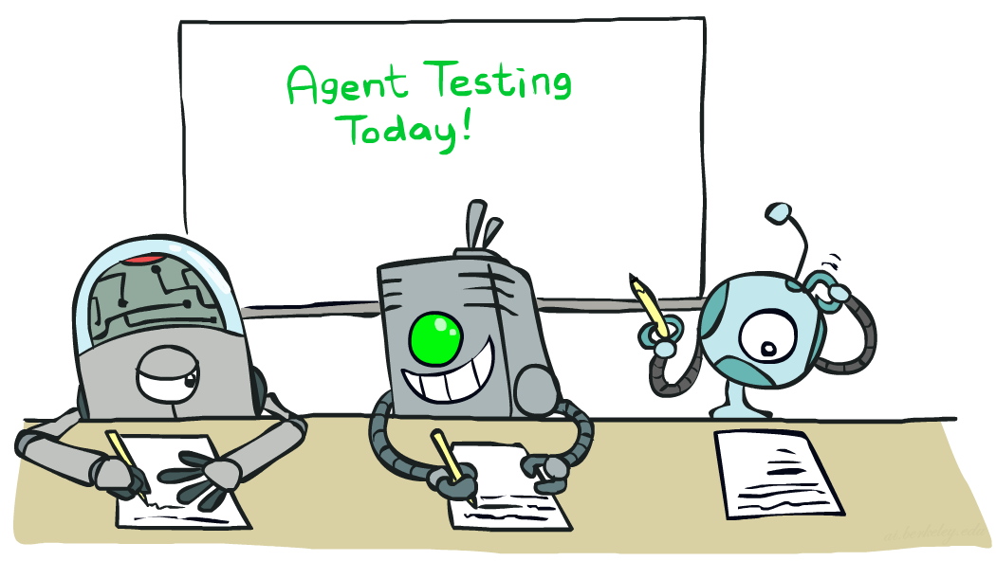
CSCE-420: Artificial Intelligence
Naïve Bayes
Instructor: Guni Sharon
Based on slides by: Pieter Abbeel, Dan Klein

Slide 2
Announcements
Quiz 10 - HMM, due Monday Apr 16, EoD
Assignment 4 – Bayes Nets and HMMs, due April 21, EoD
Quiz 11 - naïve Bayes, due April 23, EoD.
Assignment 5: Machine Learning (Extra credit), due May 1, EoD
Contest 3: Multiagent Adversarial Pacman, due May 1, EoD
  You are encouraged to combine various AI tools
    Heuristic search for deterministic planning
    Adversarial search and game theory for modeling opponents
    MDPs for modeling uncertainties
    Reinforcement learning for solving MDPs
    Bayes nets for inference
    DNN as function approximators

Slide 3
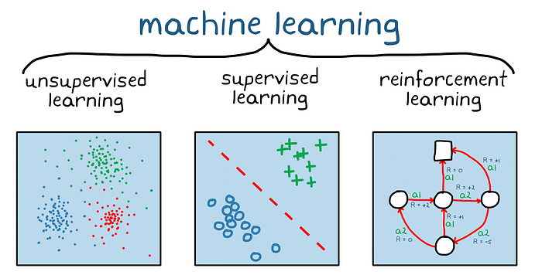

Slide 4

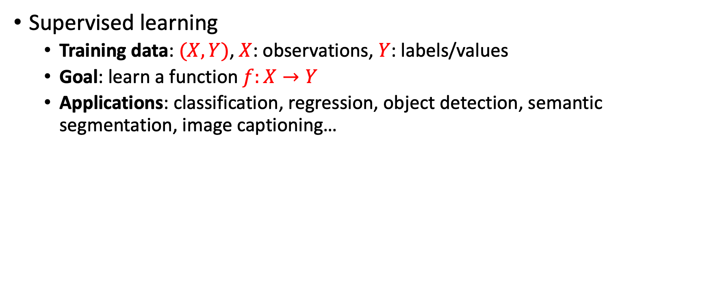
Machine learning
Supervised learning
  Training data: $(X,Y)$, $X$: observations, $Y$: labels/values
  Goal: learn a function $f:X→Y$
  Applications: classification, regression, object detection, semantic segmentation, image captioning…

Slide 5
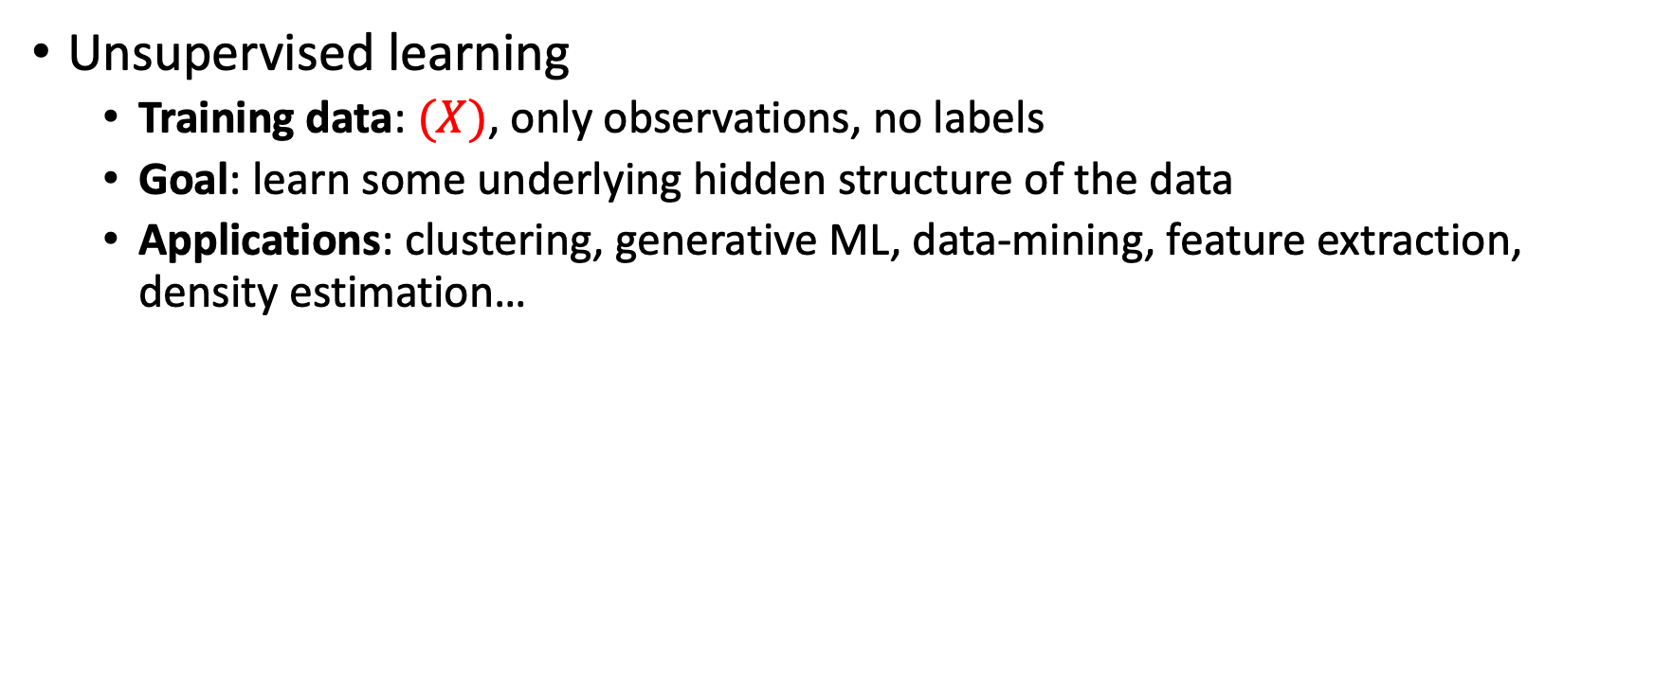
Machine learning
Unsupervised learning
  Training data: $(X)$, only observations, no labels
  Goal: learn some underlying hidden structure of the data
  Applications: clustering, generative ML, data-mining, feature extraction, density estimation…

Slide 6
Machine learning
Reinforcement learning
  Training data: interactions with an environment
  Goal: learn a policy (mapping states to actions) that maximizes some utility function
  Applications: Robotics and automation, text speech and dialog systems, resource management …

Slide 7
Machine Learning
Up until now: how to use a model to make optimal decisions
Next: how to acquire a model from data / experience
  Learning parameters (e.g. probabilities)
  Learning structure (e.g. BN graphs)
  Learning hidden concepts (e.g. clustering, neural nets)
Today: model-based classification with Naive Bayes

Slide 8
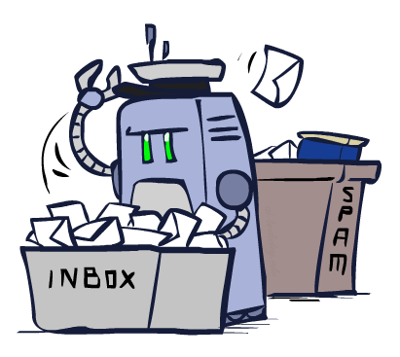
Classification

Slide 9
Example: Spam Filter
Input: an email
Output: spam/ham
Setup (supervised learning):
  Get a large collection of example emails, each labeled “spam” or “ham”
  Note: someone has to hand label all this data!
  Want to learn to predict labels of new emails
Features: The attributes used to make the ham / spam decision
  Words: FREE!
  Text Patterns: $dd, CAPS
  Non-text: SenderInContacts, WidelyBroadcast
  …
Dear Sir.
First, I must solicit your confidence in this transaction, this is by virture of its nature as being utterly confidencial and top secret. …
TO BE REMOVED FROM FUTURE MAILINGS, SIMPLY REPLY TO THIS MESSAGE AND PUT "REMOVE" IN THE SUBJECT.
99 MILLION EMAIL ADDRESSES
FOR ONLY $99
Ok, Iknow this is blatantly OT but I'm beginning to go insane. Had an old Dell Dimension XPS sitting in the corner and decided to put it to use, I know it was working pre being stuck in the corner, but when I plugged it in, hit the power nothing happened.

Slide 10

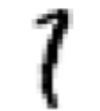



Example: Digit Recognition
Input: images / pixel grids
Output: a digit 0-9
Setup:
  Get a large collection of example images, each labeled with a digit
  Note: someone has to hand label all this data!
  Want to learn to predict labels of new, future digit images
Features: The attributes used to make the digit decision
  Pixels: (6,8)=ON
  Shape Patterns: NumComponents, AspectRatio, NumLoops
  …
  Features should be increasingly induced rather than crafted
0
1
2
1
??

Slide 11
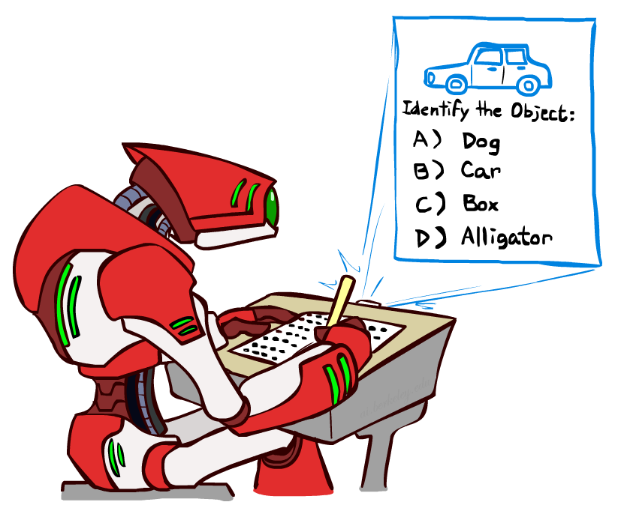
Other Classification Tasks
Classification: given inputs x, predict labels (classes) y
Examples:
  Medical diagnosis (input: symptoms,
  classes: diseases)
  Fraud detection (input: account activity,
  classes: fraud / no fraud)
  Automatic essay grading (input: document,
  classes: grades)
  Customer service email routing
  Review sentiment
  Language ID
  … many more
Classification is an important commercial technology!

Slide 12
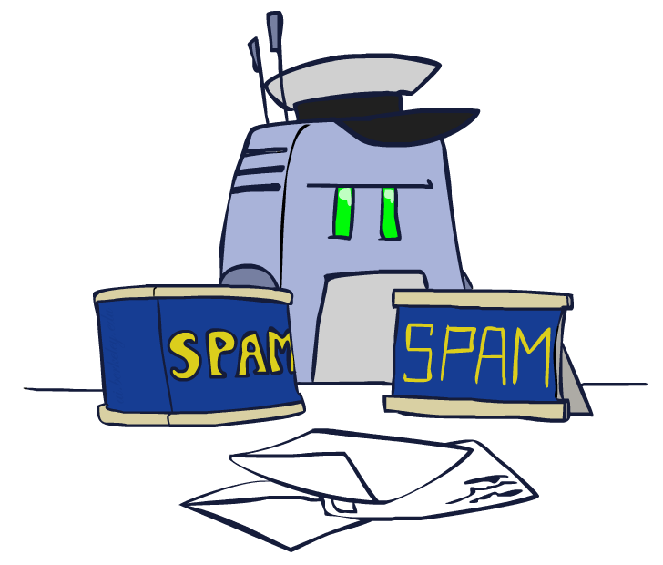
Model-Based Classification
Model-based approach
  Build a model (e.g. Bayes’ net) where both the output label and input features are random variables
  Instantiate any observed features
  Query for the distribution of the label conditioned on the features
Challenges
  What structure should the BN have?
  How should we learn its parameters?

Slide 13


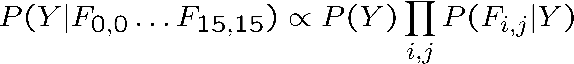
Naïve Bayes for Digits
Naïve Bayes: Assume all features are independent effects of the label
Simple digit recognition version:
  One feature (variable) F_{ij} for each grid position <i,j>
  Feature values are on / off
  is more or less than 0.5 in underlying image
  Each input maps to a feature vector, e.g.
  Here: lots of features, each is binary valued
Naïve Bayes model:
What do we need to train?
Y
F₁
F₂
F_{n}
Definition of conditional prob (=joint/P(Y)) + Chain rule + independency assumptions (Fs given Y)

Slide 14

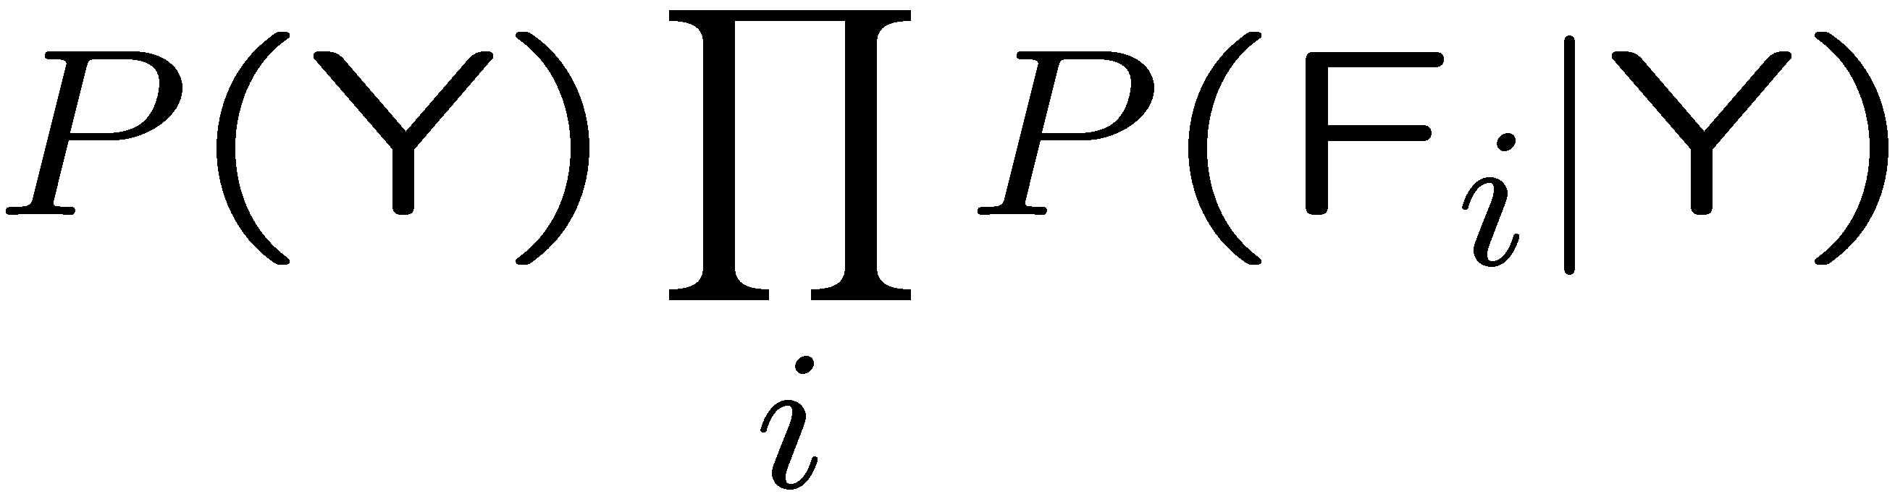
General Naïve Bayes
Y
A general Naive Bayes model:
We only have to specify how each feature depends on the class
Total number of parameters is linear in n
Model is very simplistic (overgeneralization), but often works anyway
F₁
F₂
F_{n}
|Y| x |F|^{n} values
|F| CPTs, each of size n x |Y| resulting in n x |Y| x |F| parameters + |Y|

Slide 15
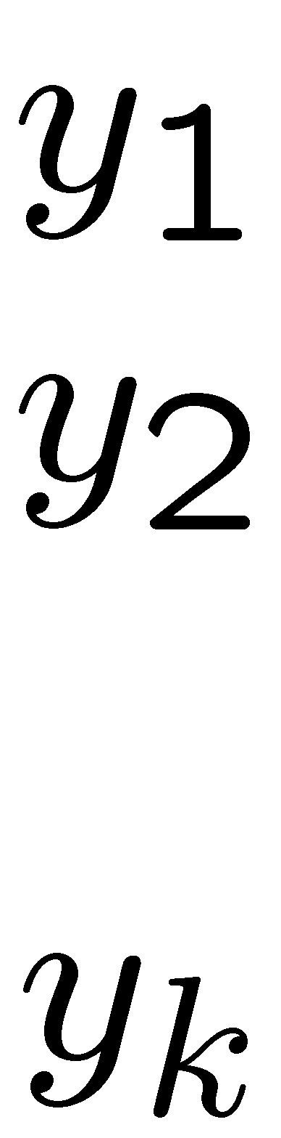
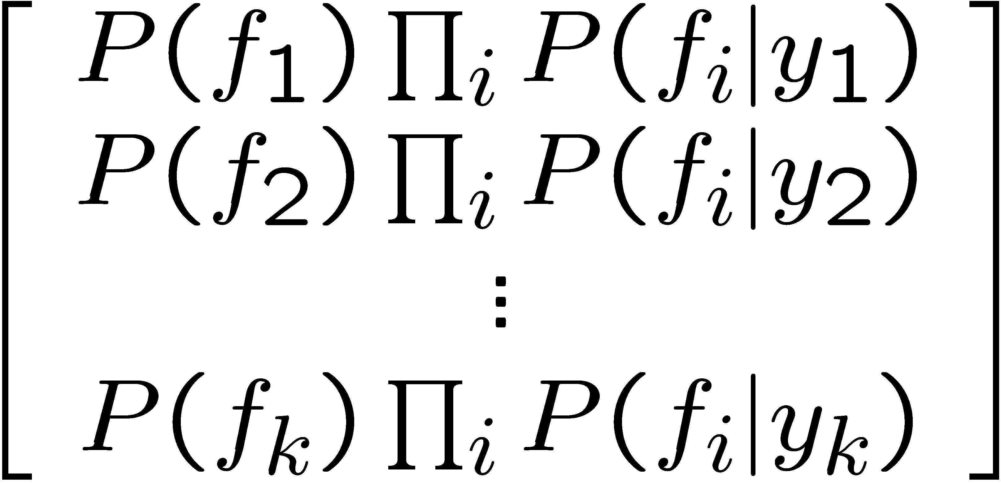

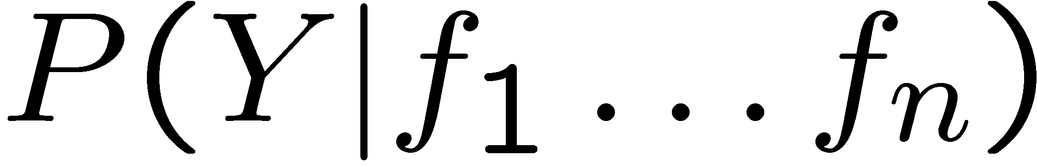
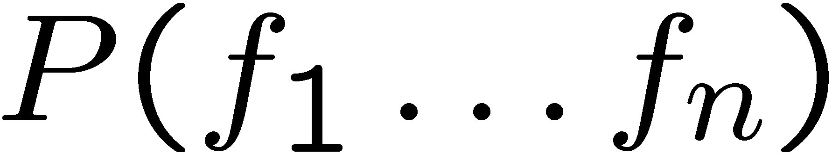
Inference for Naïve Bayes
Goal: compute posterior distribution over label variable Y
  Step 1: compute conditional probabilities using the chain rule
  Step 2: normalize
+

Slide 16
General Naïve Bayes
What do we need in order to use Naïve Bayes?
  Inference method (we just saw this part)
    Start with a bunch of probabilities: P(Y) and the P(F_{i}|Y) tables (CPT)
    Use standard inference to compute P(Y|F₁…F_{n})
    Nothing new here
  Estimates of local conditional probability tables
    P(Y), the prior over labels
    P(F_{i}|Y) for each feature (evidence variable)
    These probabilities are collectively called the parameters of the model and denoted by θ
    Up until now, we assumed these appeared by magic, but…
    …they typically come from training data: we’ll look at this soon

Slide 17
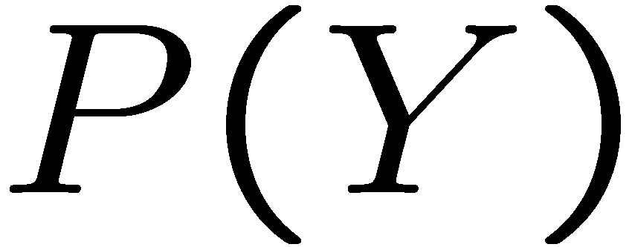


Example: Conditional Probabilities
1 | 0.1
2 | 0.1
3 | 0.1
4 | 0.1
5 | 0.1
6 | 0.1
7 | 0.1
8 | 0.1
9 | 0.1
0 | 0.1
1 | 0.01
2 | 0.05
3 | 0.05
4 | 0.30
5 | 0.80
6 | 0.90
7 | 0.05
8 | 0.60
9 | 0.50
0 | 0.80
1 | 0.05
2 | 0.01
3 | 0.90
4 | 0.80
5 | 0.90
6 | 0.90
7 | 0.25
8 | 0.85
9 | 0.60
0 | 0.80

Slide 18
A Spam Filter
Dear Sir.
First, I must solicit your confidence in this transaction, this is by virture of its nature as being utterly confidencial and top secret. …
Naïve Bayes spam filter
Data:
  Collection of emails, labeled spam or ham
  Note: someone has to hand label all this data!
  Split into training, held-out, test sets
Classifiers
  Learn on the training set
  (Tune it on a held-out set)
  Test it on new emails
TO BE REMOVED FROM FUTURE MAILINGS, SIMPLY REPLY TO THIS MESSAGE AND PUT "REMOVE" IN THE SUBJECT.
99 MILLION EMAIL ADDRESSES
FOR ONLY $99
Ok, Iknow this is blatantly OT but I'm beginning to go insane. Had an old Dell Dimension XPS sitting in the corner and decided to put it to use, I know it was working pre being stuck in the corner, but when I plugged it in, hit the power nothing happened.

Slide 19
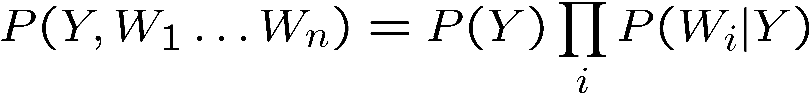
Naïve Bayes for Text
Bag-of-words Naïve Bayes:
  Features: W_{i} is the word at position i
  As before: predict label conditioned on feature variables (spam vs. ham)
  As before: assume features are conditionally independent given label
  New: each W_{i} is identically distributed
Naïve Bayes model:
“Tied” distributions and bag-of-words
  Usually, each variable gets its own conditional probability distribution P(F|Y)
  In a bag-of-words model
    Each position is identically distributed
    All positions share the same conditional probs P(W|Y)
    Why make this assumption?
  Called “bag-of-words” because model is insensitive to word order or reordering
  A similar approach is used in Convolutional Neural Networks
Word at position i, not i^{th} word in the dictionary!

Slide 20

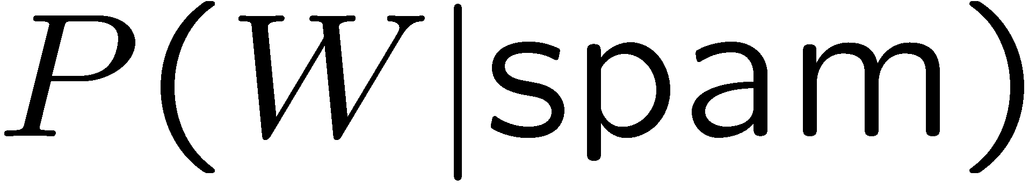
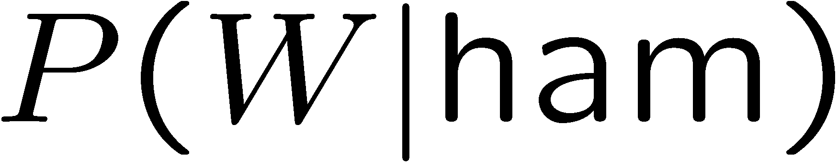
Example: Spam Filtering
Model:
What are the parameters?
Where do these tables come from?
ham : 0.66
spam: 0.33
the : 0.0156
to : 0.0153
and : 0.0115
of : 0.0095
you : 0.0093
a : 0.0086
with: 0.0080
from: 0.0075
...
the : 0.0210
to : 0.0133
of : 0.0119
2002: 0.0110
with: 0.0108
from: 0.0107
and : 0.0105
a : 0.0100
...

Slide 21
Spam Example
Word | P(w|spam) | P(w|ham) | Tot Spam | Tot Ham
(prior) | 0.33333 | 0.66666 | -1.1 | -0.4
Gary | 0.00002 | 0.00021 | -11.8 | -8.9
would | 0.00069 | 0.00084 | -19.1 | -16.0
you | 0.00881 | 0.00304 | -23.8 | -21.8
like | 0.00086 | 0.00083 | -30.9 | -28.9
to | 0.01517 | 0.01339 | -35.1 | -33.2
lose | 0.00008 | 0.00002 | -44.5 | -44.0
weight | 0.00016 | 0.00002 | -53.3 | -55.0
while | 0.00027 | 0.00027 | -61.5 | -63.2
you | 0.00881 | 0.00304 | -66.2 | -69.0
sleep | 0.00006 | 0.00001 | -76.0 | -80.5
P(spam | w) = 0.989

Slide 22
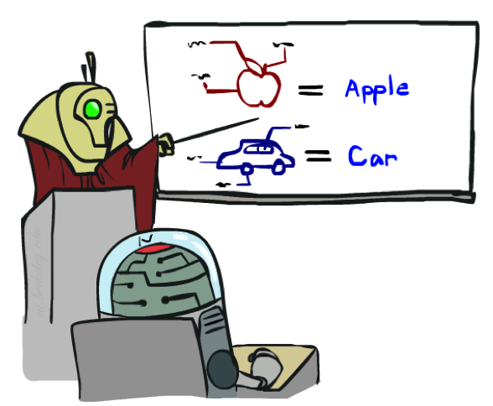
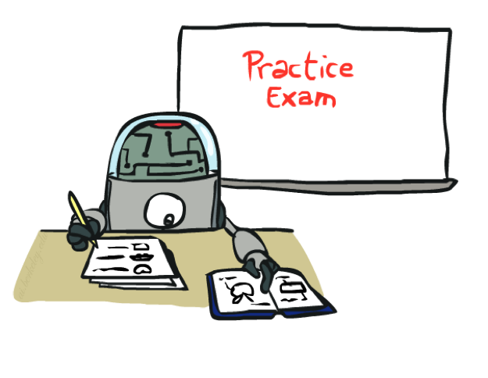
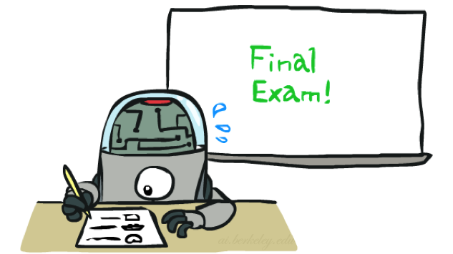
Training and Testing

Slide 23
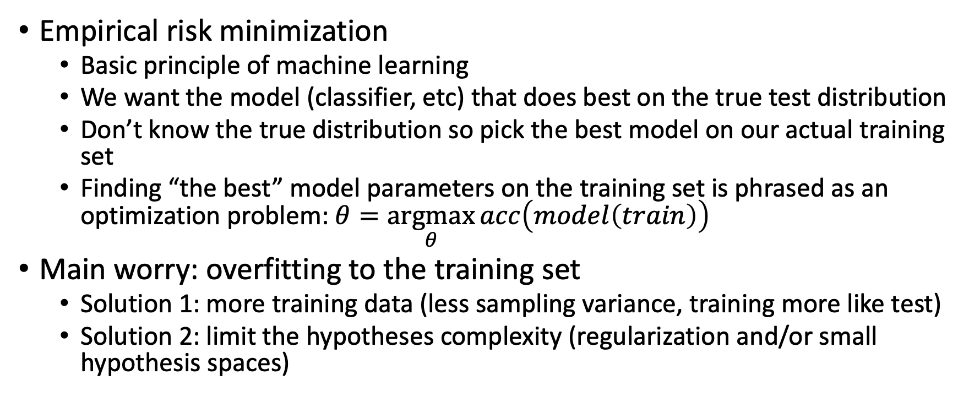
Empirical Risk Minimization
Empirical risk minimization
  Basic principle of machine learning
  We want the model (classifier, etc) that does best on the true test distribution
  Don’t know the true distribution so pick the best model on our actual training set
  Finding “the best” model parameters on the training set is phrased as an optimization problem: $θ=\underset{θ}{argmax}{acc\left(model\left(train\right)\right)}$
Main worry: overfitting to the training set
  Solution 1: more training data (less sampling variance, training more like test)
  Solution 2: limit the hypotheses complexity (regularization and/or small hypothesis spaces)

Slide 24

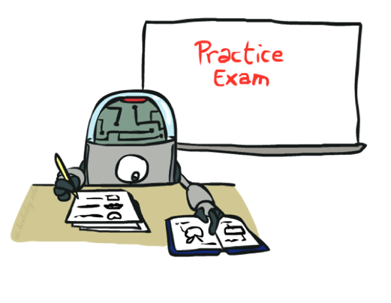
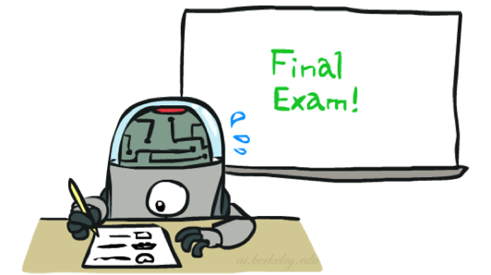
Important Concepts
Data: labeled instances (e.g. emails marked spam/ham)
  Training set
  Held out set
  Test set
Features: attribute values which characterize each x
Experimentation cycle
  Learn parameters (e.g. model probabilities) on training set
  (Tune hyperparameters on held-out set)
  Compute accuracy of test set
  Very important: never optimize parameters for the test set!
Evaluation (many metrics possible, e.g. accuracy)
  Accuracy: fraction of instances predicted correctly
Overfitting and generalization
  Want a classifier which does well on test data
  Overfitting: fitting the training data very closely, but not generalizing well
Training
Data
Held-Out
Data
Test
Data

Slide 25

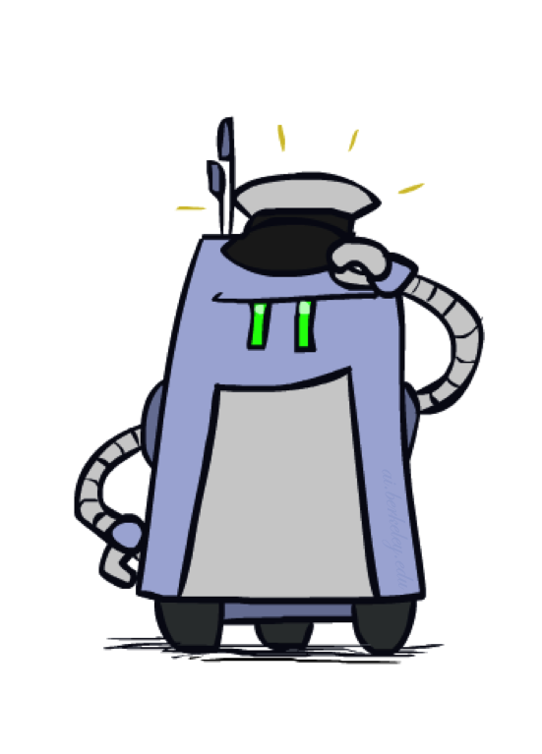
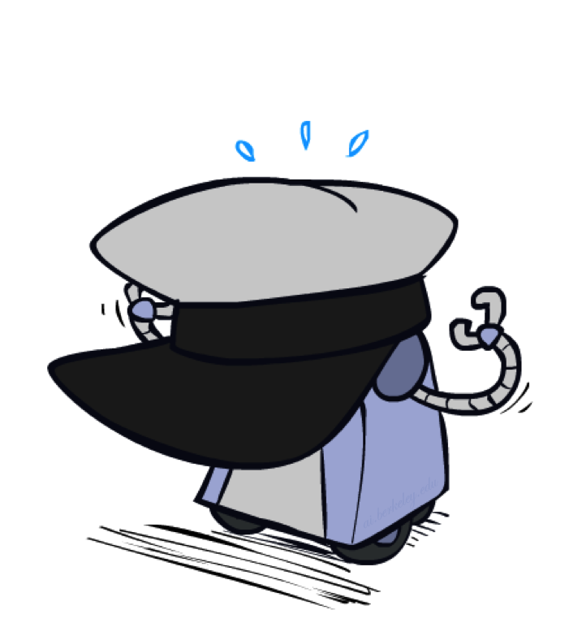
Generalization and Overfitting

Slide 26
Overfitting
30
25
20
Degree 15 polynomial
15
10
5
0
-5
-10
-15
0
2
4
6
8
10
12
14
16
18
20

Slide 27












Example: Overfitting
2 wins!!

Slide 28
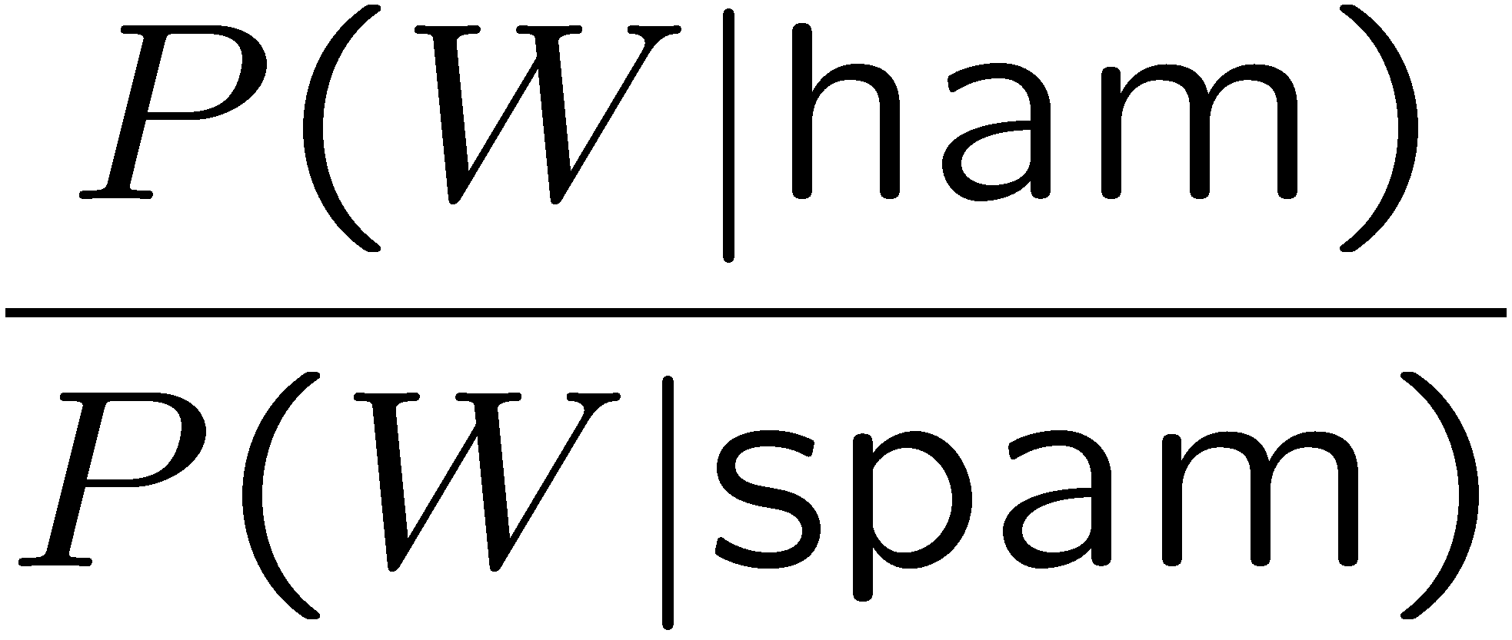
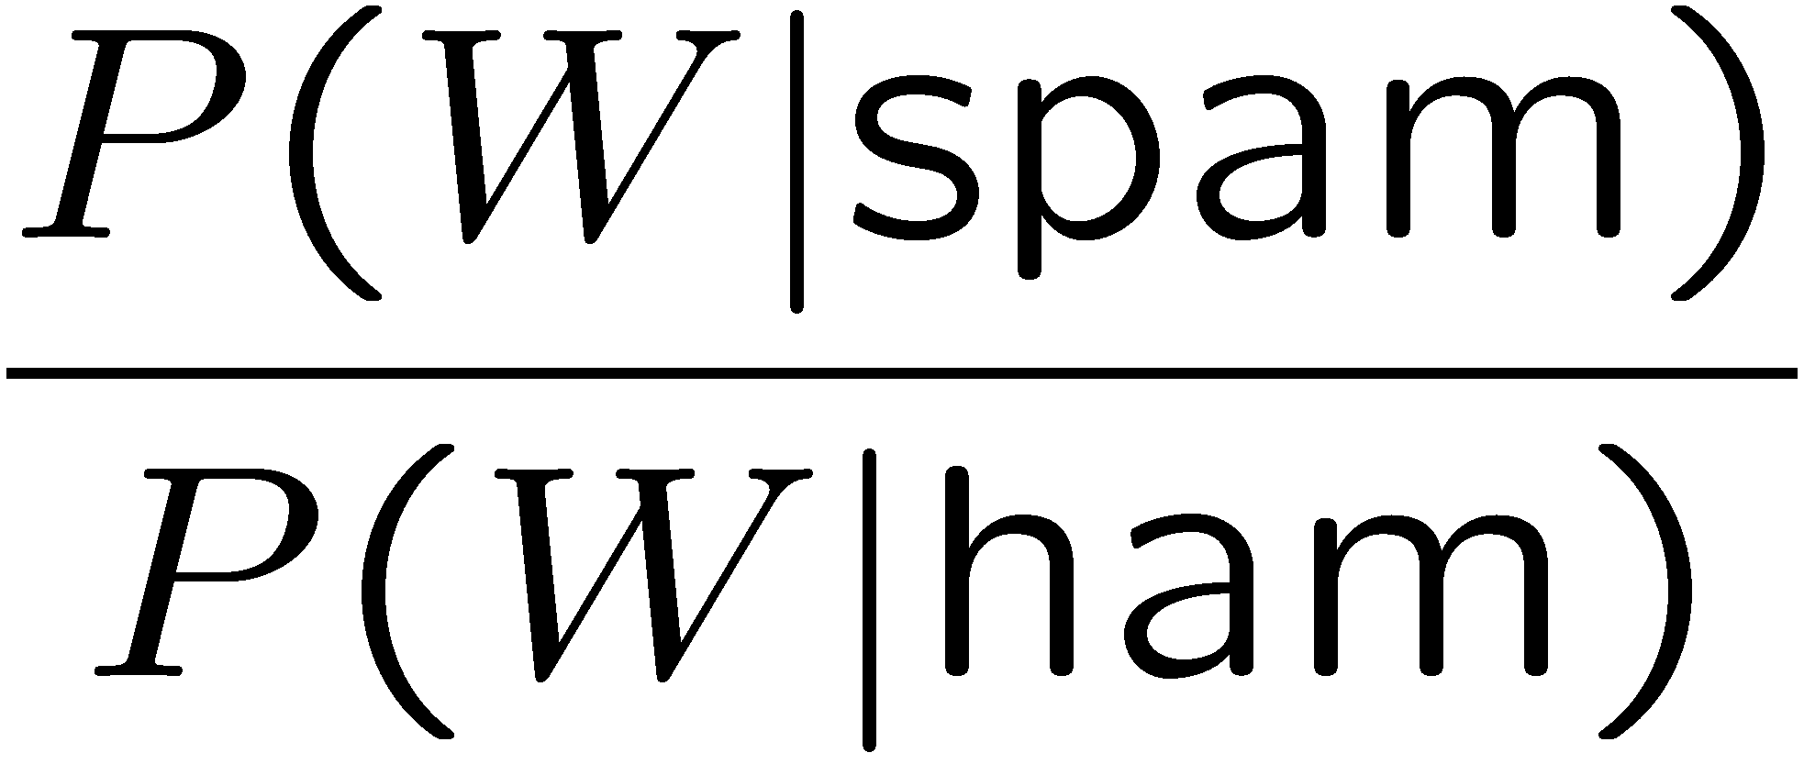
Example: Overfitting
Posteriors determined by relative probabilities (how much more likely is a word to appear in ‘spam’ relative to ‘ham’):
south-west : inf
nation : inf
morally : inf
nicely : inf
extent : inf
seriously : inf
...
screens : inf
minute : inf
guaranteed : inf
$205.00 : inf
delivery : inf
signature : inf
...
What went wrong here?

Slide 29
Generalization and Overfitting
Rare parameter values will overfit the training data!
  Just because we never saw a 3 with pixel (15,15) on during training doesn’t mean we won’t see it at test time
  Unlikely that every occurrence of “minute” is 100% spam
  Unlikely that every occurrence of “seriously” is 100% ham
  What about all the words that don’t occur in the training set at all?
  In general, we can’t go around giving unseen events zero probability
As an extreme case, imagine using the entire email as the only feature (e.g. document ID)
  Would get the training data perfect (if deterministic labeling)
  Wouldn’t generalize at all
  Just making the bag-of-words assumption gives us some generalization, but isn’t enough
To generalize better: we need to smooth or regularize the estimates

Slide 30
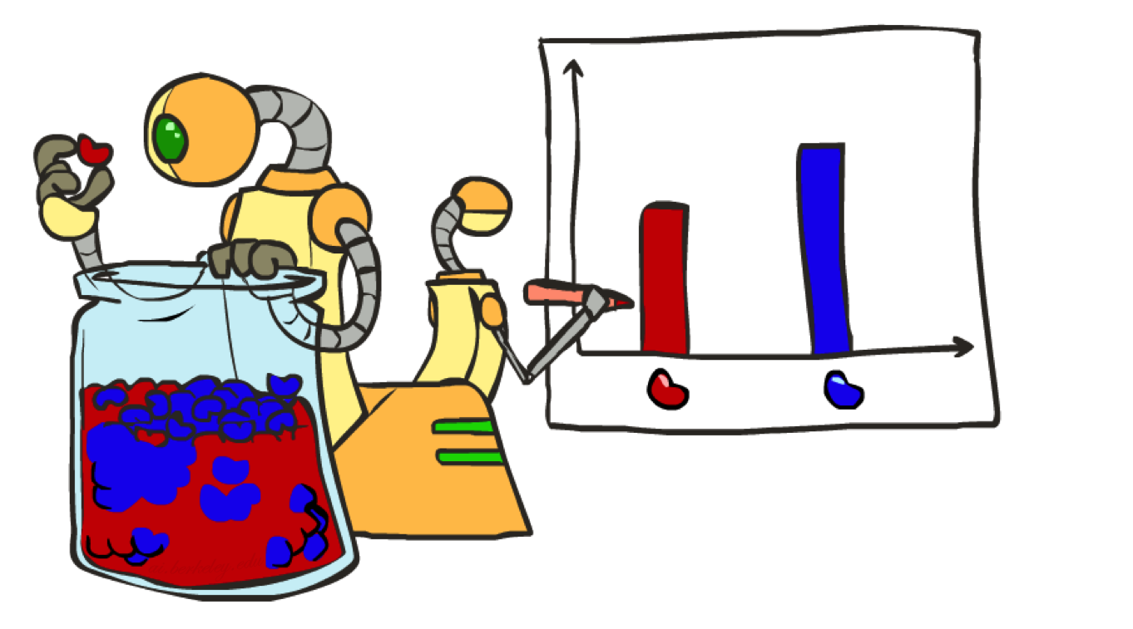
Parameter Estimation

Slide 31
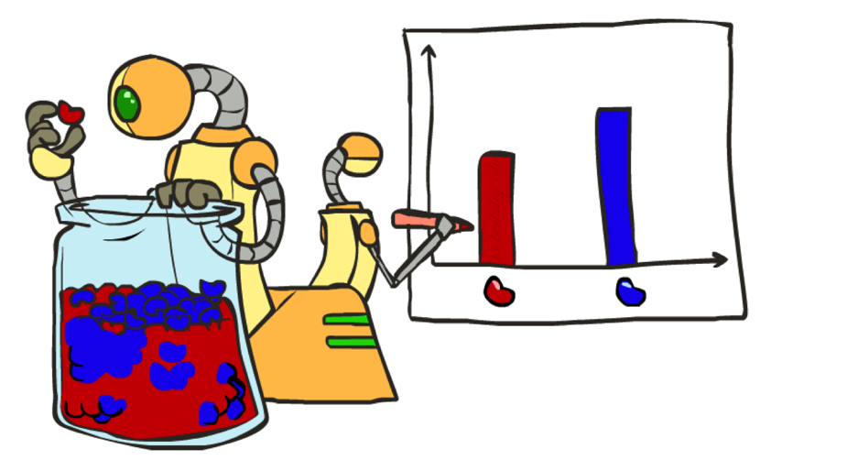
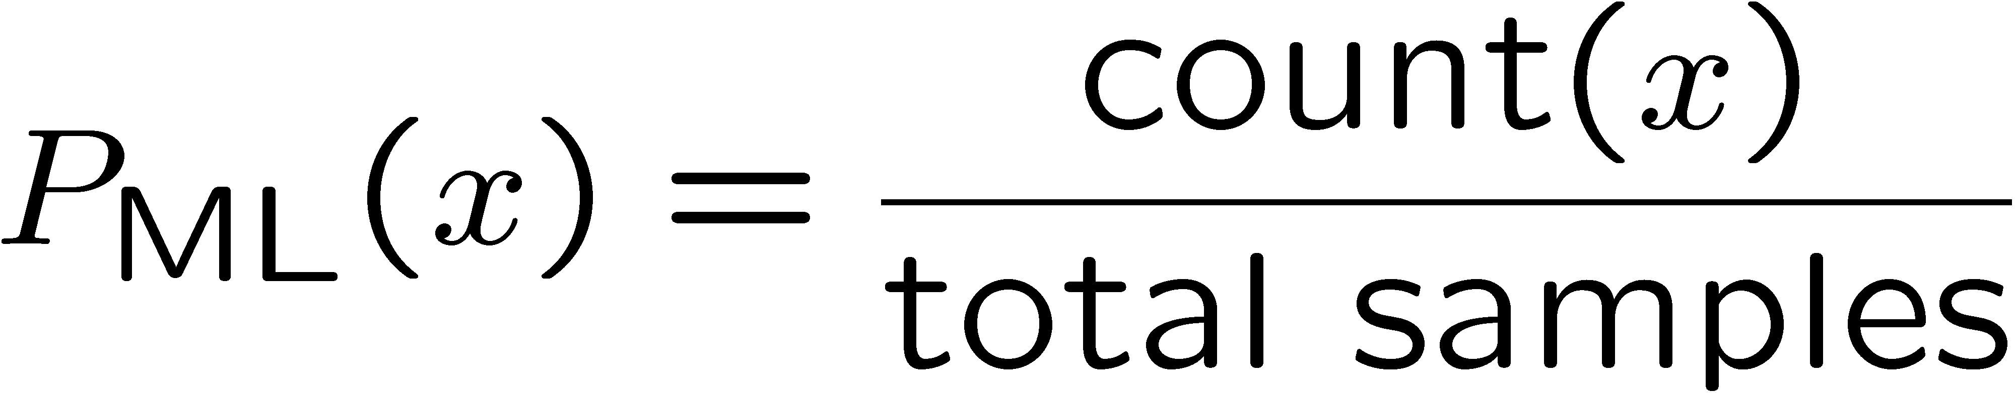

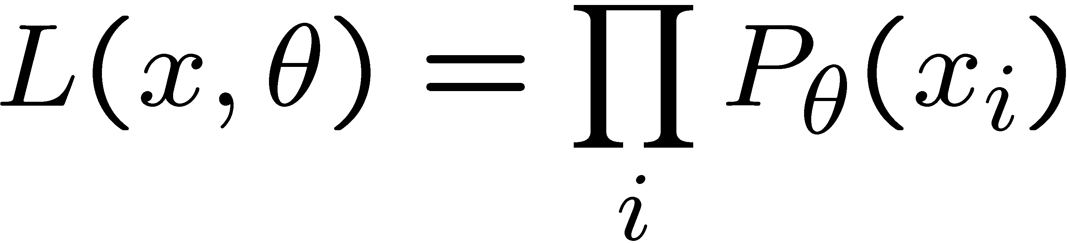
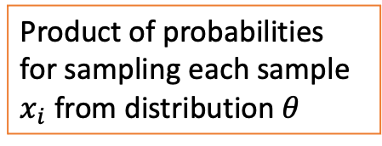
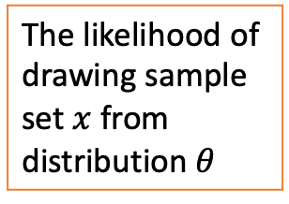
Parameter Estimation
Estimating the distribution of a random variable
Elicitation: ask a human (why is this hard?)
Empirically: use training data (learning!)
  E.g.: for each outcome x, look at the empirical rate of that value:
  This is the estimate that maximizes the likelihood of the data
r
b
b
b
r
r
b
b
b
r
r
b
b
b
b
r
r
b
The likelihood of drawing sample set $x$ from distribution $θ$
Product of probabilities for sampling each sample $x_{i}$ from distribution $θ$

Slide 32
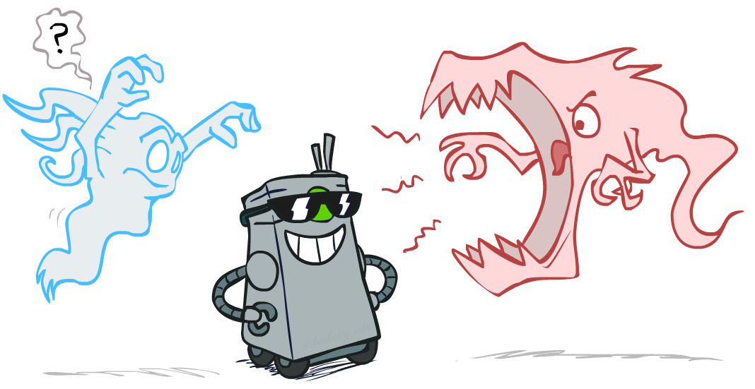
Smoothing

Slide 33
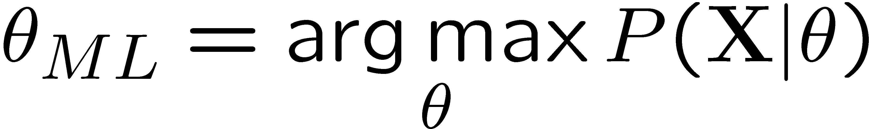
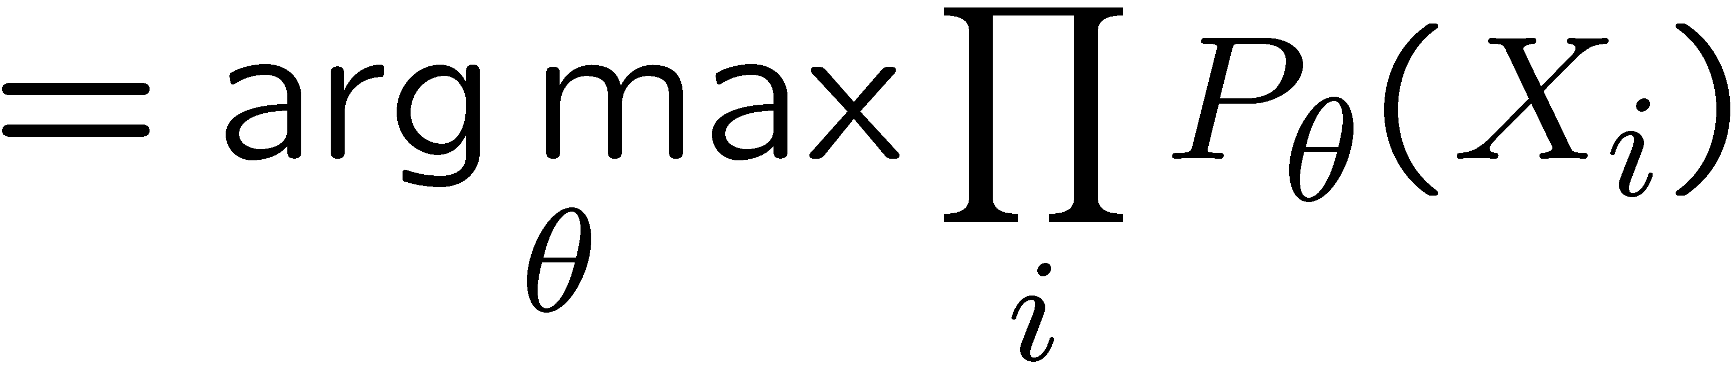
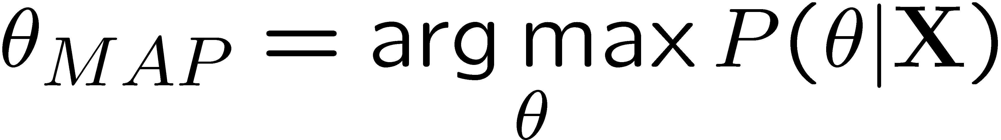
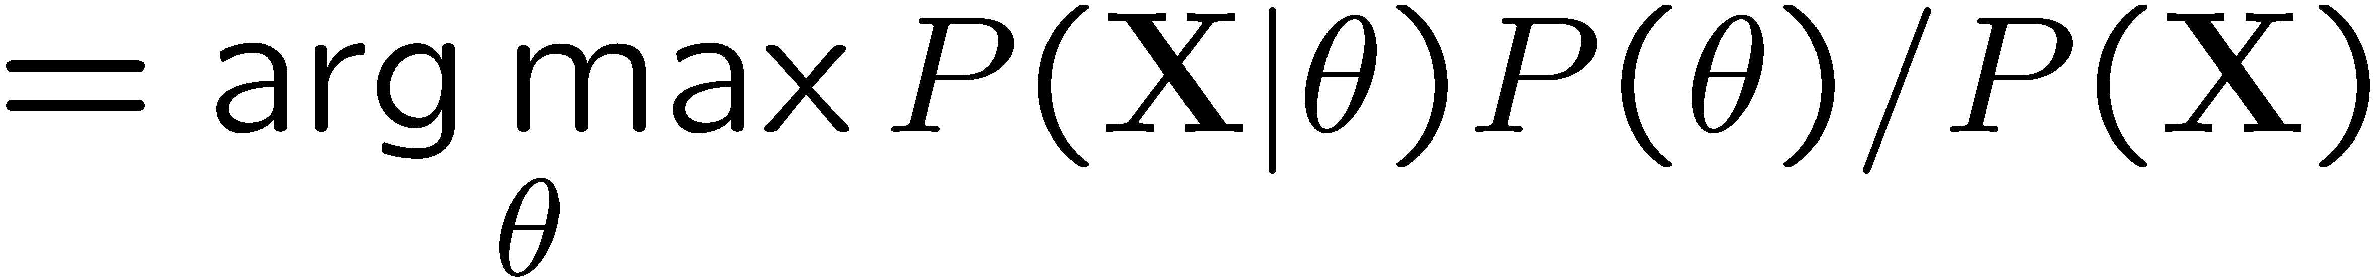
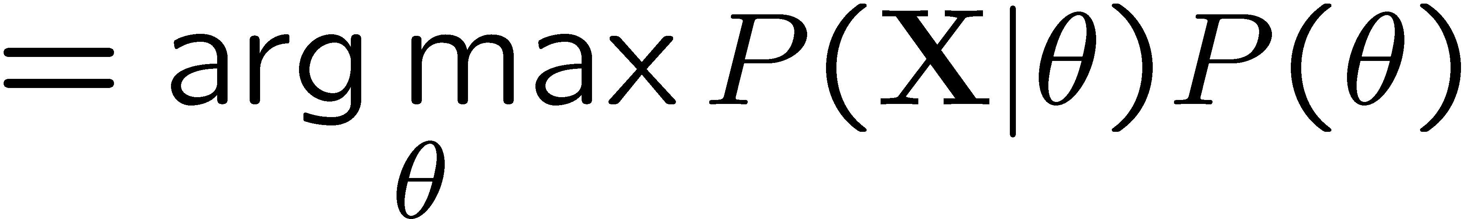
Maximum Likelihood
Maximum Likelihood Estimation (MLE) and Maximum A Posteriori (MAP), are both a method for estimating some variable in the setting of probability distributions or graphical models.
Relative frequencies are the maximum likelihood estimates for a given data set
Another option is to consider the most likely parameter value given the data
We need a prior for the distribution (this is a good way to inject domain knowledge)

Slide 34

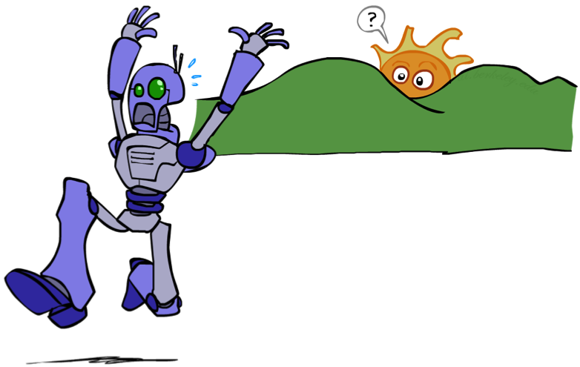
Assuming Unseen Trianing Events

Slide 35
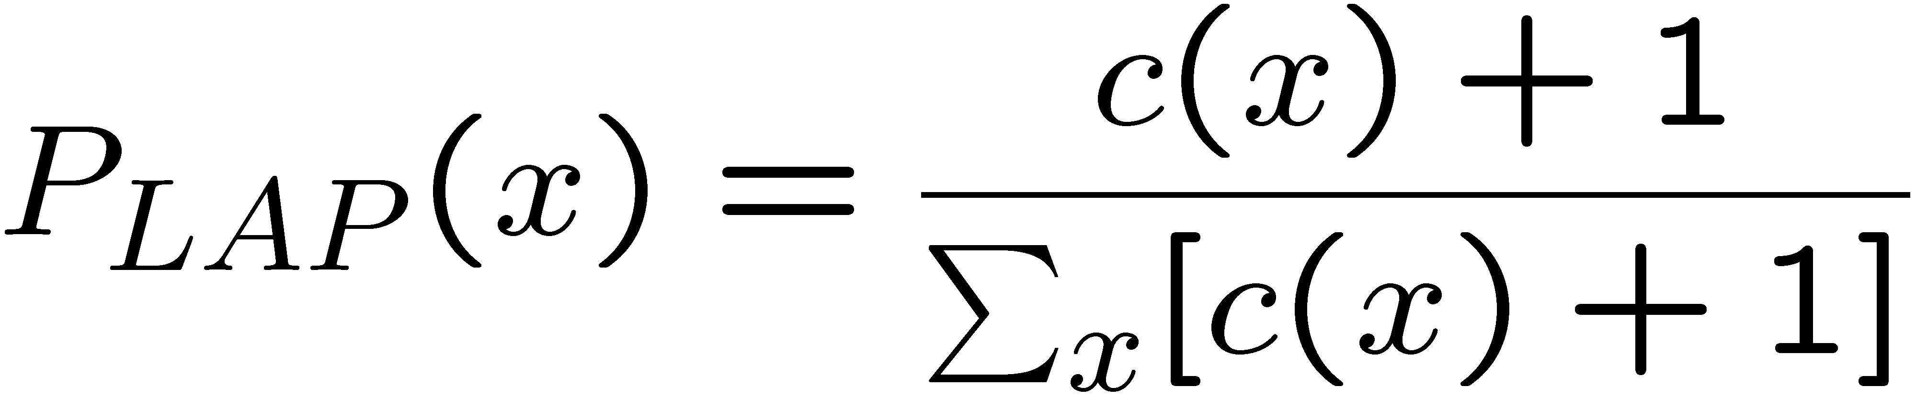
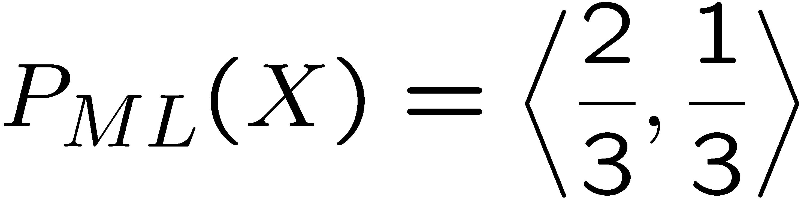
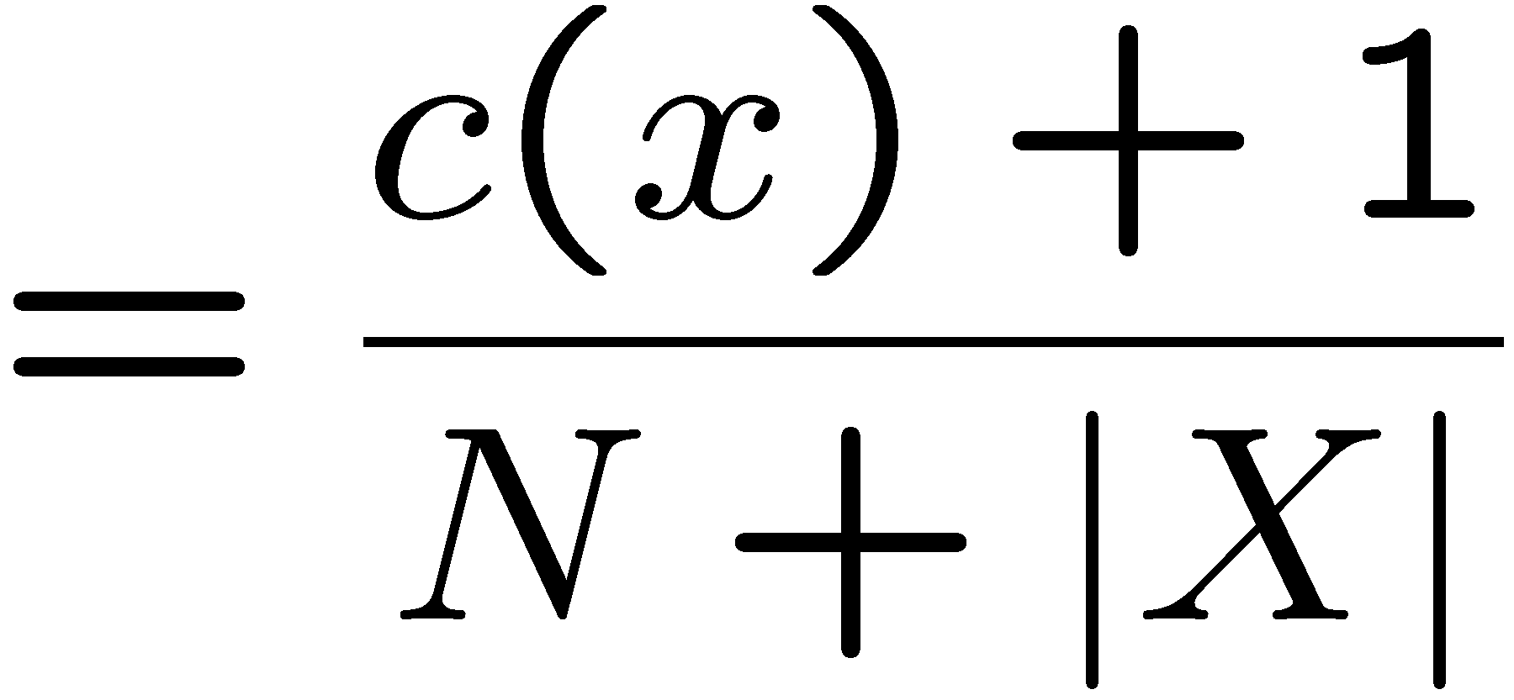
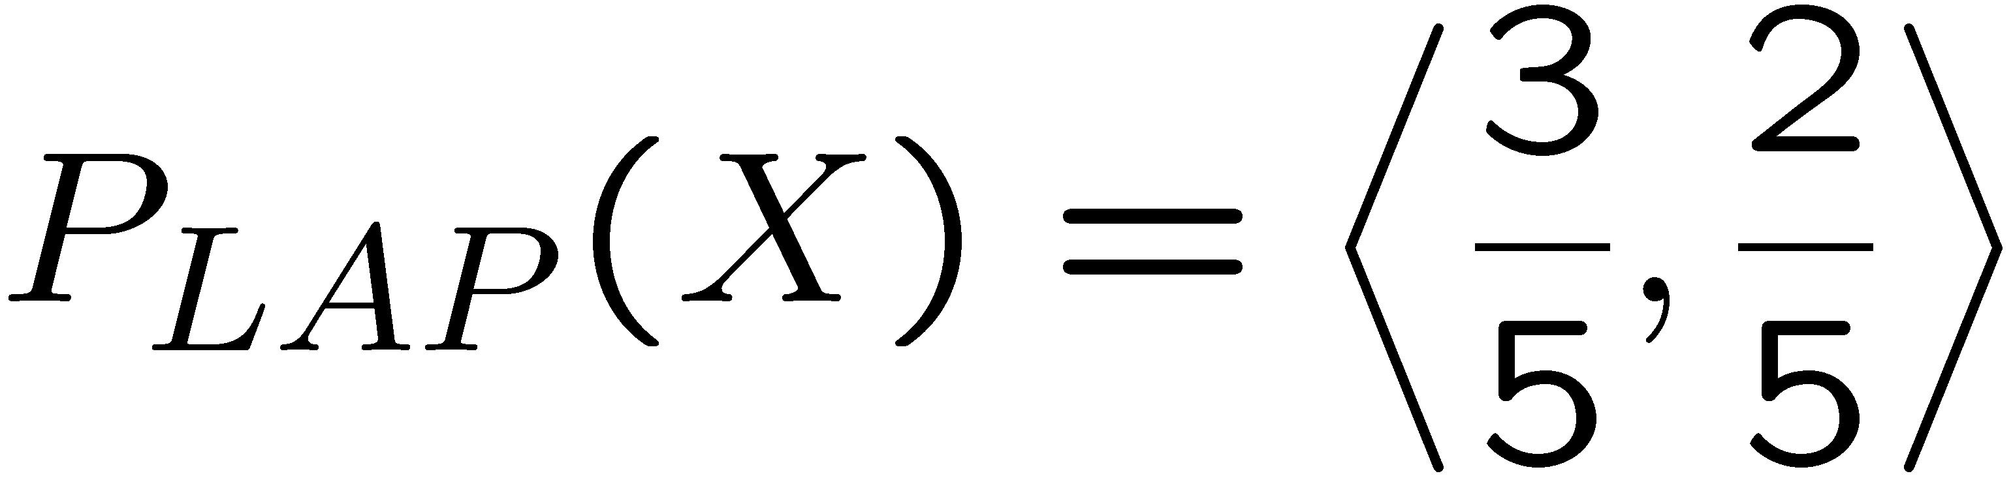
Laplace Smoothing
Estimate the probability of drawing ‘red’ given 3 observations
Laplace’s estimate:
  Pretend you saw every outcome once more than you actually did
r
r
b

Slide 36
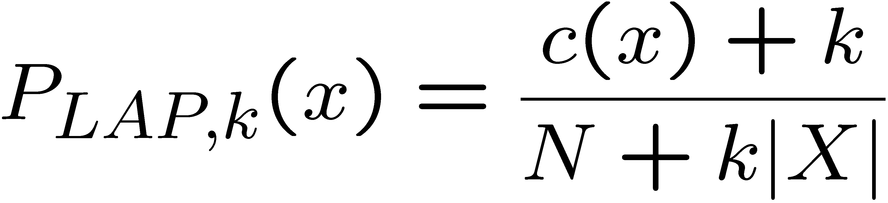
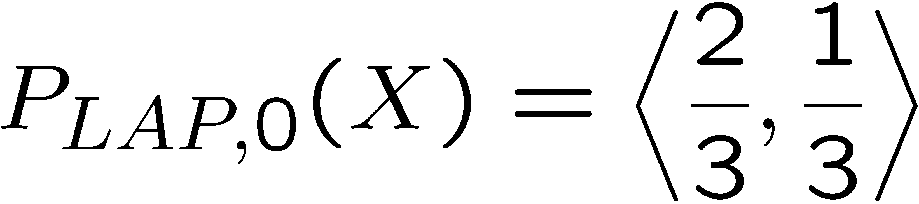
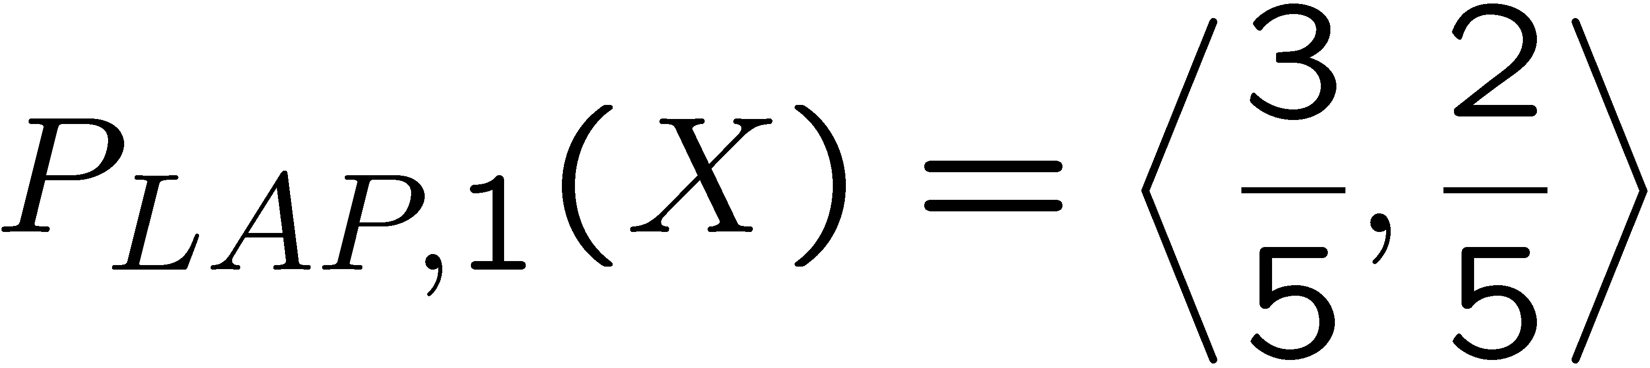
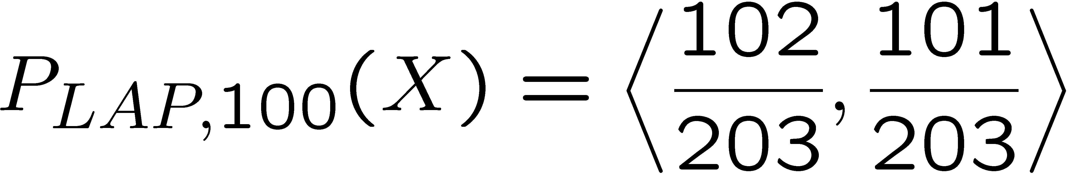
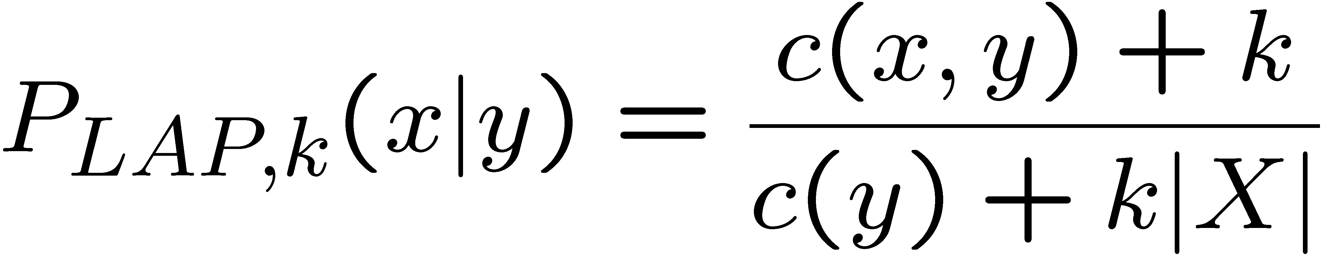

Laplace Smoothing
Laplace’s estimate (extended):
  Pretend you saw every outcome k extra times
  What’s Laplace with k = 0?
  What’s Laplace with k = $∞$?
  k is the strength of the uniformity prior
Laplace for conditionals:
  Smooth each condition independently:
r
r
b

Slide 37
Estimation: Linear Interpolation*
In practice, Laplace often performs poorly for P(X|Y):
  When |X| is very large
  When |Y| is very large
Another option: linear interpolation
  Also get the empirical P(X) from the data
  Make sure the estimate of P(X|Y) isn’t too different from the empirical P(X)
  What if α is 0? 1?

Slide 38
Real NB: Smoothing
For real classification problems, smoothing is critical
New odds ratios:
helvetica : 11.4
seems : 10.8
group : 10.2
ago : 8.4
areas : 8.3
...
verdana : 28.8
Credit : 28.4
ORDER : 27.2
<FONT> : 26.9
money : 26.5
...
Do these make more sense?

Slide 39

Hyperparameter Tuning (e.g., k in LAP)

Slide 40








Tuning on Held-Out Data
Now we’ve got two kinds of unknowns
  Parameters: the probabilities P(X|Y), P(Y)
  Hyperparameters: e.g. the amount / type of smoothing to do, k, α
What should we learn where?
  Learn parameters from training data
  Tune hyperparameters on different data
    Why?
  For each value of the hyperparameters, train and test on the held-out data
  Choose the best value and do a final test on the test data

Slide 41
Errors, and What to Do
ML engineers commonly analyze and address prediction errors
Dear GlobalSCAPE Customer,
GlobalSCAPE has partnered with ScanSoft to offer you the latest version of OmniPage Pro, for just $99.99* - the regular list price is $499! The most common question we've received about this offer is - Is this genuine? We would like to assure you that this offer is authorized by ScanSoft, is genuine and valid. You can get the . . .
. . . To receive your $30 Amazon.com promotional certificate, click through to
http://www.amazon.com/apparel
and see the prominent link for the $30 offer. All details are there. We hope you enjoyed receiving this message. However, if you'd rather not receive future e-mails announcing new store launches, please click . . .

Slide 42

Add Features for Addressing Prediction Errors

Slide 43

Spam detector example
Need more features– words aren’t enough!
  Have you emailed the sender before?
  Have 1K other people just gotten the same email?
  Is the sending information consistent?
  Is the email in ALL CAPS?
  Do inline URLs point where they say they point?
  Does the email address you by (your) name?
Can add these information sources as new variables in the NB model
Next class we’ll talk about classifiers which let you add arbitrary features more easily, and, later, how to induce new features

Slide 44
Baselines
First step: get a baseline
  Baselines are very simple “straw man” procedures
  Help determine how hard the task is
  Help know what a “good” accuracy is
Weak baseline: most frequent label classifier
  Gives all test instances whatever label was most common in the training set
  E.g. for spam filtering, might label everything as ham
  Accuracy might be very high if the problem is skewed
  E.g. calling everything “ham” gets 66%, so a classifier that gets 70% isn’t very good…
For real research, usually use previous work as a (strong) baseline

Slide 45


Confidences from a Classifier
The confidence of a probabilistic classifier:
  Posterior probability of the top label
  Represents how sure the classifier is of the classification
  Any probabilistic model will have confidences
  No guarantee confidence is correct
Calibration
  Weak calibration: higher confidences mean higher accuracy
  Strong calibration: confidence predicts accuracy rate
  What’s the value of calibrating confidence?
Image: Ulas Bagci

Slide 46
Summary
Bayes rule allows for diagnostic queries from causal probabilities
The naïve Bayes assumption: all features are independent given the class label
We can build classifiers out of a naïve Bayes model using training data
Smoothing estimates is important in real-world systems
Classifier confidences are useful, when you can calibrate them

