Slide 1

CSCE-420: Artificial Intelligence
HMMs, Particle Filters, and Applications
Instructor: Guni Sharon
Based on slides by: Pieter Abbeel, Dan Klein

Slide 2
Announcements
Quiz 10 - HMM, due Monday Apr 16, EoD
Assignment 4 – Bayes Nets and HMMs, due April 21, EoD

Slide 3



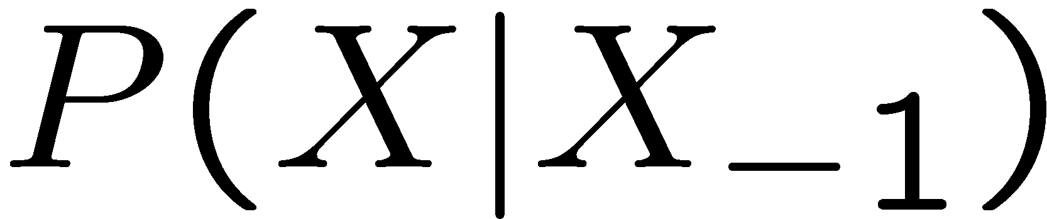

Recap: Reasoning Over Time
Markov models
Hidden Markov models
0.3
0.7
X₁
X₂
X₃
X₄
rain
sun
0.7
0.3
X₁
X₂
X₃
X₄
X₅
X | E | P
rain | umbrella | 0.9
rain | no umbrella | 0.1
sun | umbrella | 0.2
sun | no umbrella | 0.8
E₁
E₂
E₃
E₄
E₅

Slide 4
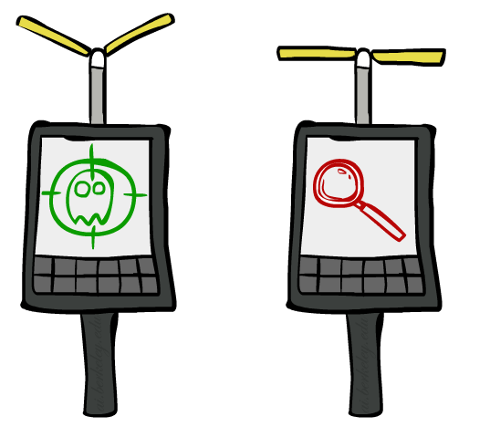



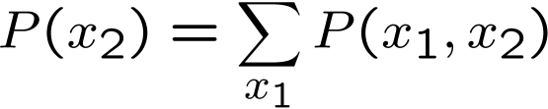

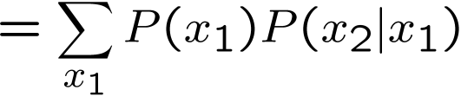

Inference: Base Cases
X₁
X₁
X₂
E₁
Conditional probability
Product rule
Product rule

Slide 5


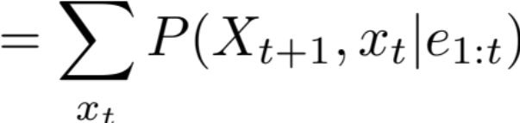
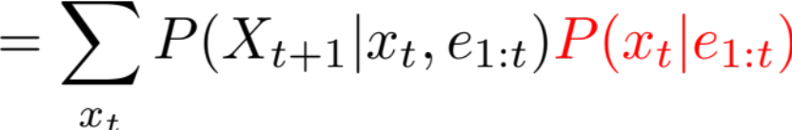
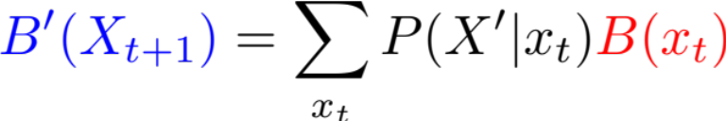
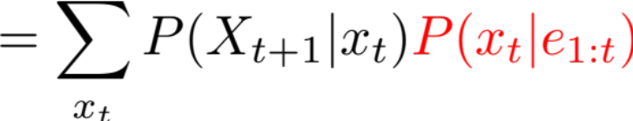

Passage of Time
Assume we have current belief P(X | evidence to date)
Then, after one time step passes:
Basic idea: beliefs get “pushed” through the transitions
  With the “B” notation, we have to be careful about what time step t the belief is about, and what evidence it includes
X₁
X₂
Chain rule
Or compactly:
$$X_{t+1} e_{1:t} | x_{t}$$
Notes:
TODO: intermediate step in derivation!

Slide 6
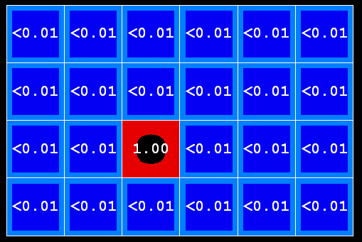
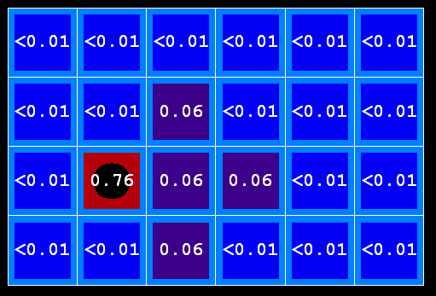
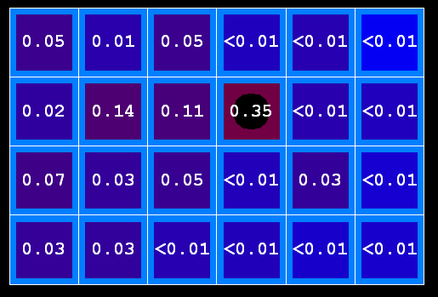

Example: Passage of Time
As time passes, uncertainty “accumulates”
(Transition model: ghosts usually go clockwise)
T = 1
T = 2
T = 5

Slide 7




Observation
X₁
Assume we have current belief P(X | previous evidence):
Then, after evidence comes in:
Or, compactly:
E₁
Conditional probability
Chain rule
$$e_{t+1} e_{1:t} | X_{t+1}$$
Basic idea: beliefs “reweighted” by likelihood of evidence
Unlike passage of time, we have to renormalize
Notes:
Basic idea: beliefs “reweighted” by likelihood of evidence
Unlike passage of time, we have to renormalize

Slide 8
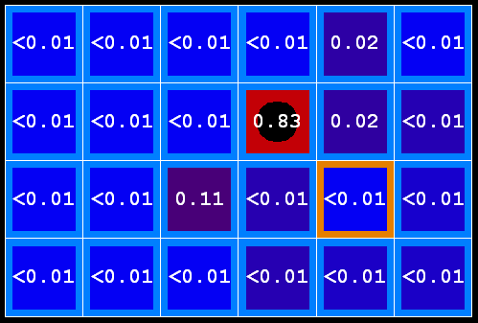



Example: Observation
As we get observations, beliefs get reweighted, uncertainty “decreases”
Before observation
After observation

Slide 9
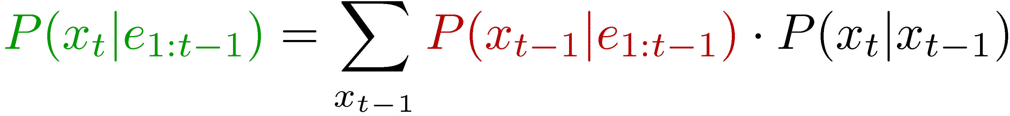


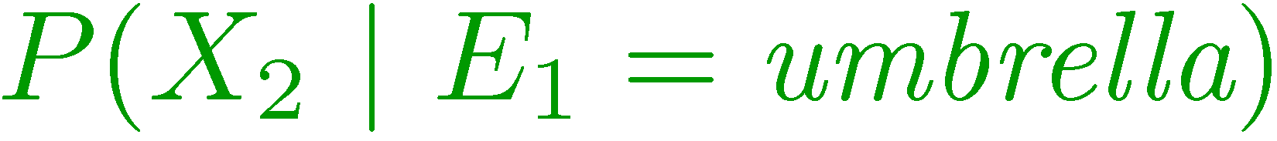
Probability tracking (filtering)
Elapse time: compute P( X_{t} | e_{1:t-1} )
Observe: compute P( X_{t} | e_{1:t} )
Belief: <P(rain), P(sun)>
X₁
X₂
<0.5, 0.5>
Prior on X₁
<0.82, 0.18>
Observe
E₁
E₂
<0.63, 0.37>
Elapse time
<0.88, 0.12>
Observe

Slide 10
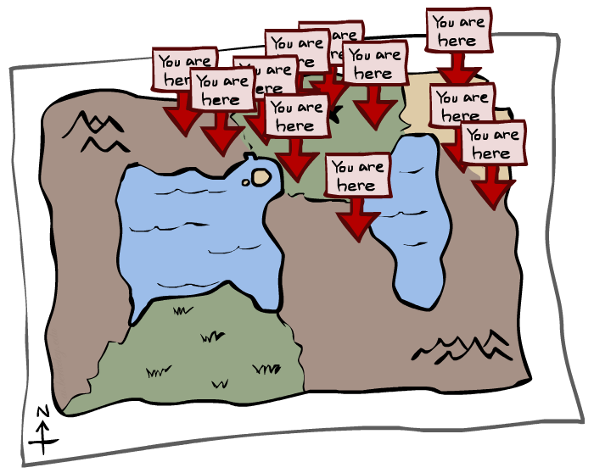
Particle Filtering

Slide 11
Particle Filtering
Filtering: approximate solution
Sometimes |X| is too big to use exact inference
  |X| may be too big to even store B(X)
  E.g. X is continuous
Solution: approximate inference
  Track samples of X, not all values
  Samples are called particles
  Time per step is linear in the number of samples
  But: number needed may be large
  In memory: list of particles, not states
This is how robot localization works in practice
Particle is just new name for sample
0.0
0.1
0.0
0.0
0.0
0.2
0.0
0.2
0.5

Slide 12
Representation: Particles
Our representation of P(X) is now a list of N particles (samples)
  Generally, N << |X|
  Storing map from X to counts would defeat the point
P(x) approximated by ratio of particles with value x
  So, many x may have P(x) = 0!
  More particles, more accuracy
For now, all particles have a weight of 1
Particles:
(3,3)
(2,3)
(3,3)
(3,2)
(3,3)
(3,2)
(1,2)
(3,3)
(3,3)
(2,3)

Slide 13

Particle Filtering: Elapse Time
Each particle is moved by sampling its next position from the transition model
  This is like prior sampling – samples’ frequencies reflect the transition probabilities
  Here, most samples move clockwise, but some move in another direction or stay in place
This captures the passage of time
  If enough samples, close to exact values before and after (consistent)
Particles:
(3,3)
(2,3)
(3,3)
(3,2)
(3,3)
(3,2)
(1,2)
(3,3)
(3,3)
(2,3)
Particles:
(3,2)
(2,3)
(3,2)
(3,1)
(3,3)
(3,2)
(1,3)
(2,3)
(3,2)
(2,2)

Slide 14


Particle Filtering: Observe
Particles:
(3,2)
(2,3)
(3,2)
(3,1)
(3,3)
(3,2)
(1,3)
(2,3)
(3,2)
(2,2)
Slightly trickier:
  Don’t sample observation, fix it
  Similar to likelihood weighting, downweight samples based on the evidence
  As before, the probabilities don’t sum to one, since all have been downweighted (in fact they now sum to (N times) an approximation of P(e))
Particles:
(3,2) w=.9
(2,3) w=.2
(3,2) w=.9
(3,1) w=.4
(3,3) w=.4
(3,2) w=.9
(1,3) w=.1
(2,3) w=.2
(3,2) w=.9
(2,2) w=.4

Slide 15
Particle Filtering: Resample
Rather than tracking weighted samples, we resample
N times, we choose from our weighted sample distribution (i.e. draw with replacement)
This is equivalent to renormalizing the distribution
Now the update is complete for this time step, continue with the next one
Particles:
(3,2) w=.9
(2,3) w=.2
(3,2) w=.9
(3,1) w=.4
(3,3) w=.4
(3,2) w=.9
(1,3) w=.1
(2,3) w=.2
(3,2) w=.9
(2,2) w=.4
(New) Particles:
(3,2)
(2,2)
(3,2)
(2,3)
(3,3)
(3,2)
(1,3)
(2,3)
(3,2)
(3,2)

Slide 16
Recap: Particle Filtering
Particles: track samples of states rather than an explicit distribution
Elapse
Weight
Resample
Particles:
(3,3)
(2,3)
(3,3)
(3,2)
(3,3)
(3,2)
(1,2)
(3,3)
(3,3)
(2,3)
Particles:
(3,2)
(2,3)
(3,2)
(3,1)
(3,3)
(3,2)
(1,3)
(2,3)
(3,2)
(2,2)
Particles:
(3,2) w=.9
(2,3) w=.2
(3,2) w=.9
(3,1) w=.4
(3,3) w=.4
(3,2) w=.9
(1,3) w=.1
(2,3) w=.2
(3,2) w=.9
(2,2) w=.4
(New) Particles:
(3,2)
(2,2)
(3,2)
(2,3)
(3,3)
(3,2)
(1,3)
(2,3)
(3,2)
(3,2)

Slide 17

Video of Demo – Moderate Number of Particles

Slide 18
Video of Demo – One Particle

Slide 19
Video of Demo – Huge Number of Particles

Slide 20
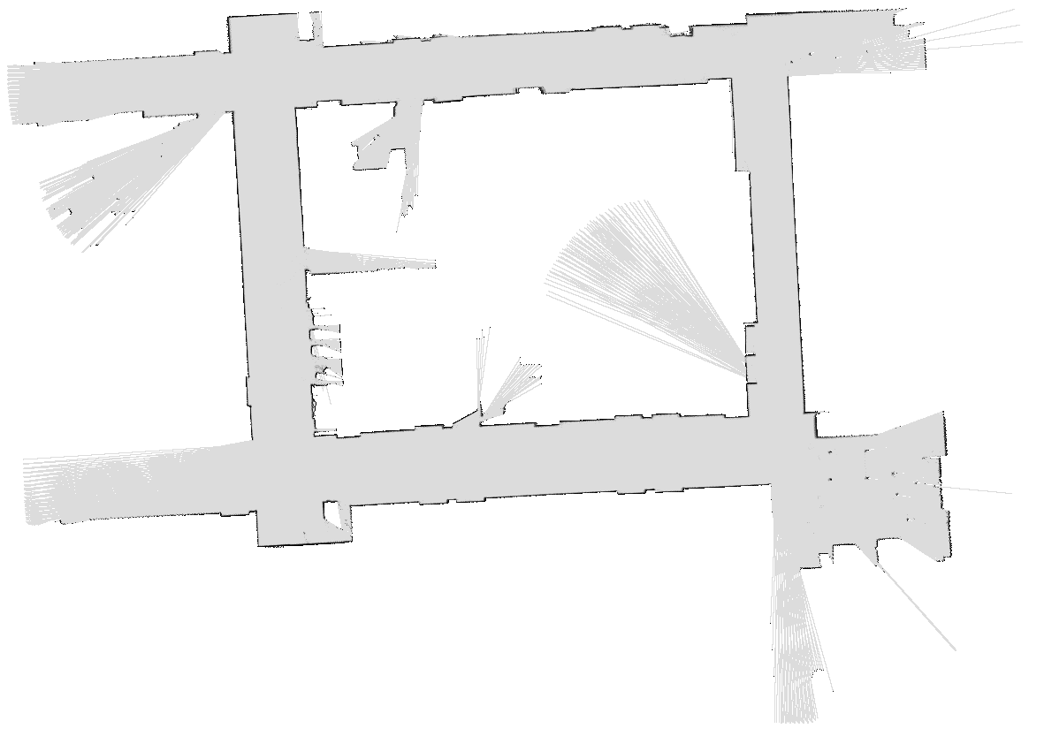
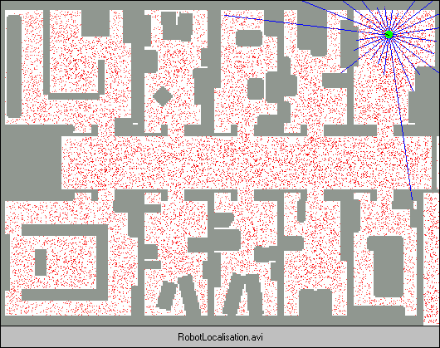

More Demos!

Slide 21
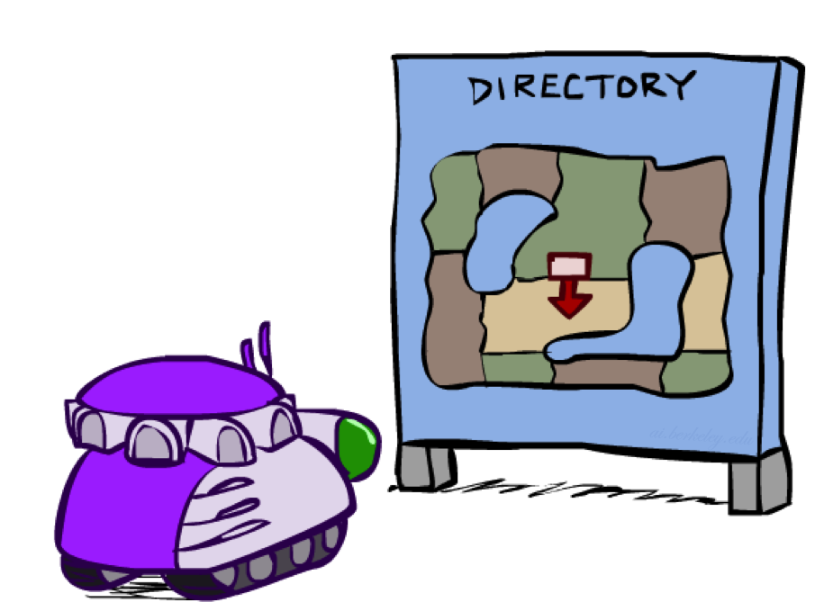
Robot Localization
In robot localization:
  We know the map, but not the robot’s position
  Observations may be vectors of range finder readings
  State space and readings are typically continuous (works basically like a very fine grid) and so we cannot store B(X)
  Particle filtering is a main technique

Slide 22

Particle Filter Localization (Sonar)
[Video: global-sonar-uw-annotated.avi]

Slide 23
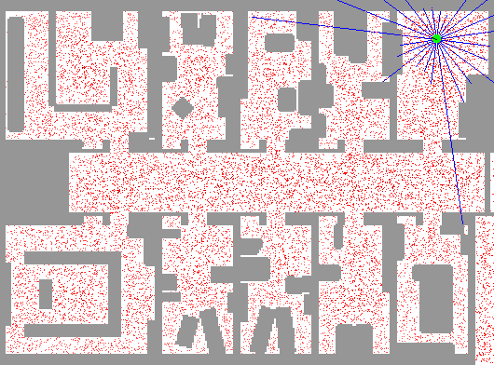
Particle Filter Localization (Laser)
[Video: global-floor.gif]

Slide 24

Robot Mapping
SLAM: Simultaneous Localization And Mapping
  We do not know the map or our location
  State consists of position AND map!
  Main techniques: Kalman filtering (Gaussian HMMs) and particle methods
DP-SLAM, Ron Parr
[Demo: PARTICLES-SLAM-mapping1-new.avi]

Slide 25

Particle Filter SLAM – Video 1
[Demo: PARTICLES-SLAM-mapping1-new.avi]

Slide 26

Particle Filter SLAM – Video 2
[Demo: PARTICLES-SLAM-fastslam.avi]

Slide 27
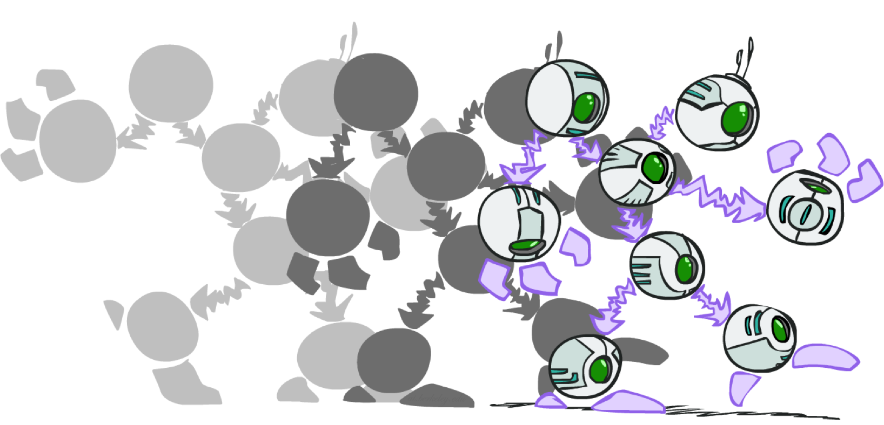
Dynamic Bayes Nets

Slide 28
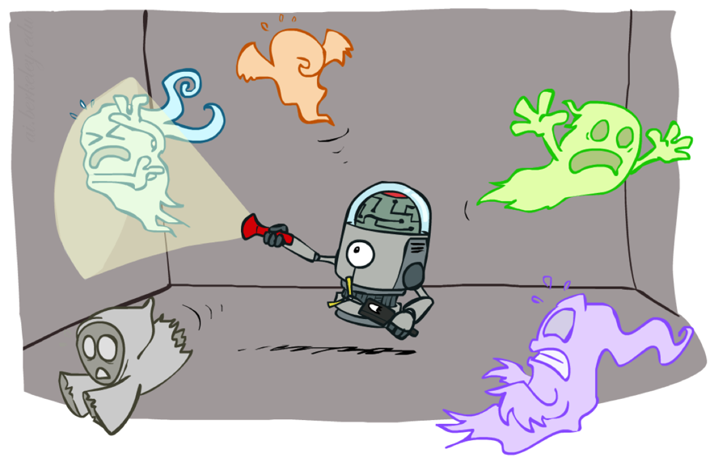
Dynamic Bayes Nets (DBNs)
A Bayesian network which relates variables to each other over adjacent time steps
We want to track multiple variables over time, using multiple sources of evidence
Variables from time t can condition on those from t-1
Dynamic Bayes nets are a generalization of HMMs
t =1
t =2
t =3
G₁ª
G₂ª
G₃ª
G₁^{b}
G₂^{b}
G₃^{b}
E₁ª
E₁^{b}
E₂ª
E₂^{b}
E₃ª
E₃^{b}
[Demo: pacman sonar ghost DBN model (L15D6)]

Slide 29
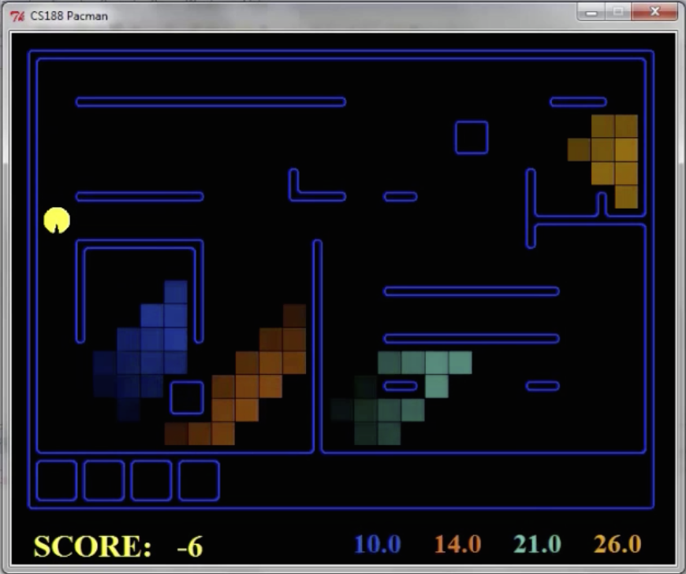
Pacman – Sonar (P4)
[Demo: Pacman – Sonar – No Beliefs(L14D1)]

Slide 30
Video of Demo Pacman Sonar Ghost DBN Model

Slide 31
Exact Inference in DBNs
Variable elimination applies to dynamic Bayes nets
Procedure: “unroll” the network for T time steps, then eliminate variables until P(X_{T}|e_{1:T}) is computed
Online belief updates: Eliminate all variables from the previous time step; store factors for current time only
t =1
t =2
t =3
G₁ª
G₂ª
G₃ª
G₃^{b}
G₁^{b}
G₂^{b}
G₃^{b}
E₁ª
E₁^{b}
E₂ª
E₂^{b}
E₃ª
E₃^{b}

Slide 32
DBN Particle Filters
A particle is a complete sample for a time step
Initialize: Generate prior samples for the t=1 Bayes net
  Example particle: G₁ª = (3,3) G₁^{b} = (5,3)
Elapse time: Sample a successor for each particle
  Example successor: G₂ª = (2,3) G₂^{b} = (6,3)
Observe: Weight each entire sample by the likelihood of the evidence conditioned on the sample
  Likelihood: P(E₁ª |G₁ª ) * P(E₁^{b} |G₁^{b} )
Resample: Select prior samples (tuples of values) in proportion to their likelihood
Notes:
Dan has a demo here.

Slide 33
What did we learn?
Exact inference is not feasible in large/continuous state spaces
Particle filtering is a practical approximation technique
  Too few particle results in inaccurate approximation
  Too many particles results in heavy processing load (though linear complexity)
Dynamic Bayes Nets are helpful in representing complex correlations between variables and evidence (observations)
  Relevant in multivariable multi-observation scenarios
Particle filtering can be applied where each particle is a complete state (all variables) assignment

Slide 34
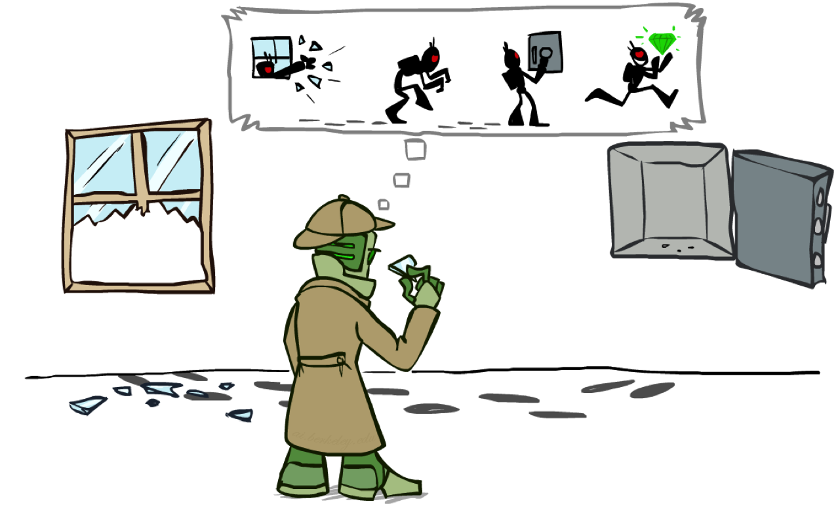
Most Likely Explanation

Slide 35

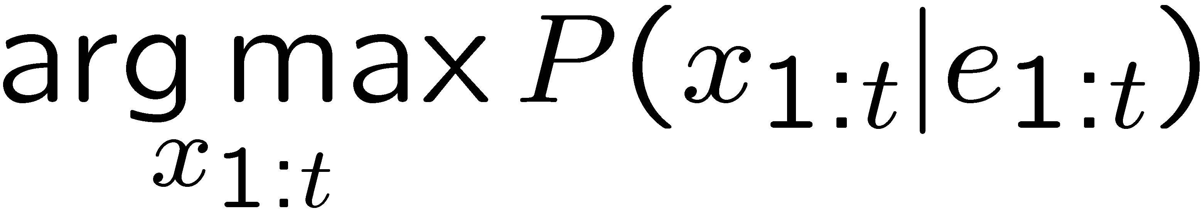
HMMs: MLE Queries
HMMs defined by
  States X
  Observations E
  Initial distribution:
  Transitions:
  Emissions:
New query: most likely explanation:
New method: the Viterbi algorithm
X₁
X₂
X₃
X₄
X₅
E₁
E₂
E₃
E₄
E₅

Slide 36

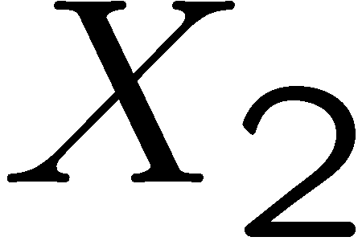

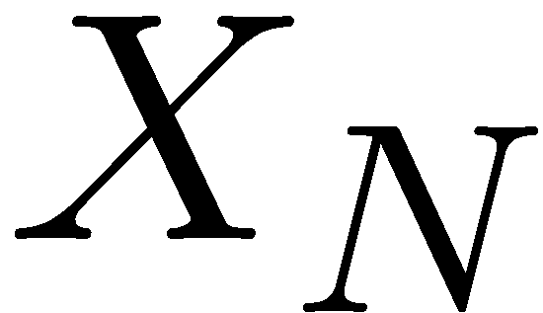

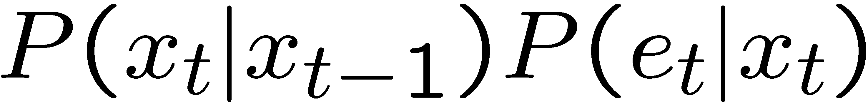
State Trellis
State trellis: graph of states and transitions over time
Each arc represents some transition
Each arc has weight
Each path is a sequence of states
The product of weights on a path is that sequence’s probability along with the evidence
Forward algorithm computes sums of paths, Viterbi computes best paths
sun
sun
sun
sun
rain
rain
rain
rain

Slide 37

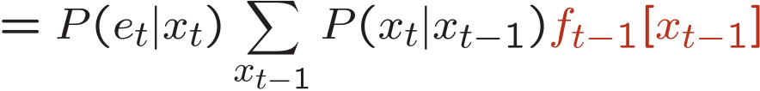
Forward / Viterbi Algorithms
sun
sun
sun
sun
rain
rain
rain
rain
Forward Algorithm (Sum)
Viterbi Algorithm (Max)

Slide 39

Speech Recognition

Slide 40

Speech Recognition in Action
[Video: NLP – ASR tvsample.avi (from Lecture 1)]

Slide 41

Digitizing Speech

Slide 42
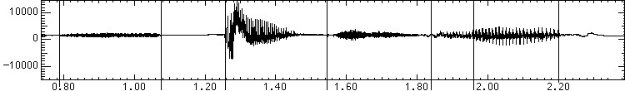

Speech in an Hour
Speech input is an acoustic waveform
s p ee ch l a b
“l” to “a”
transition:
Figure: Simon Arnfield, http://www.psyc.leeds.ac.uk/research/cogn/speech/tutorial/

Slide 43
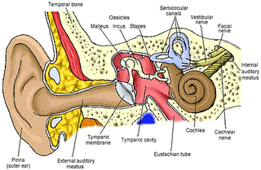
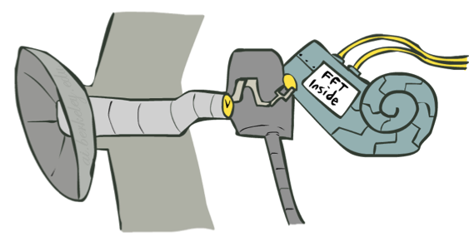
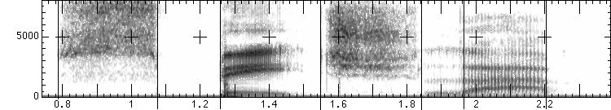
Spectral Analysis
Frequency gives pitch; amplitude gives volume
  Sampling at ~8 kHz (phone), ~16 kHz (mic) (kHz=1000 cycles/sec)
Fourier transform of wave displayed as a spectrogram
  Darkness indicates energy at each frequency
s p ee ch l a b
amplitude
frequency
Human ear figure: depion.blogspot.com

Slide 44
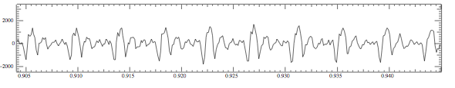
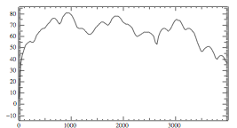
Part of [ae] from “lab”
Complex wave repeating nine times
  Plus smaller wave that repeats 4x for every large cycle
  Large wave: freq of 250 Hz (9 times in .036 seconds)
  Small wave roughly 4 times this, or roughly 1000 Hz

Slide 45
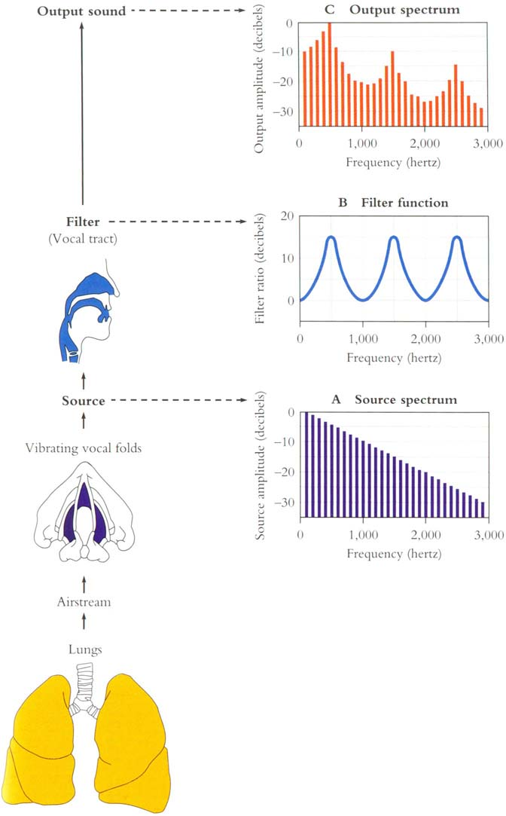
Why These Peaks?
Articulator process:
  Vocal cord vibrations create harmonics
  The mouth is an amplifier
  Depending on shape of mouth, some harmonics are amplified more than others

Slide 46
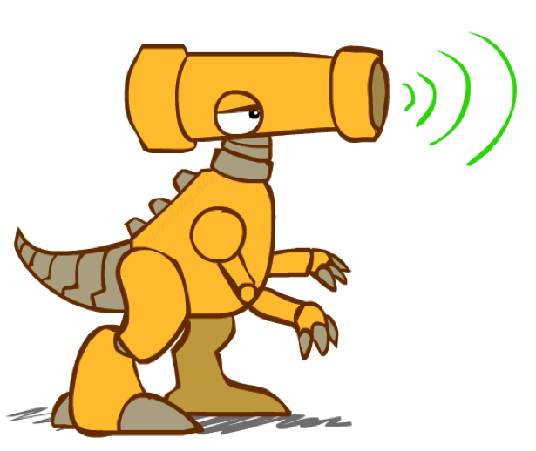
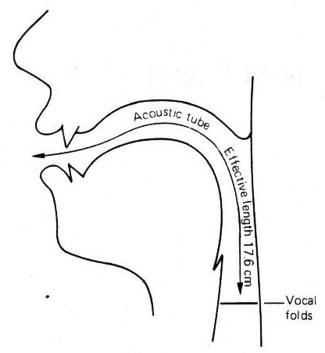
Resonances of the Vocal Tract
The human vocal tract as an open tube
Air in a tube of a given length will tend to vibrate at resonance frequency of tube
Constraint: Pressure differential should be maximal at (closed) glottal end and minimal at (open) lip end
Closed end
Open end
Length 17.5 cm.
Figure: W. Barry Speech Science slides

Slide 47
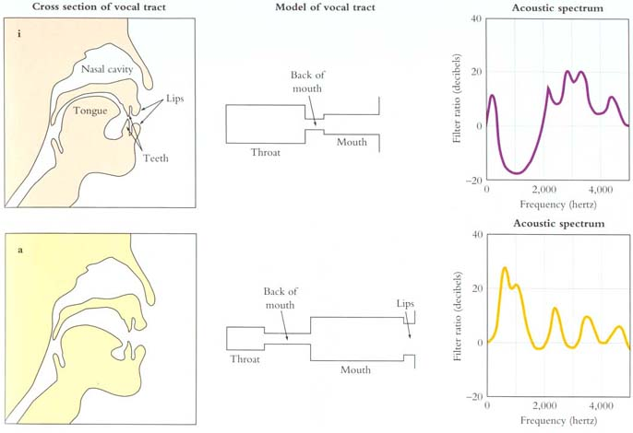
Spectrum Shapes
Figure: Mark Liberman
[Demo: speech synthesis ]

Slide 48
Video of Demo Speech Synthesis

Slide 49
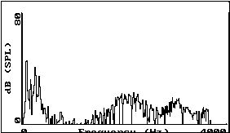
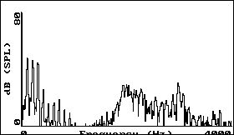
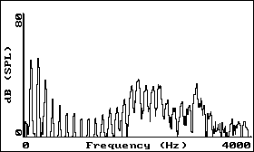
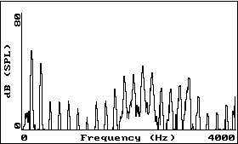
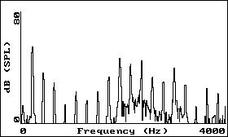
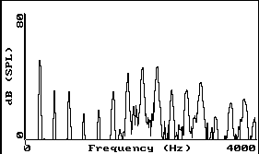
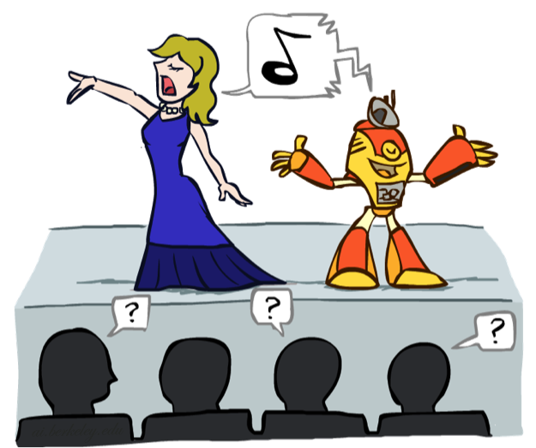
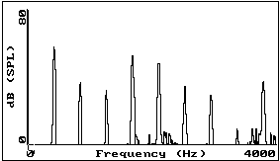
Vowel [i] sung at successively higher pitches
F#2
A2
C3
F#3
A3
C4 (middle C)
A4
Graphs: Ratree Wayland

Slide 50
Acoustic Feature Sequence
Time slices are translated into acoustic feature vectors (~39 real numbers per slice)
These are the observations E, now we need the hidden states X
frequency
……………………………………………..e₁₂e₁₃e₁₄e₁₅e₁₆………..

Slide 51
Speech State Space
HMM Specification
  P(E|X) encodes which acoustic vectors are appropriate for each phoneme (each kind of sound)
  P(X|X’) encodes how sounds can be strung together
State Space
  We will have one state for each sound in each word
  Mostly, states advance sound by sound
  Build a little state graph for each word and chain them together to form the state space X

Slide 52
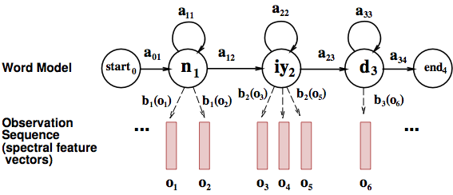
States in a Word

Slide 53
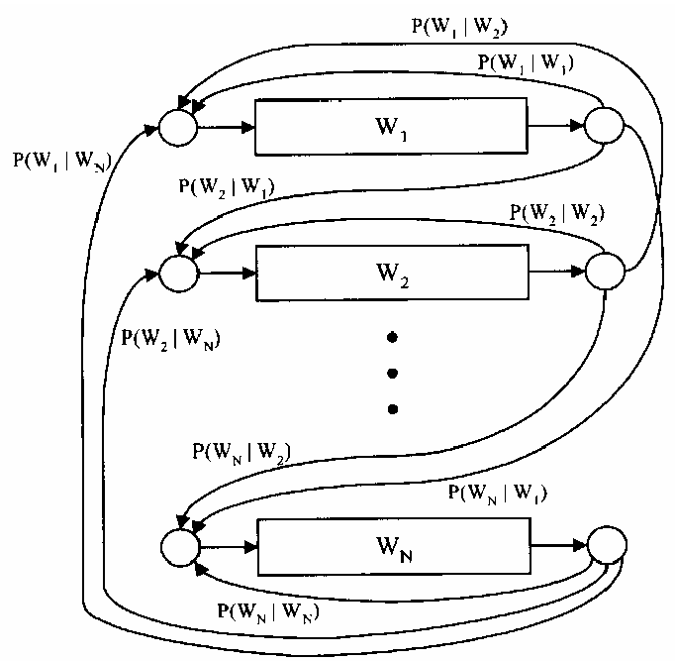
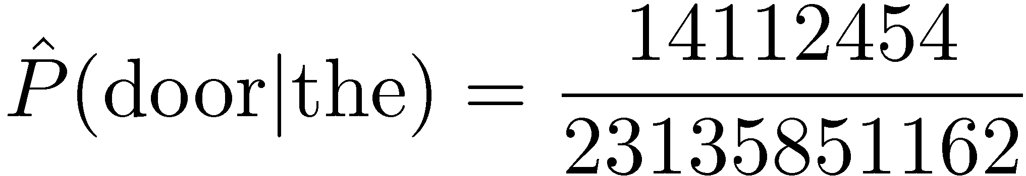

Transitions with a Bigram Model
198015222 the first
194623024 the same
168504105 the following
158562063 the world
…
14112454 the door
-----------------------------------
23135851162 the *
Training Counts
Figure: Huang et al, p. 618

Slide 54
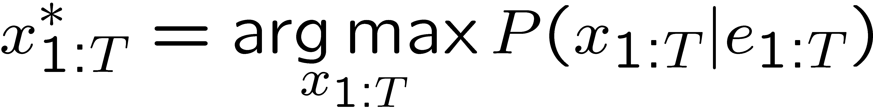


Decoding
Finding the words given the acoustics is an HMM inference problem
Which state sequence x_{1:T} is most likely given the evidence e_{1:T}?
From the sequence x, we can simply read off the words

Slide 55

AI in the News
I Know Why You Went to the Clinic: Risks and Realization of HTTPS Traffic Analysis
Brad Miller, Ling Huang, A. D. Joseph, J. D. Tygar (UC Berkeley)

Slide 56
Challenge
Setting
  User we want to spy on use HTTPS to browse the internet
Measurements
  IP address
  Sizes of packets coming in
Goal
  Infer browsing sequence of that user
E.g.: medical, financial, legal, …

Slide 57
HMM
Transition model
  Probability distribution over links on the current page + some probability to navigate to any other page on the site
Noisy observation model due to traffic variations
  Caching
  Dynamically generated content
  User-specific content, including cookies
  → Probability distribution P( packet size | page )

Slide 58

Results
BoG = described approach, others are prior work

Slide 59

Results

