Slide 1
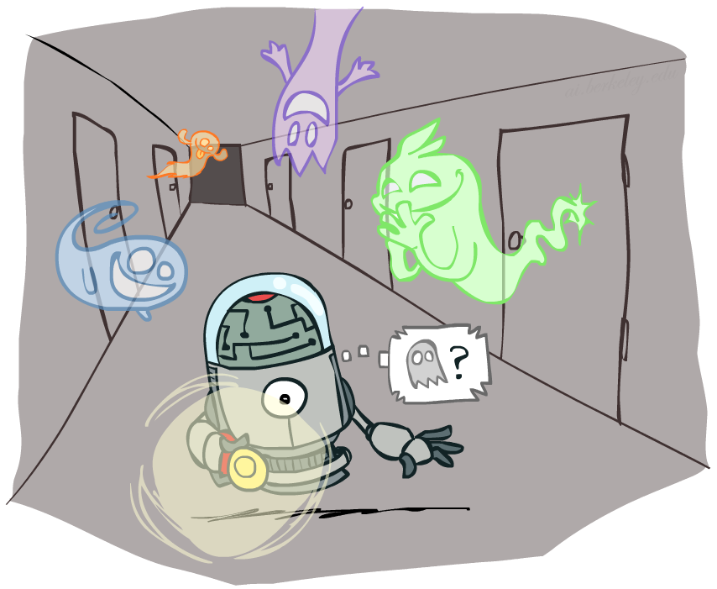
CSCE-420: Artificial Intelligence
Hidden Markov Models
Instructor: Guni Sharon
Based on slides by: Pieter Abbeel, Dan Klein

Slide 2
Announcements
Quiz 9 - Decision networks, due April 9, EoD
Quiz 10 - HMM, due Monday Apr 16, EoD

Slide 3
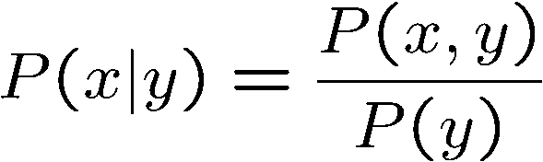

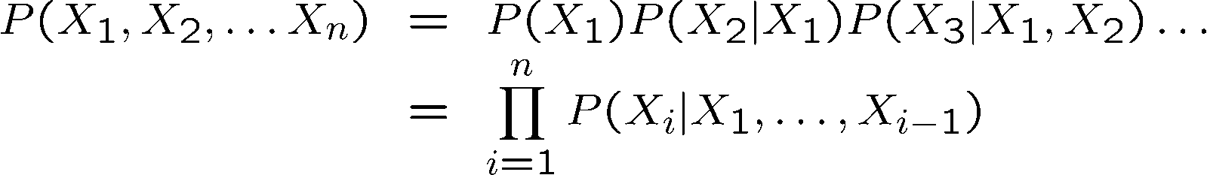

Probability Recap
Conditional probability
Product rule
Chain rule
X, Y independent if and only if:
X and Y are conditionally independent given Z if and only if:

Slide 4
Reasoning over Time or Space
Often, we want to reason about a sequence of observations
  Speech recognition
  Robot localization
  User attention
  Medical monitoring
Need to introduce time (or space) into our models

Slide 5
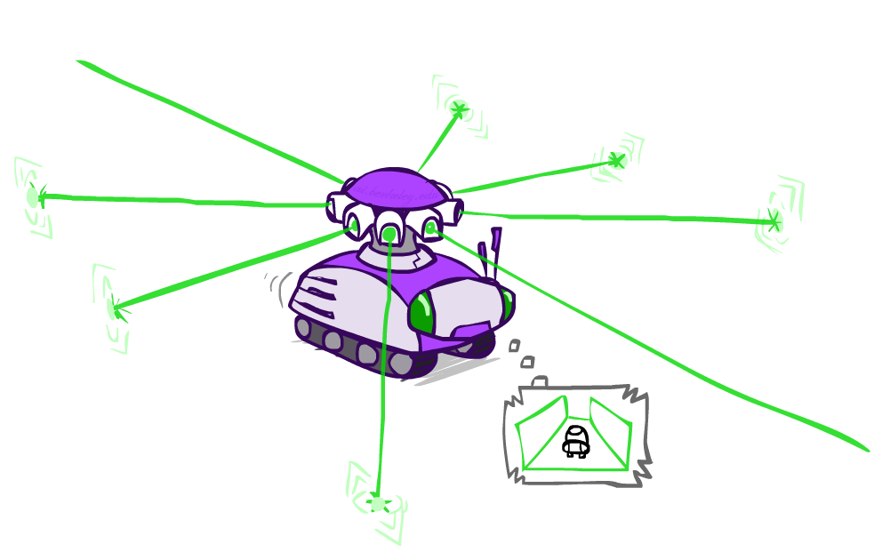
Example: Robot Localization
Prob
0
1
t=0
Sensor model: can read in which directions there is a wall, never more than 1 mistake
Motion model: may not execute action with small prob.
Example from Michael Pfeiffer

Slide 6
Example: Robot Localization
Prob
0
1
t=1
Lighter grey: was possible to get the reading, but less likely b/c required 1 mistake

Slide 7
Example: Robot Localization
Prob
0
1
t=2

Slide 8
Example: Robot Localization
Prob
0
1
t=3

Slide 9
Example: Robot Localization
Prob
0
1
t=4

Slide 10
Example: Robot Localization
Prob
0
1
t=5

Slide 11


Markov Models
  Value of X at a given time is called the state
  Parameters: called transition probabilities or dynamics, specify how the state evolves over time (also, initial state probabilities)
  Stationarity assumption: transition probabilities are the same at all times
  Same as MDP transition model, but no choice of action
X₁
X₂
X₃
X₄

Slide 12

Conditional Independence
Basic conditional independence:
  Past and future independent given the present
  Each time step only depends on the previous
  This is called the (first order) Markov property
Note that the chain is just a (growable) BN
  We can always use generic BN reasoning on it if we truncate the chain at a fixed length

Slide 13
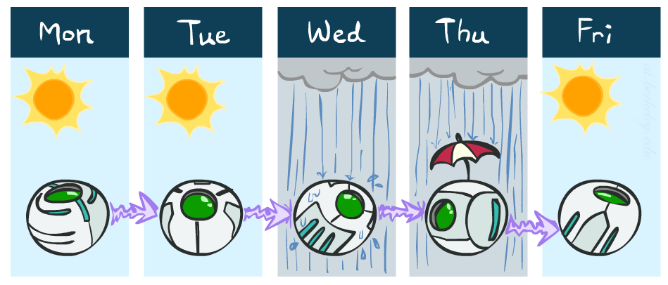
Example Markov Chain: Weather
States: X = {rain, sun}
Initial distribution: 1.0 sun
CPT P(X_{t} | X_{t-1}):
Two new ways of representing the same CPT
X_{t-1} | X_{t} | P(X_{t}|X_{t-1})
sun | sun | 0.9
sun | rain | 0.1
rain | sun | 0.3
rain | rain | 0.7
0.9
0.3
0.9
rain
sun
sun
sun
0.1
0.3
rain
rain
0.7
0.7
0.1

Slide 14
Example Markov Chain: Weather
0.9
Initial distribution: 1.0 sun
What is the probability distribution after one step?
0.3
rain
sun
0.7
0.1

Slide 15
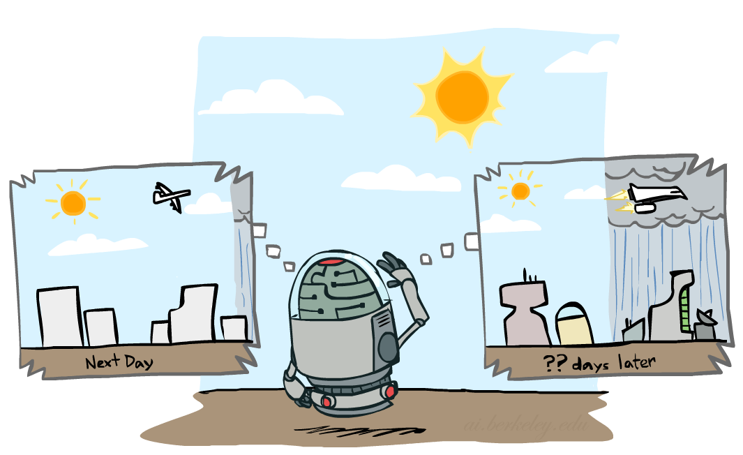


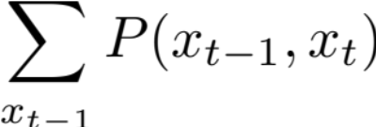
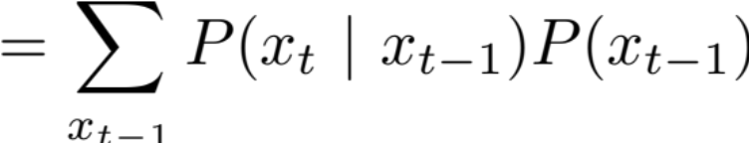
Mini-Forward Algorithm
Question: What’s P(X) on some day t?
X₁
X₂
X₃
X₄
Forward simulation

Slide 16
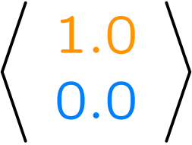
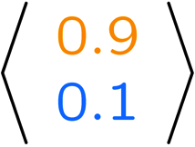
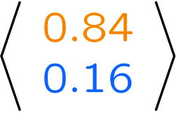
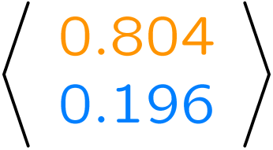
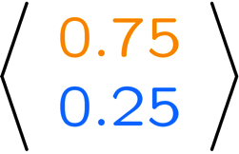
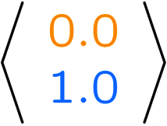
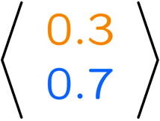
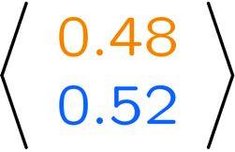
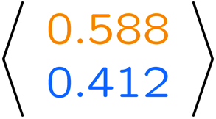
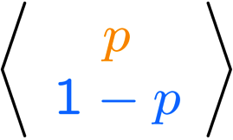
Example Run of Mini-Forward Algorithm
From initial observation of sun
From initial observation of rain
From yet another initial distribution P(X₁):
P(X₁)
P(X₂)
P(X₃)
P(X₄)
P(X∞)
P(X₁)
P(X₂)
P(X₃)
P(X₄)
P(X∞)
…
P(X₁)
P(X∞)

Slide 17

Video of Demo Ghostbusters Basic Dynamics

Slide 18
Video of Demo Ghostbusters Circular Dynamics

Slide 19
Video of Demo Ghostbusters Whirlpool Dynamics

Slide 20


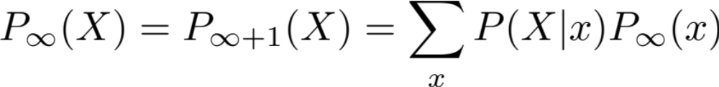
Stationary Distributions
For most chains:
  Influence of the initial distribution gets less and less over time
  The distribution we end up in is independent of the initial distribution
  Can you think of chains that don’t satisfy this probability?
Stationary distribution:
  The distribution we end up with is called the stationary distribution of the chain
  It satisfies

Slide 21
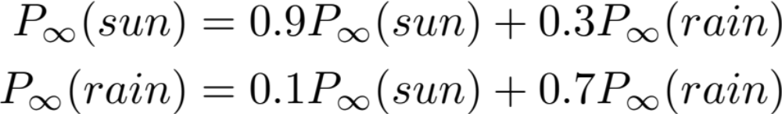
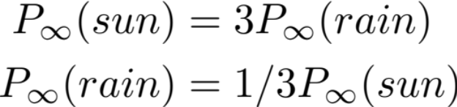
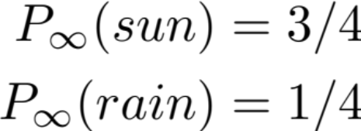
Example: Stationary Distributions
Question: What’s P(X) at time t = infinity?
X₁
X₂
X₃
X₄
X_{t-1} | X_{t} | P(X_{t}|X_{t-1})
sun | sun | 0.9
sun | rain | 0.1
rain | sun | 0.3
rain | rain | 0.7
Also:

Slide 22
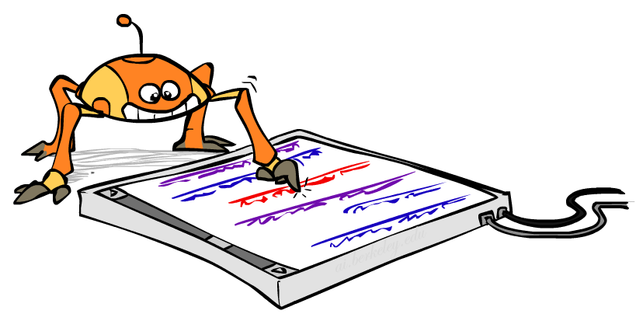
Application of Stationary Distribution: Web Link Analysis
PageRank over a web graph
  Each web page is a state
  Initial distribution: uniform over pages
  Transitions:
    With prob c, uniform jump to a
    random page (dotted lines, not all shown)
    With prob 1-c, follow a random
    outlink (solid lines)
Stationary distribution
  Will spend more time on highly reachable pages
  E.g. many ways to get to the Acrobat Reader download page
  Google 1.0 returned the set of pages containing all your keywords in decreasing rank, now all search engines use link analysis along with many other factors (rank actually getting less important over time)
Notes:
Before: most search engines were merely based on how well a page matches your search words.
Note: currently dominated by clickstreams

Slide 23

Application of Stationary Distributions (Bayesian inference): Gibbs Sampling
Each joint instantiation over all hidden and query variables is a state: {X₁, …, X_{n}}
Transitions:
  With probability 1/n resample variable X_{j} according to
  P(X_{j} | x₁, x₂, …, x_{j-1,} x_{j+1}, …, x_{n,} e_{1,} …, e_{m})
Stationary distribution:
  Conditional distribution P(X₁, X₂ , … , X_{n}|e_{1,} …, e_{m})
  Means that when running Gibbs sampling long enough we get a sample from the desired distribution
  Requires some proof to show this is true!
Notes:
With re-ordering of topics, can’t cover this here yet, need to wait till after sampling.

Slide 24

Hidden Markov Models

Slide 25
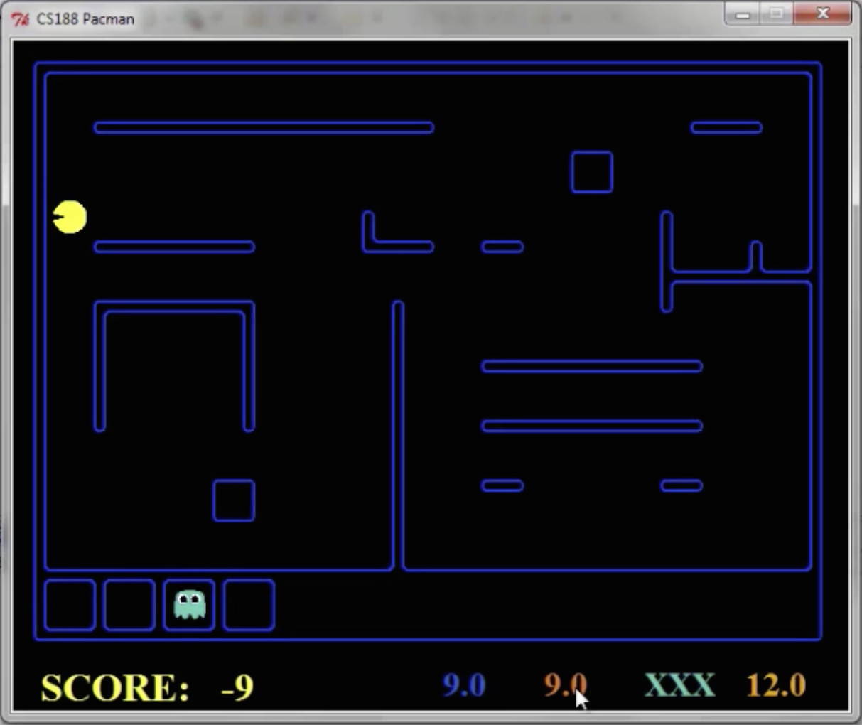
Pacman – Sonar (P4)
[Demo: Pacman – Sonar – No Beliefs(L14D1)]
Notes:
python3 busters.py

Slide 26
Video of Demo Pacman – Sonar (no beliefs)

Slide 27
Hidden Markov Models
Markov chains not so useful for most agents
  Agents should sense and incorporate observations into belief states
Hidden Markov models (HMMs)
  Underlying Markov chain over states X
  You observe outputs (effects) at each time step
X₁
X₂
X₃
X₄
X₅
E₁
E₂
E₃
E₄
E₅

Slide 28
X₁
X₂
X₃
X₄
E₁
E₂
E₃
E₄
X₁
X₂
X₃
X₄
E₁
E₂
E₃
E₄

Slide 29




Example: Weather HMM
Rain_{t-1}
Rain_{t}
Rain_{t+1}
Umbrella_{t-1}
Umbrella_{t}
Umbrella_{t+1}
An HMM is defined by:
  Initial distribution:
  Transitions:
  Emissions:
R_{t-1} | R_{t} | P(R_{t}|R_{t-1})
+r | +r | 0.7
+r | -r | 0.3
-r | +r | 0.3
-r | -r | 0.7
R_{t} | U_{t} | P(U_{t}|R_{t})
+r | +u | 0.9
+r | -u | 0.1
-r | +u | 0.2
-r | -u | 0.8
Notes:
demo

Slide 30


Example: Ghostbusters HMM
P(X₁) = uniform
P(X|X’) = usually move clockwise, but sometimes move in a random direction or stay in place
P(R_{ij}|X) = same sensor model as before:
red means close, green means far away.
1/9
1/9
1/9
1/9
1/9
1/9
1/9
1/9
1/9
P(X₁)
1/6
1/6
1/2
0
1/6
0
X₁
X₂
X₃
X₄
0
0
0
X₅
P(X|X’=<1,2>)
R_{i,j}
R_{i,j}
R_{i,j}
R_{i,j}
Notes:
Dan has some demo for this.

Slide 31
Video of Demo Ghostbusters – Circular Dynamics -- HMM

Slide 32
Conditional Independence
HMMs have two important independence properties:
  Markov hidden process: future depends on past via the present
  Current observation independent of all else given current state
Does this mean that evidence variables are guaranteed to be independent?
  [No, they tend to be correlated by the hidden state]
X₁
X₂
X₃
X₄
X₅
E₁
E₂
E₃
E₄
E₅

Slide 33
Real HMM Examples
Speech recognition HMMs:
  Observations are acoustic signals (continuous valued)
  States are specific positions in specific words (so, tens of thousands)
Machine translation HMMs:
  Observations are words (tens of thousands)
  States are translation options
Robot tracking:
  Observations are range readings (continuous)
  States are positions on a map (continuous)

Slide 34
Filtering / Monitoring
Filtering, or monitoring, is the task of tracking the distribution B_{t}(X) = P_{t}(X_{t} | e₁, …, e_{t}) (the belief state) over time
We start with B₁(X) in an initial setting, usually uniform
As time passes, or we get observations, we update B(X)
Notes:
Dan has some demo for this

Slide 35


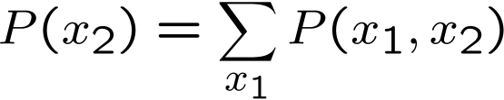

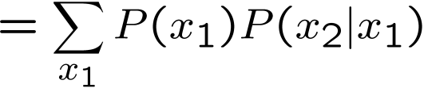

Inference: Base Cases
X₁
X₁
X₂
E₁
We want to know P(disease |symptom) but we usually have P(symptom|disease)

Slide 36


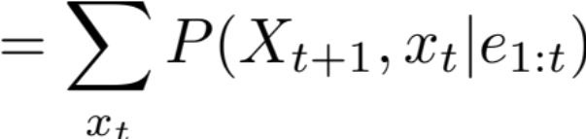
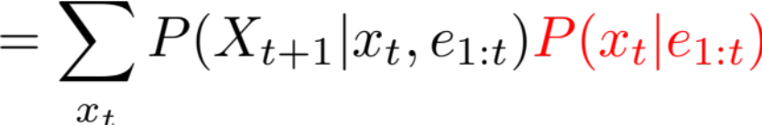
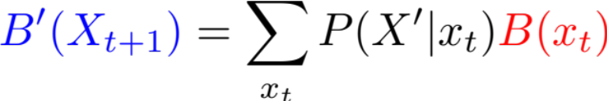
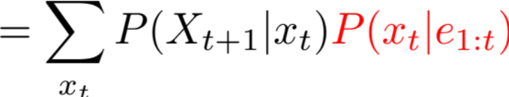
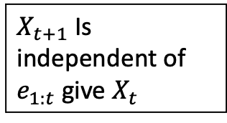
Passage of Time
Assume we have current belief P(X | evidence to date)
We can define our belief after one time step passes:
Basic idea: beliefs get “pushed” through the transitions
  With the “B” notation, we have to be careful about what time step t the belief is about, and what evidence it includes
X₁
X₂
Chain rule
Or compactly:
$X_{t+1}$ Is independent of $e_{1:t}$ give $X_{t}$
Notes:
TODO: intermediate step in derivation!

Slide 37
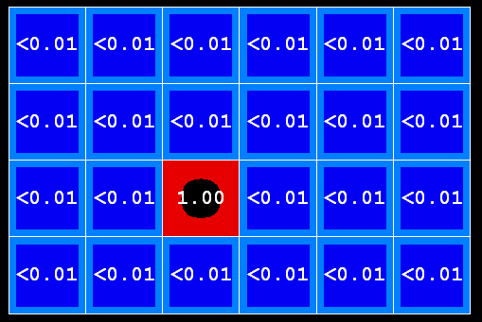
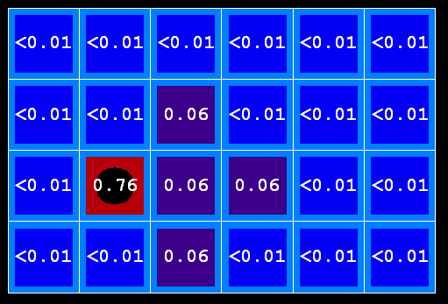
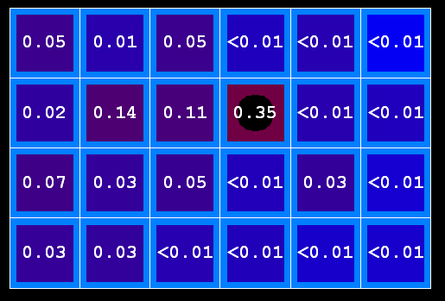

Example: Passage of Time
As time passes, uncertainty “accumulates”
(Transition model: ghosts usually go clockwise)
T = 1
T = 2
T = 5

Slide 38



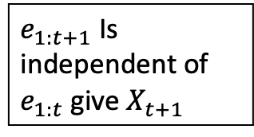
Observation
X₁
Assume we have current belief P(X | previous evidence):
Then, after evidence comes in:
Or, compactly:
New evidence
E₁
Chain rule
$e_{1:t+1}$ Is independent of $e_{1:t}$ give $X_{t+1}$
Basic idea: beliefs “reweighted” by likelihood of evidence
Unlike passage of time, we have to renormalize
Notes:
Basic idea: beliefs “reweighted” by likelihood of evidence
Unlike passage of time, we have to renormalize

Slide 39
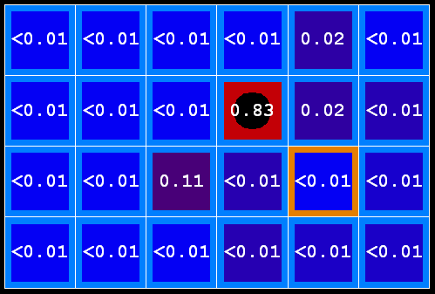



Example: Observation
As we get observations, beliefs get reweighted, uncertainty “decreases”
Before observation
After observation

Slide 40

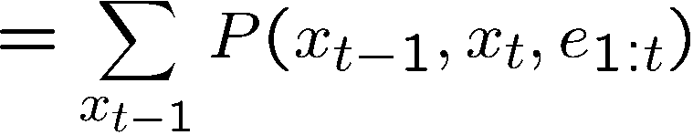
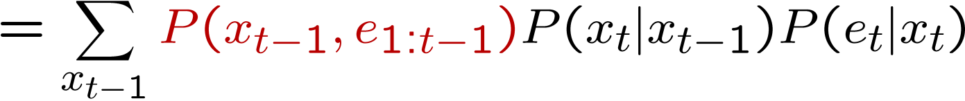
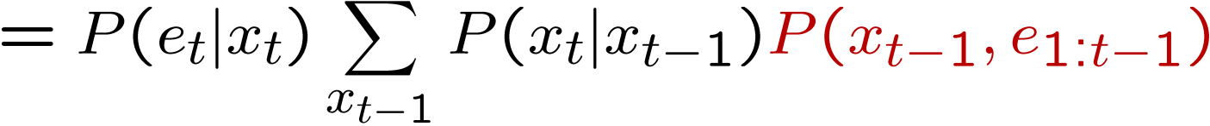
The Forward Algorithm
We are given evidence at each time and want to know
We can derive the following updates
We can normalize as we go if we want to have P(x|e) at each time step, or just once at the end…
Notes:
TODO: explain propto and it’s X_t, not X

Slide 41
Online Belief Updates
Every time step, we start with current P(X | evidence)
We update for time:
We update for evidence:
X₁
X₂
X₂
E₂

Slide 42
Example: Weather HMM
B’(+r) = 0.5
B’(-r) = 0.5
B’(+r) = 0.627
B’(-r) = 0.373
Time:
Observation:
B(+r) = 0.5
B(-r) = 0.5
B(+r) = 0.818
B(-r) = 0.182
B(+r) = 0.883
B(-r) = 0.117
Rain₀
Rain₁
Rain₂
R_{t} | R_{t+1} | P(R_{t+1}|R_{t})
+r | +r | 0.7
+r | -r | 0.3
-r | +r | 0.3
-r | -r | 0.7
R_{t} | U_{t} | P(U_{t}|R_{t})
+r | +u | 0.9
+r | -u | 0.1
-r | +u | 0.2
-r | -u | 0.8
Umbrella₁
Umbrella₂
Notes:
demo

Slide 43
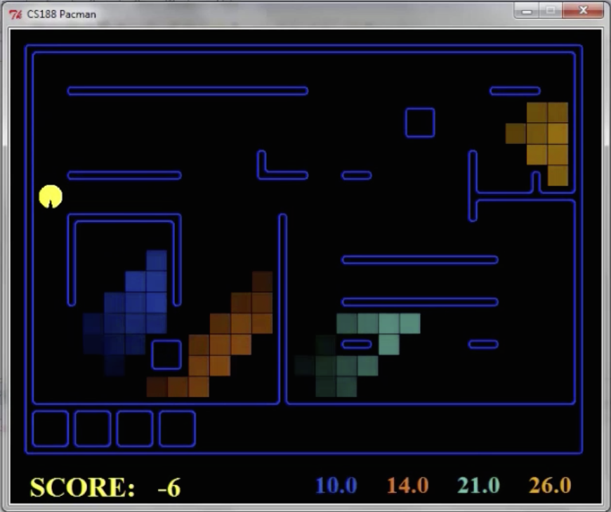
Pacman – Sonar (P4)
[Demo: Pacman – Sonar – No Beliefs(L14D1)]

Slide 44
Video of Demo Pacman – Sonar (with beliefs)

Slide 45
Summary
Variable assignment change over time according to some probabilistic model = Markov chains
Will converge to a stationary distribution at the limit (in most cases)
Variable assignment are unknown but are sensed at each time step = Hidden Markov Model
No need to remember all previous evidence, current belief state breaks dependency with old evidence
Next Time: Particle Filtering and Applications of HMMs

