Slide 1
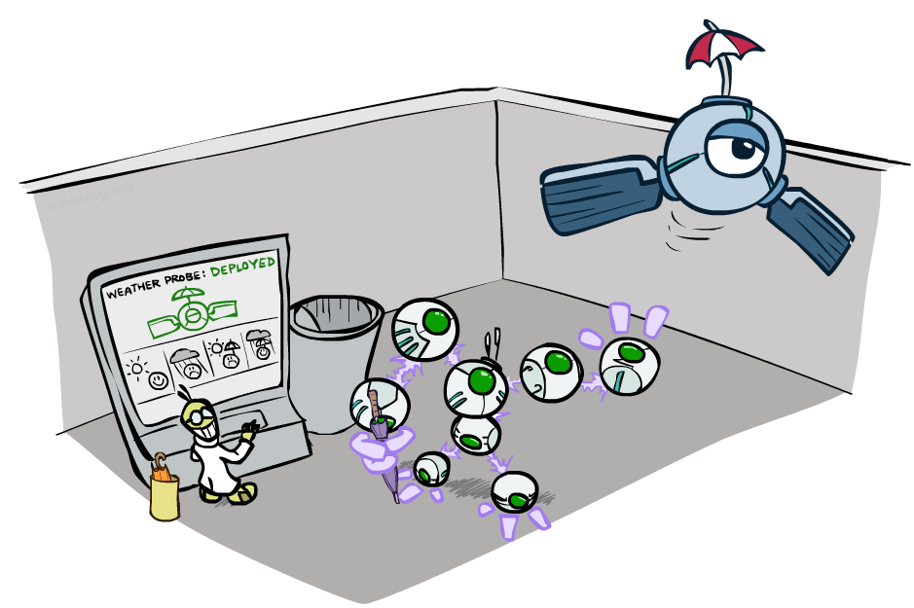
CSCE-420: Artificial Intelligence
Decision Networks and Value of Information
Instructor: Guni Sharon
Based on slides by: Pieter Abbeel, Dan Klein

Slide 2
Announcements
Assignment 3: Reinforcement learning, due Monday, March-25, EoD
Quiz 8 – Probabilities, due Wednesday, March 27, EoD
Quiz 9 - Decision networks, due Wednesday Apr 3, 2024 at 11:59 PM

Slide 3
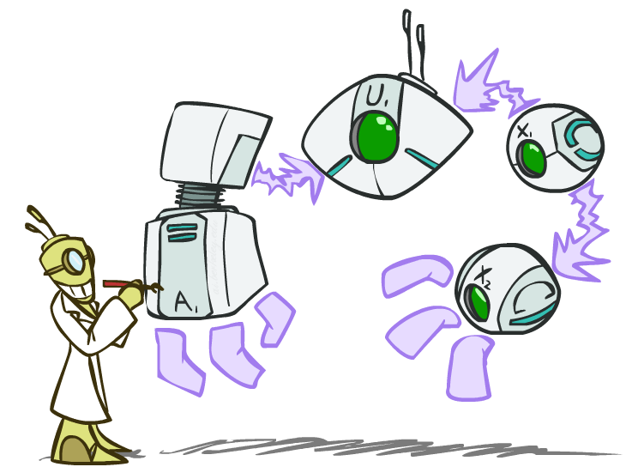
Decision Networks

Slide 4

Unused art

Slide 5
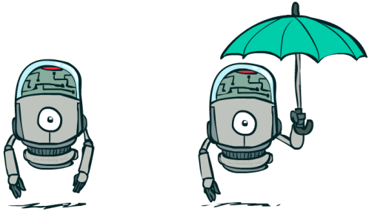
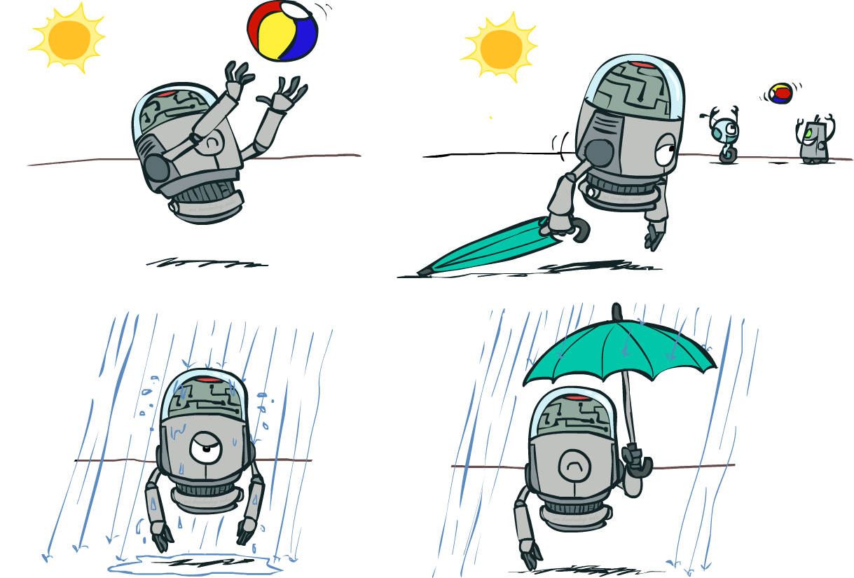

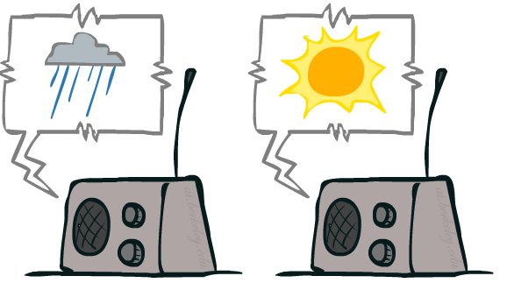
Decision Networks
Action nodes
Umbrella
U
Utility nodes
Weather
BN Random vars
Forecast
Notes:
There exists a ghostbusters demo

Slide 6
Decision Networks
MEU: choose the action which maximizes the expected utility given the evidence
Can directly operationalize this with decision networks
  Bayes nets with nodes for utility and actions
  Lets us calculate the expected utility for each action
New node types:
  Chance nodes (just like BNs – random variables)
  Actions (rectangles, cannot have parents, act as observed evidence)
  Utility node (diamond, usually depends on action and chance nodes)
Umbrella
U
Weather
Forecast
Notes:
There exists a ghostbusters demo

Slide 7
Decision Networks
Action selection
  Instantiate all evidence
  Set action node(s) each possible way
  Calculate posterior for all parents of utility node, given the evidence
  Calculate expected utility for each action
  Choose maximizing action
Umbrella
U
Weather
Forecast
Notes:
There exists a ghostbusters demo

Slide 8
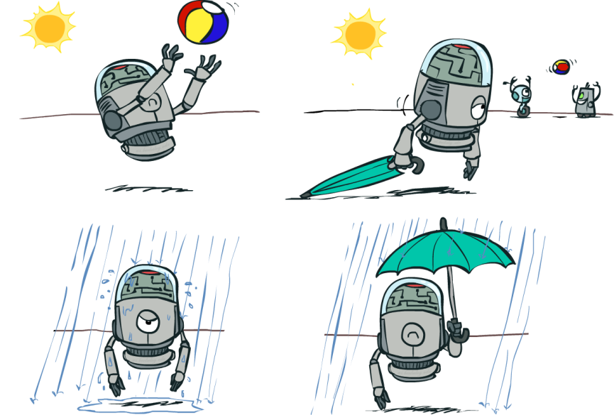
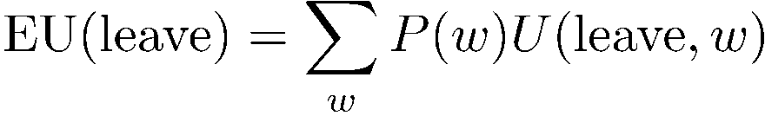
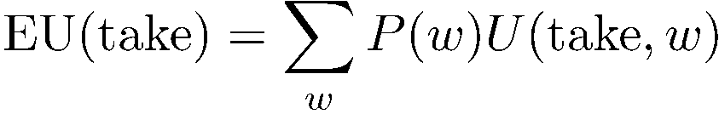

Decision Networks
Umbrella = leave
Umbrella
U
Umbrella = take
Weather
A | W | U(A,W)
leave | sun | 100
leave | rain | 0
take | sun | 20
take | rain | 70
W | P(W)
sun | 0.7
rain | 0.3
Optimal decision = leave
Notes:
There exists a ghostbusters demo

Slide 9

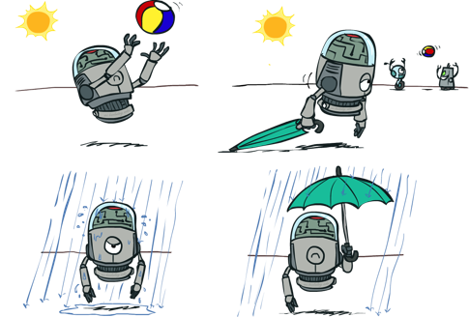
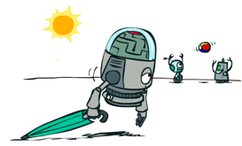

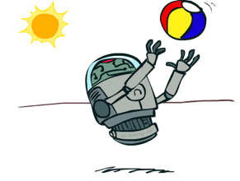
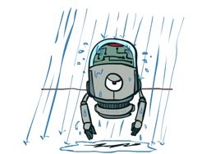
Decisions as Outcome Trees
{}
take
leave
Weather | {}
Weather | {}
sun
sun
rain
rain
U(t,s)
U(t,r)
U(l,s)
U(l,r)
Umbrella
U
Weather
Almost exactly like expectimax / MDPs
What’s changed?

Slide 10
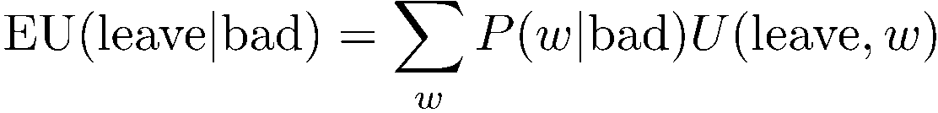


Example: Decision Networks
Umbrella = leave
A | W | U(A,W)
leave | sun | 100
leave | rain | 0
take | sun | 20
take | rain | 70
Umbrella
U
Umbrella = take
Weather
W | P(W|F=bad)
sun | 0.34
rain | 0.66
Optimal decision = take
Forecast
=bad

Slide 11

Decisions as Outcome Trees
{b}
take
leave
Umbrella
W | {b}
W | {b}
sun
sun
rain
rain
U
U(t,s)
U(t,r)
U(l,s)
U(l,r)
Weather
Forecast
=bad

Slide 12

Video of Demo Ghostbusters with Probability

Slide 13
Ghostbusters Decision Network
Bust
U
Ghost Location
…
Sensor (1,1)
Sensor (1,2)
Sensor (1,3)
Sensor (1,n)
Sensor (2,1)
…
…
…
Sensor (m,1)
Sensor (m,n)

Slide 14
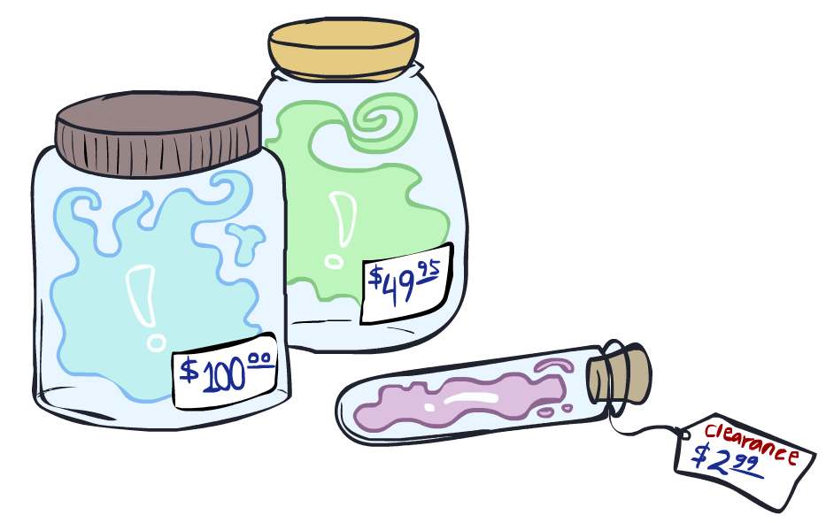
Value of Information

Slide 15
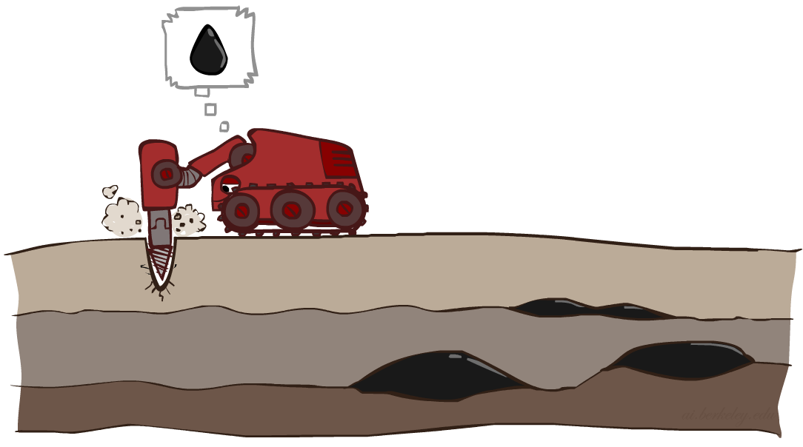
Value of Information
Idea: compute value of acquiring evidence
  Can be done directly from decision network
Example: buying oil drilling rights
  Two blocks A and B, exactly one has oil, worth k
  You can drill in one location
  Prior probabilities 0.5 each, & mutually exclusive
  Drilling in either A or B has EU = k/2, MEU = k/2
Question: what’s the value of information of O?
  Value of knowing which of A or B has oil
  Value is expected gain in MEU from new info
  Survey may say “oil in a” or “oil in b”, prob 0.5 each
  If we know OilLoc, MEU is k (either way)
  Gain in MEU from knowing OilLoc?
  VPI(OilLoc) = k/2
  Fair price of information: k/2
D | O | U
a | a | k
a | b | 0
b | a | 0
b | b | k
DrillLoc
U
O | P
a | 1/2
b | 1/2
OilLoc

Slide 16

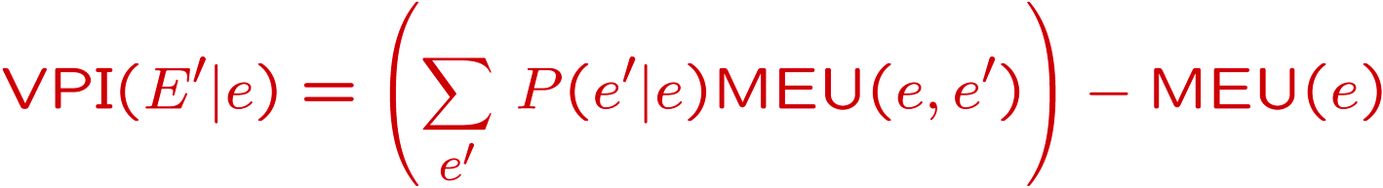
VPI Example: Weather
Umbrella
A | W | U
leave | sun | 100
leave | rain | 0
take | sun | 20
take | rain | 70
MEU with no evidence
U
Weather
MEU if forecast is bad
MEU if forecast is good
Forecast
Forecast distribution
F | P(F)
good | 0.59
bad | 0.41

Slide 17
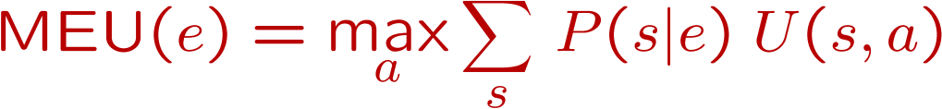
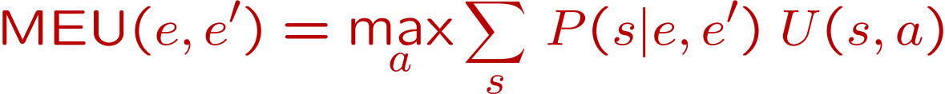
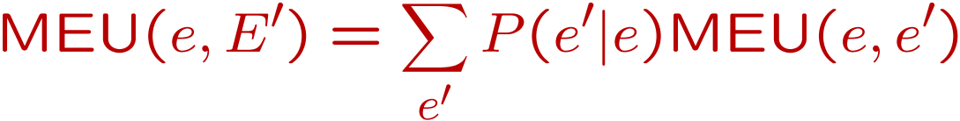
Value of Information
{+e}
Assume we have evidence E=e. Value if we act now:
Assume we see that E’ = e’. Value if we act then:
BUT E’ is a random variable whose value is
unknown, so we don’t know what e’ will be
Expected value if E’ is revealed and then we act:
Value of information: how much MEU goes up
by revealing E’ first then acting, over acting now:
a
P(s | +e)
U
{+e, +e’}
a
P(s | +e, +e’)
U
{+e}
P(+e’ | +e)
P(-e’ | +e)
{+e, +e’}
{+e, -e’}
a

Slide 18
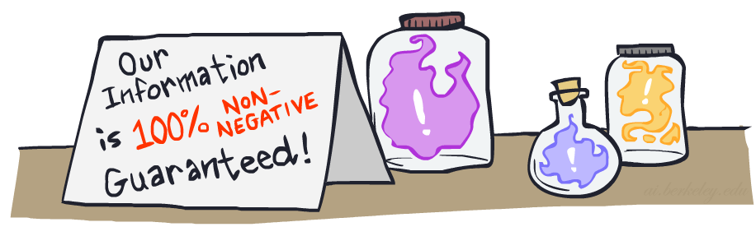

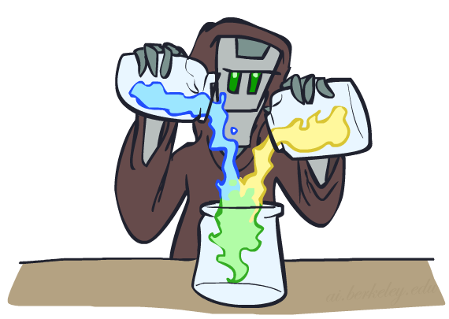
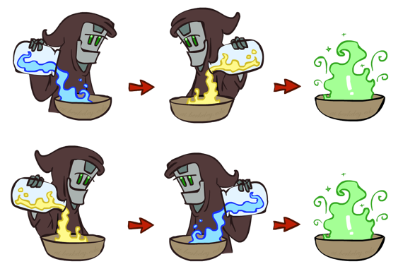
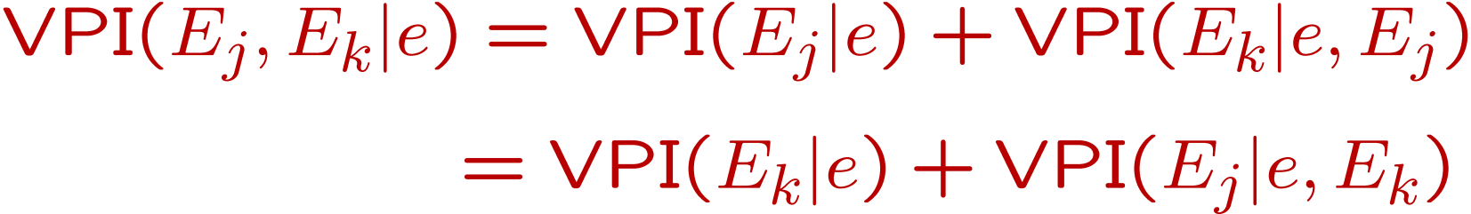
VPI Properties
Nonnegative
Nonadditive
  (think of observing E_{j} twice)
Order-independent

Slide 19
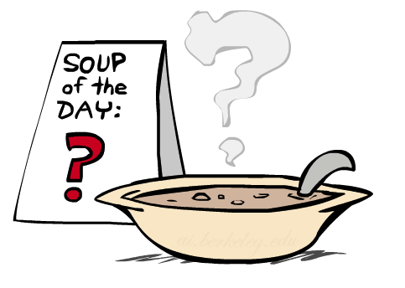
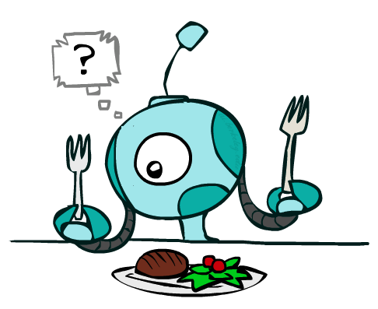
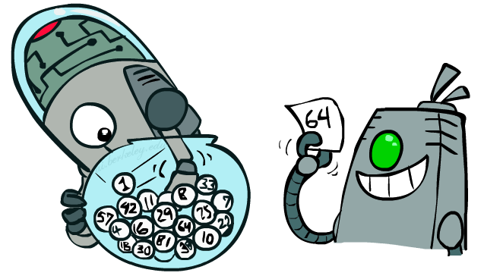
Quick VPI Questions
The soup of the day is either clam chowder or split pea, but you wouldn’t order either one. What’s the value of knowing which it is?
There are two kinds of plastic forks at a picnic. One kind is slightly sturdier. What’s the value of knowing which?
You’re playing the lottery. The prize will be $0 or $100. You can play any number between 1 and 100 (chance of winning is 1%). What is the value of knowing the winning number?

Slide 20
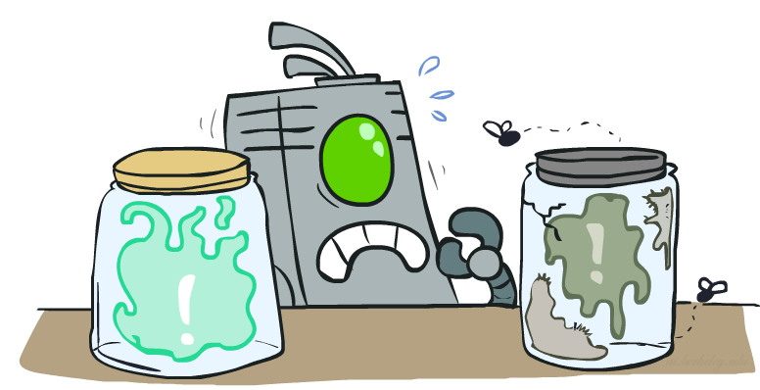
Value of Imperfect Information?
No such thing (as we formulate it)
Information corresponds to the observation of a node in the decision network
If data is “noisy” that just means we don’t observe the original variable, but another variable which is a noisy version of the original one

Slide 21
VPI Question
DrillLoc
U
Scout
OilLoc
VPI(OilLoc) ?
VPI(ScoutingReport) ?
VPI(Scout) ?
VPI(Scout | ScoutingReport) ?
Generally:
  If Parents(U) Z | CurrentEvidence
  Then VPI( Z | CurrentEvidence) = 0
Scouting
Report

Slide 22
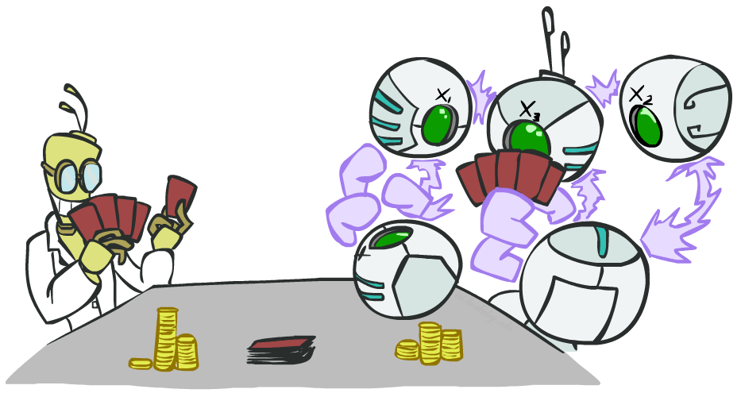
POMDPs

Slide 23
POMDPs
MDPs have:
  States S
  Actions A
  Transition function P(s’|s,a) (or T(s,a,s’))
  Rewards R(s,a,s’)
POMDPs add:
  Observations O
  Observation function P(o|s) (or O(s,o))
POMDPs are MDPs over belief
states b (distributions over S)
We’ll be able to say more in a few lectures
s
a
s, a
s,a,s’
s'
b
a
b, a
o
b'

Slide 24
Example: Ghostbusters
b
{e}
In (static) Ghostbusters:
  Belief state determined by evidence to date {e}
  Tree really over evidence sets
  Probabilistic reasoning needed to evaluate new evidence given past evidence
Solving POMDPs
  One way: use truncated expectimax to compute approximate value of actions
  What if you only considered busting or one sense followed by a bust?
  You get a (one step) VPI-based agent!
a
a
b, a
e, a
e’
e’
b’
{e, e’}
{e}
a_{bust}
a_{sense}
{e}, a_{sense}
U(a_{bust}, {e})
e’
{e, e’}
a_{bust}
U(a_{bust}, {e, e’})

Slide 25
Video of Demo Ghostbusters with VPI

Slide 26
More Generally
General solutions map belief functions to actions
  Can divide regions of belief space (set of belief functions) into policy regions (gets complex quickly)
  Can build approximate policies using discretization methods
  Can factor belief functions in various ways
Overall, POMDPs are very (actually PSPACE-) hard
Most real problems are POMDPs, and we can rarely solve then in their full generality

Slide 27
What did we learn?
Decision networks composed of BNs, decision and utility nodes
Compute the optimal action based on MEU principals
Compute the value of information
  Change in MEU given the new evidence
Next time: Hidden Markov Models

