Slide 1
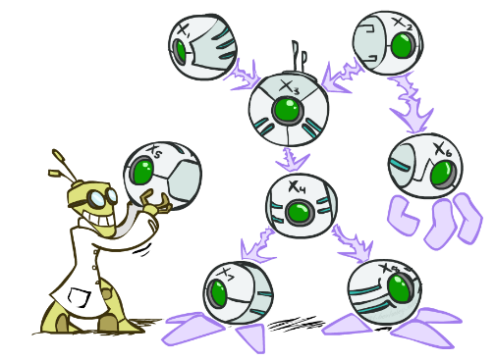
CSCE-420: Artificial Intelligence
Bayes’ Nets
Instructor: Guni Sharon
Based on slides by: Pieter Abbeel, Dan Klein

Slide 2
Announcements
Quiz 8 – Probabilities, due April 7, EoD

Slide 3
Probabilistic inference from joint distribution
A | B | … | Z | Prob
a1 | b1 | … | z1 | ?
a2 | b2 | … | z2 | ?
… | … | … | … | ?
an | bn | … | zn | ?
Assume for now a probability oracle (is this a reasonable assumption?)
Still, inference from the full joint distribution is not a practical solution

Slide 4

Practical Probabilistic Models
Models describe how (a portion of) the world works
Models are always simplifications
  May not account for every variable
  May not account for all interactions between variables
  “All models are wrong; but some are useful.”
  – George E. P. Box
What do we do with probabilistic models?
  We (or our agents) need to reason about unknown variables, given evidence
  Example: explanation (diagnostic reasoning)
  Example: prediction (causal reasoning)
  Example: value of information
Notes:
George Box: All models are wrong; some of them are useful

Slide 5
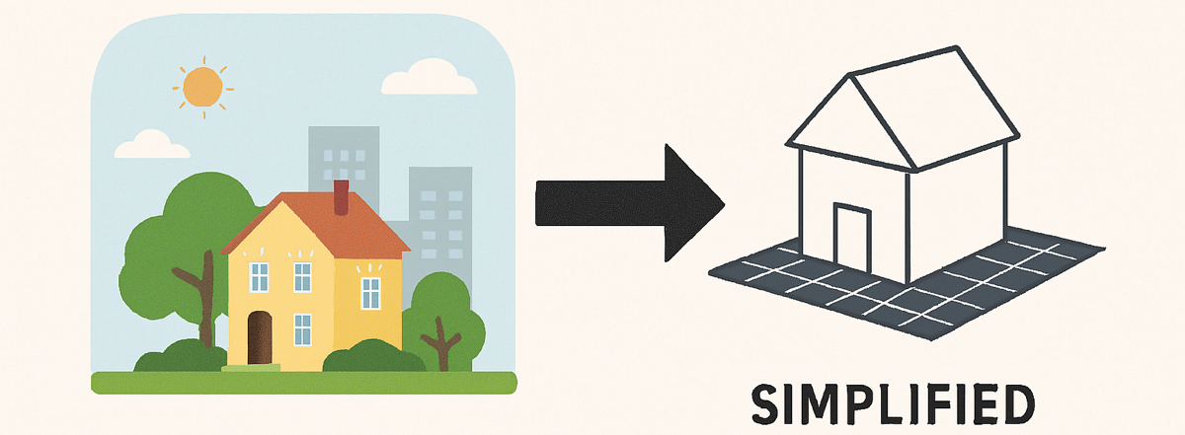
Practical models
Practical models can be processed and stored in memory
They lead to modeling errors
Data engineers are required to balance these factors
Let’s look at a common approach for model simplification…

Slide 6
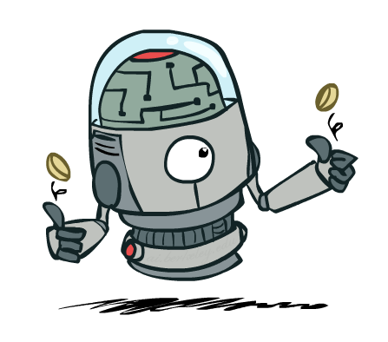

Independence
Two variables are independent if:
  This says that their joint distribution factors into a product of the two simpler distributions
  Another form:
  We write:
Independence is a simplifying modeling assumption
  Empirical joint distributions: at best “close” to independent
  What could we assume for {Weather, Traffic, Cavity, Toothache}?

Slide 7
Example: Independence?
T | P
hot | 0.5
cold | 0.5
T | W | P
hot | sun | 0.4
hot | rain | 0.1
cold | sun | 0.2
cold | rain | 0.3
T | W | P
hot | sun | 0.3
hot | rain | 0.2
cold | sun | 0.3
cold | rain | 0.2
X
OK
W | P
sun | 0.6
rain | 0.4

Slide 8


Example: Independence
N fair, independent coin flips:
H | 0.5
T | 0.5
H | 0.5
T | 0.5
H | 0.5
T | 0.5

Slide 9
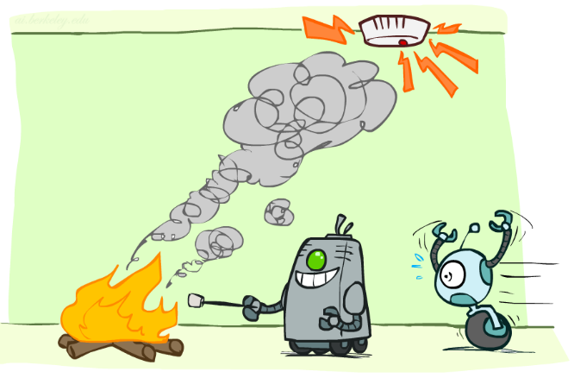
Conditional Independence

Slide 10
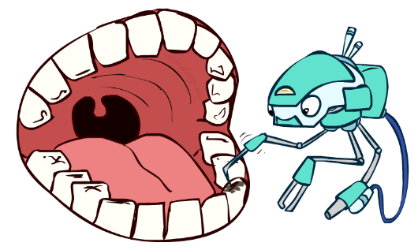
Conditional Independence
P(Toothache, Cavity, Catch)
If I have a cavity, the probability that the probe catches in it doesn't depend on whether I have a toothache:
  P(+catch | +toothache, +cavity) = P(+catch | +cavity)
The same independence holds if I don’t have a cavity:
  P(+catch | +toothache, -cavity) = P(+catch| -cavity)
Catch is conditionally independent of Toothache given Cavity:
  P(Catch | Toothache, Cavity) = P(Catch | Cavity)
Equivalent statements:
  P(Toothache | Catch , Cavity) = P(Toothache | Cavity)
  P(Toothache, Catch | Cavity) = P(Toothache | Cavity) P(Catch | Cavity)
  One can be derived from the other easily

Slide 11

Conditional Independence
Unconditional (absolute) independence very rare
Conditional independence is our most basic and robust form of knowledge about uncertain environments.
X is conditionally independent of Y given Z
if and only if:
or, equivalently, if and only if

Slide 12
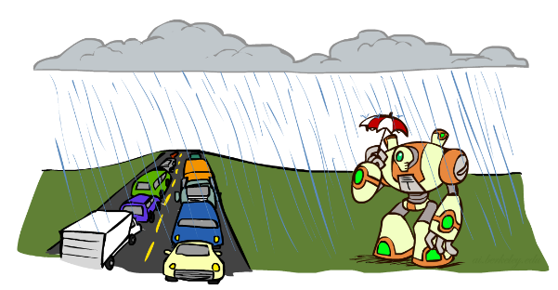
Conditional Independence
What about this domain:
  Traffic
  Umbrella
  Raining

Slide 13

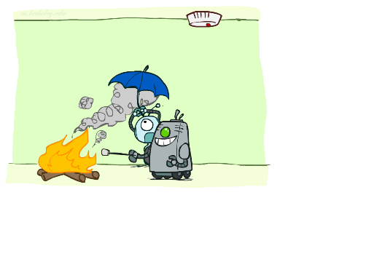
Conditional Independence
What about this domain:
  Fire
  Smoke
  Alarm

Slide 14

Conditional Independence and the Chain Rule
Chain rule:
Trivial decomposition:
With assumption of conditional independence:
Bayes’nets / graphical models exploit conditional independence assumptions

Slide 15
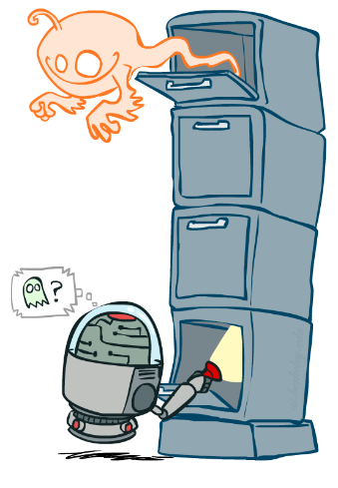
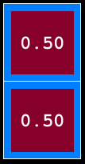
Ghostbusters Chain Rule
Each sensor depends only
on where the ghost is
That means, the two sensors (top sensor, bottom sensor) are conditionally independent, given the ghost position
T: Top square is red
B: Bottom square is red
G: Ghost is in the top
Givens:
P( +g ) = 0.5
P( -g ) = 0.5
P( +t | +g ) = 0.8
P( +t | -g ) = 0.4
P( +b | +g ) = 0.4
P( +b | -g ) = 0.8
P(T,B,G) = P(G) P(T|G) P(B|G)
T | B | G | P(T,B,G)
+t | +b | +g | 0.16
+t | +b | -g | 0.16
+t | -b | +g | 0.24
+t | -b | -g | 0.04
-t | +b | +g | 0.04
-t | +b | -g | 0.24
-t | -b | +g | 0.06
-t | -b | -g | 0.06
Can be encoded as:
P(G)
P(T|G)
P(B|G)

Slide 16
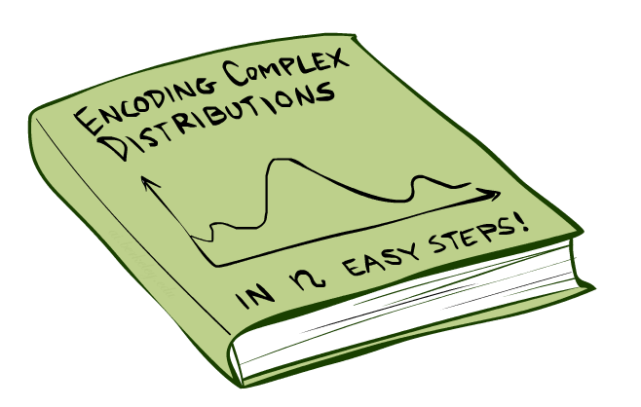
Bayes’Nets: Big Picture

Slide 17

Bayes’ Nets: Big Picture
Two problems with using full joint distribution tables as our probabilistic models:
  Unless there are only a few variables, the joint is WAY too big to represent explicitly
  Hard to learn (estimate) anything empirically about more than a few variables at a time
Bayes’ nets: a technique for describing complex joint distributions (models) using simple, local distributions (conditional probabilities)
  Also called graphical models
  Describes how variables locally interact
  Local interactions chain together to give global, indirect interactions

Slide 18
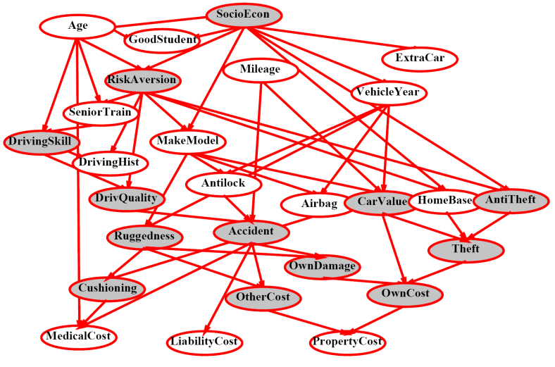
Example Bayes’ Net: Insurance

Slide 19
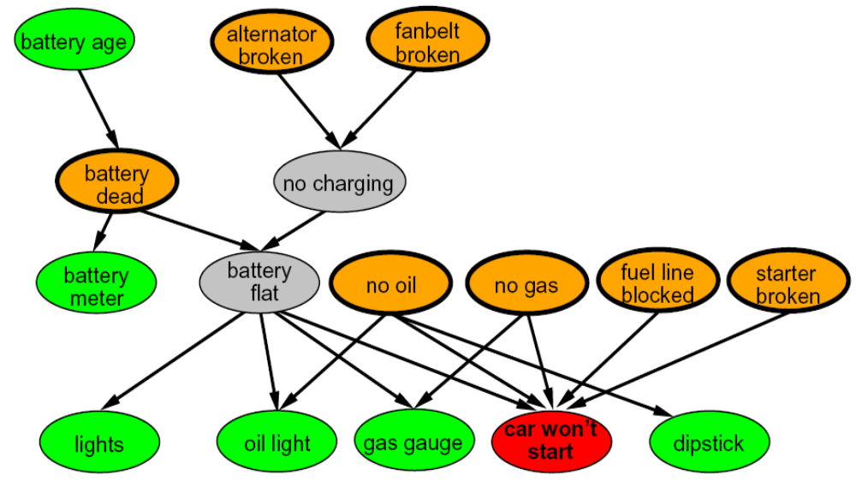
Example Bayes’ Net: Car

Slide 20
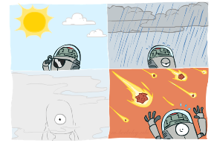
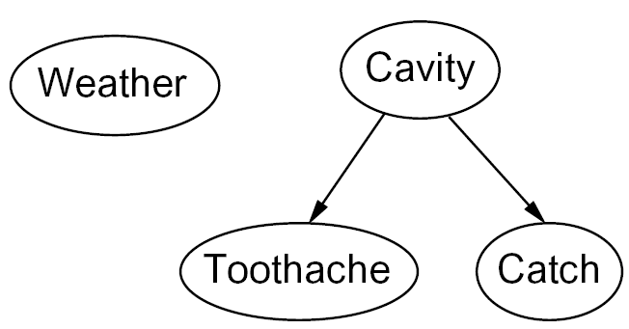

Graphical Model Notation
Nodes: variables (with domains)
  Can be assigned (observed) or unassigned (unobserved)
Arcs: interactions
  Indicate “direct influence” between variables
  Formally: encode conditional independence (more later)
For now: imagine that arrows mean direct causation (in general, they don’t!)

Slide 21

Example: Coin Flips
N independent coin flips
No interactions between variables: absolute independence
X₁
X₂
X_{n}

Slide 22
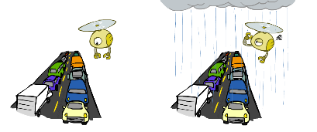
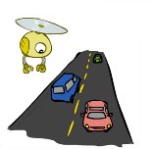
Example: Traffic
Model 2: rain causes traffic
Variables:
  R: It rains
  T: There is traffic
Model 1: independence
Why is an agent using model 2 better?
R
R
T
T

Slide 23
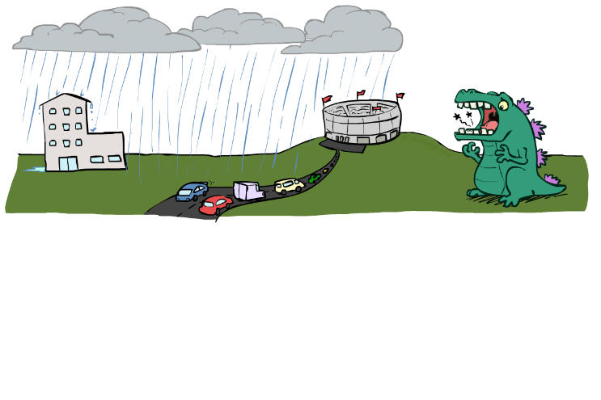
Example: Traffic II
Let’s build a causal graphical model!
Variables
  T: Traffic
  R: It rains
  L: Low pressure
  D: Roof drips
  B: Ballgame
  C: Cavity

Slide 24
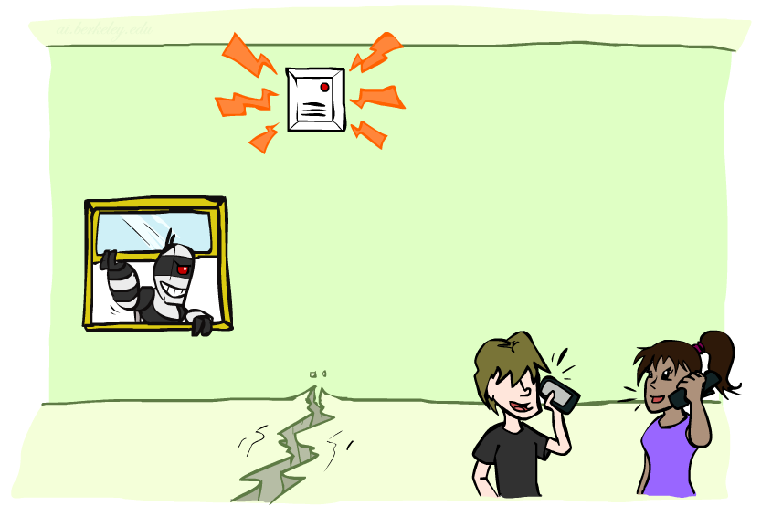
Example: Alarm Network
Variables
  B: Burglary
  A: Alarm goes off
  M: Mary calls
  J: John calls
  E: Earthquake!

Slide 25
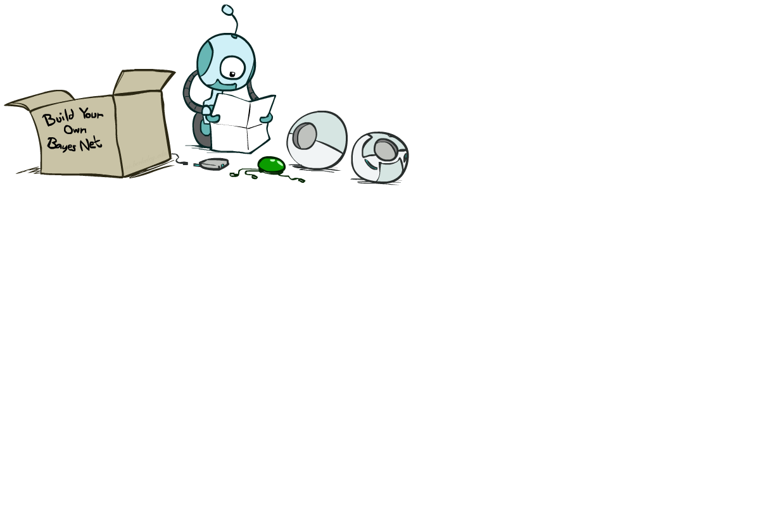
Bayes’ Net Semantics

Slide 26
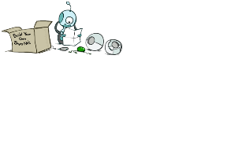


Bayes’ Net Semantics
A set of nodes, one per variable X
A directed, acyclic graph
A conditional distribution for each node
  A collection of distributions over X, one for each combination of parents’ values
  CPT: conditional probability table
  Description of a noisy “causal” process
A₁
A_{n}
X
A Bayes net = Topology (graph) + Local Conditional Probabilities

Slide 27


Probabilities in BNs
Bayes’ nets implicitly encode joint distributions
  As a product of local conditional distributions
  To see what probability a BN gives to a full assignment, multiply all the relevant conditionals together:
  Example:

Slide 28


Probabilities in BNs
Why are we guaranteed that setting
results in a proper joint distribution?
Chain rule (valid for all distributions):
Assume conditional independences:
→ Consequence:

Slide 29

Example: Coin Flips
X₁
X₂
X_{n}
h | 0.5
t | 0.5
h | 0.5
t | 0.5
h | 0.5
t | 0.5
Only distributions whose variables are absolutely independent can be represented by a Bayes’ net with no arcs.
Notes:
demo

Slide 30

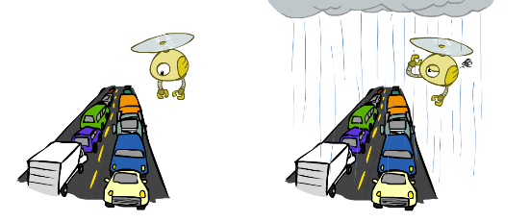

Example: Traffic
R
+r | 1/4
-r | 3/4
+r | +t | 3/4
 | -t | 1/4
T
-r | +t | 1/2
 | -t | 1/2
Notes:
demo

Slide 31
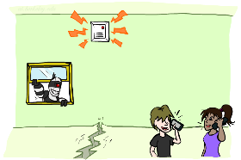
Example: Alarm Network
B | P(B)
+b | 0.001
-b | 0.999
E | P(E)
+e | 0.002
-e | 0.998
Burglary
Earthqk
Alarm
B | E | A | P(A|B,E)
+b | +e | +a | 0.95
+b | +e | -a | 0.05
+b | -e | +a | 0.94
+b | -e | -a | 0.06
-b | +e | +a | 0.29
-b | +e | -a | 0.71
-b | -e | +a | 0.001
-b | -e | -a | 0.999
John calls
Mary calls
A | J | P(J|A)
+a | +j | 0.9
+a | -j | 0.1
-a | +j | 0.05
-a | -j | 0.95
A | M | P(M|A)
+a | +m | 0.7
+a | -m | 0.3
-a | +m | 0.01
-a | -m | 0.99
Notes:
demo

Slide 32

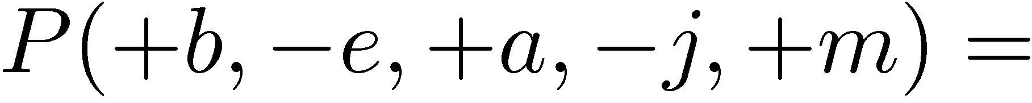
Example: Alarm Network
B | P(B)
+b | 0.001
-b | 0.999
B
E
E | P(E)
+e | 0.002
-e | 0.998
A
A | J | P(J|A)
+a | +j | 0.9
+a | -j | 0.1
-a | +j | 0.05
-a | -j | 0.95
A | M | P(M|A)
+a | +m | 0.7
+a | -m | 0.3
-a | +m | 0.01
-a | -m | 0.99
B | E | A | P(A|B,E)
+b | +e | +a | 0.95
+b | +e | -a | 0.05
+b | -e | +a | 0.94
+b | -e | -a | 0.06
-b | +e | +a | 0.29
-b | +e | -a | 0.71
-b | -e | +a | 0.001
-b | -e | -a | 0.999
J
M
Notes:
demo

Slide 33

Example: Alarm Network
B | P(B)
+b | 0.001
-b | 0.999
B
E
E | P(E)
+e | 0.002
-e | 0.998
A
A | J | P(J|A)
+a | +j | 0.9
+a | -j | 0.1
-a | +j | 0.05
-a | -j | 0.95
A | M | P(M|A)
+a | +m | 0.7
+a | -m | 0.3
-a | +m | 0.01
-a | -m | 0.99
B | E | A | P(A|B,E)
+b | +e | +a | 0.95
+b | +e | -a | 0.05
+b | -e | +a | 0.94
+b | -e | -a | 0.06
-b | +e | +a | 0.29
-b | +e | -a | 0.71
-b | -e | +a | 0.001
-b | -e | -a | 0.999
J
M
Notes:
demo

Slide 34
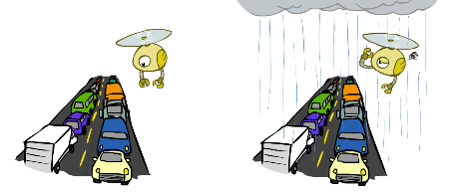

Example: Traffic
Causal direction
R
+r | 1/4
-r | 3/4
+r | +t | 3/16
+r | -t | 1/16
-r | +t | 6/16
-r | -t | 6/16
+r | +t | 3/4
 | -t | 1/4
T
-r | +t | 1/2
 | -t | 1/2

Slide 35
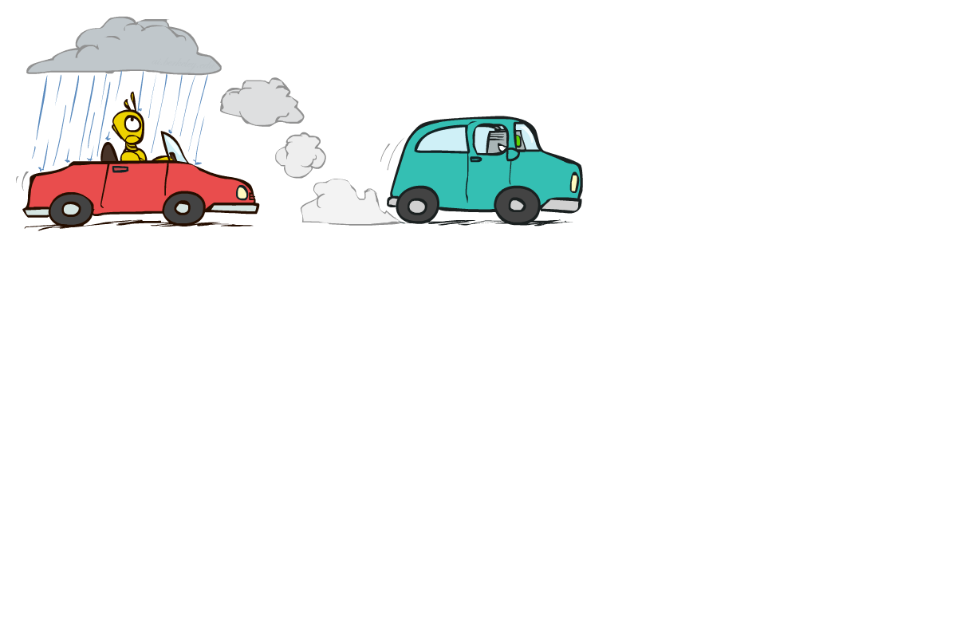

Example: Reverse Traffic
Reverse causality?
T
+t | 9/16
-t | 7/16
+r | +t | 3/16
+r | -t | 1/16
-r | +t | 6/16
-r | -t | 6/16
+t | +r | 1/3
 | -r | 2/3
R
-t | +r | 1/7
 | -r | 6/7

Slide 36
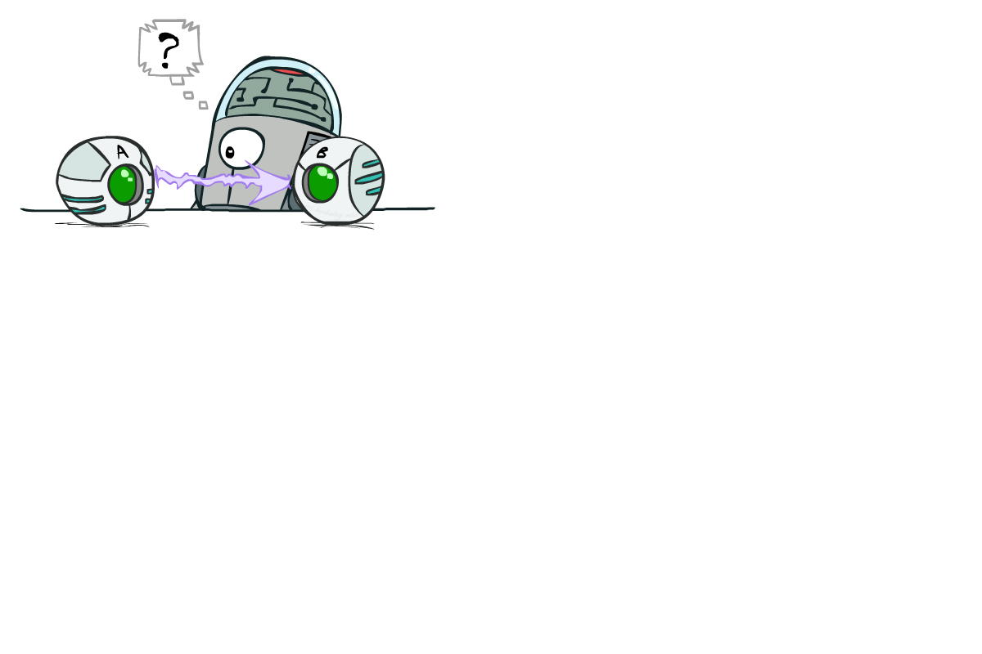
Causality?
When Bayes’ nets reflect the true causal patterns:
  Often simpler (nodes have fewer parents)
  Often easier to think about
  Often easier to elicit from experts
BNs need not actually be causal
  Sometimes no causal net exists over the domain (especially if variables are missing)
  E.g. consider the variables Traffic and roof Drips
  End up with arrows that reflect correlation, not causation
What do the arrows really mean?
  Topology may happen to encode causal structure
  Topology really encodes conditional independence

Slide 37

What did we learn?
Bayes’ nets encode a joint distribution through local CPTs
Assemble BNs using an intuitive notion of conditional independence
key idea: use causality to represent conditional independence
Main goal: answer queries about conditional probabilities
Next: Making decisions based on BNs

