Slide 1
An Introduction to Microarchtectural Prediction

Slide 2
Why Prediction?
In the beginning, computation proceeded one step at a time
We discovered parallelism, in particular instruction-level parallelism
  Some instructions can execute at the same time as others without violating program semantics
  But some dependences remain, giving rise to control and data hazards
  Naïve solution to hazards: wait for them to resolve. Can negate the benefit of exploiting parallelism
Some operations take longer than others
  E.g. accessing memory, accessing the network, executing FP instructions
  Caching can mitigate the latency, as long as the caches contain data that will be accessed in the future
So we try to predict the future:
  What will be the result of that instruction?
  What will be the most profitable data to keep or bring into the cache?

Slide 3
Pipeline Hazards
A simple model to understand why we predict: pipelining
  Simple model of pipelining, IF ID EX MM WB, is a useful lie
  A value is needed in cycle t, but produced at time t+Δ
  For example, a control hazard:
    We fetch a branch at cycle 0, at stage IF of the pipeline At cycle 1 we need to fetch another instruction
    But the branch might not resolve until after EX
    So we stall for two cycles?
    In real pipelines the delay might be 15 or more cycles
  For example, a data hazard
    We attempt to read a load at cycle 4, at stage MM in the pipeline
    A subsequent instruction needs the load value at cycle 5, at stage EX
    But the load missed in the cache. Stall for how many cycles? 4? 20? 200+?

Slide 4
Control Hazards
Branches
What is the outcome of the branch? Where should we fetch next?
  Conditional branch – taken or not taken, fetch from target only if taken
  Indirect branch or call – target from register or memory
  Return – target from machine stack
  Unconditional branch or call – target from offset in opcode
Some ISAs (e.g. ARMv7) also have conditional indirects, conditional calls, conditional returns
We must predict whether the branch is taken or not taken, and if it’s taken, we must predict the target
  Neither of these things is readily available when the instruction is fetched

Slide 5
Branch Direction Prediction
First important case of microarchitectural prediction
Predict whether a conditional branch is taken or not
Jim Smith first documented ideas for conditional branch prediction in https://dl.acm.org/doi/10.5555/800052.801871 A study of branch prediction strategies in ISCA 1981. I was in 6th grade. You weren’t born yet. Raiders of the Lost Ark was the #1 movie.
Yeh and Patt documented significant advancement in a line of papers beginning with https://dl.acm.org/doi/10.1145/123465.123475 Two-level adaptive training branch prediction in MICRO 1991. Home Alone was the #1 movie.

Slide 6
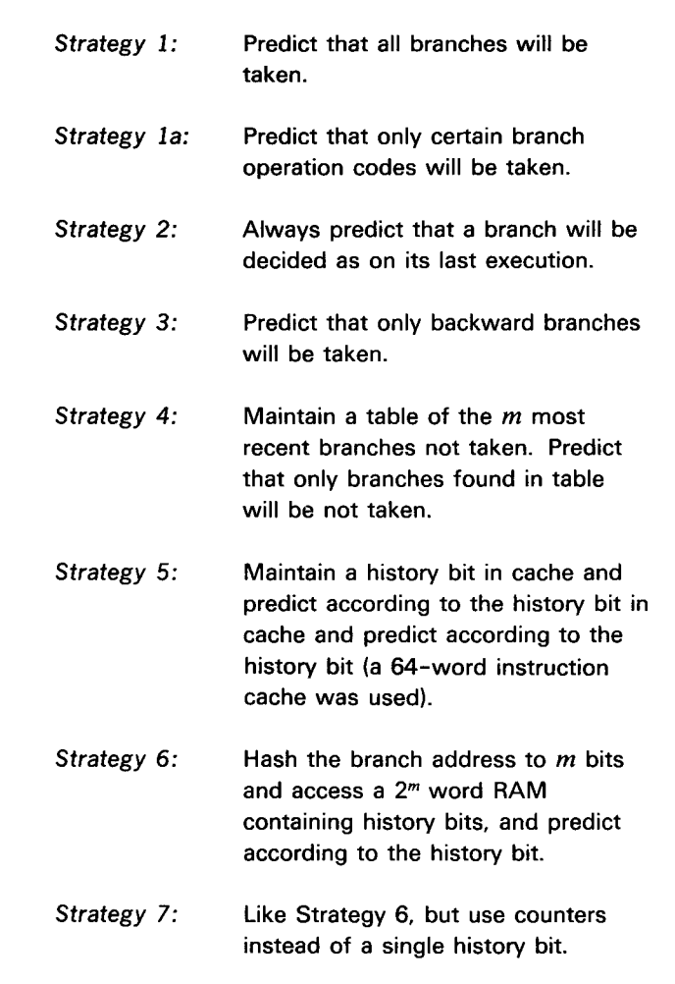
Smith’s paper

Slide 7
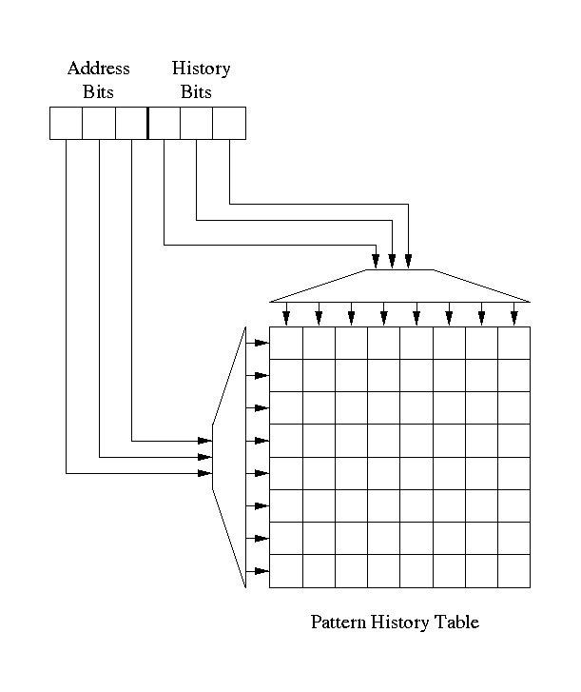
Two-level adaptive branch prediction
Most predictors based on 2-level adaptive branch prediction [Yeh & Patt ’91]
Branch outcomes shifted into history register, 1=taken, 0=not taken
History bits and address bits combine to index a pattern history table (PHT) of 2-bit saturating counters
Prediction is high bit of counter
Counter is incremented if branch is taken, decremented if branch is not taken
Branches tend to be highly biased
GAs – a common type of predictor

Slide 8
Branch Direction Prediction continued
Scott McFarling documented two more significant advances, gshare and tournament-style hybrid branch predictors, in https://www.hpl.hp.com/techreports/Compaq-DEC/WRL-TN-36.pdf, Combining Branch Predictors, a DEC technical report in 1993. Jurassic Park was the #1 movie.
The work of Patt’s group along with McFarling’s contributions inspired a lot of follow-up research using correlation and various kinds of hybrid predictors
A lot of papers published in the 1990s. Too many. Some good ones:
  analysis via compression: https://dl.acm.org/doi/10.1145/248209.237171 (ASPLOS 1996)
    This paper seems boring but becomes very important later!
  gskew: https://dl.acm.org/doi/10.1145/384286.264211 (ISCA 1997) - funny hash functions
  Agree: https://dl.acm.org/doi/10.1145/384286.264210 (ISCA 1997) - avoid aliasing via bias
  Bi-Mode: https://ieeexplore.ieee.org/document/645792 (MICRO 1997) - avoid aliasing again
  YAGS: https://ieeexplore.ieee.org/abstract/document/742770 (MICRO 1998) - tagging

Slide 9
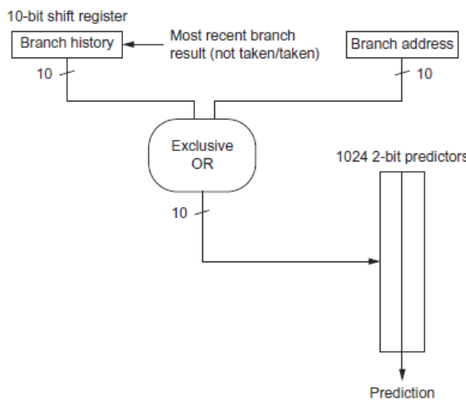
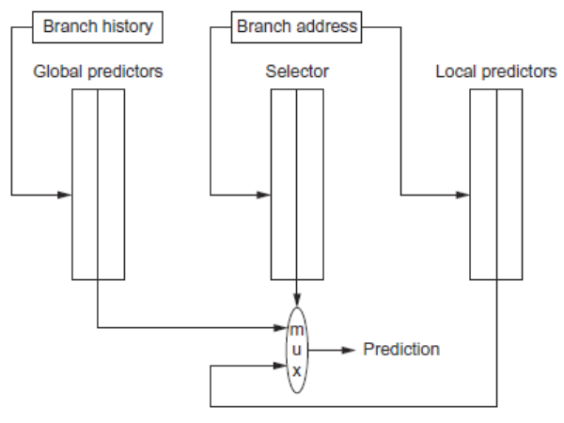
McFarling’s predictors
gshare
tournament
Figures from H&P architecture textbook

Slide 10
Branch Direction Prediction continued
Calvin Lin and I published https://ieeexplore.ieee.org/document/903263 Dynamic Branch Prediction with Perceptrons, at HPCA 2001. Had a big impact and motivated more research (Harry Potter was the movie)
I wrote several more papers on neural branch prediction
  https://ieeexplore.ieee.org/stamp/stamp.jsp?arnumber=1253199 Fast Path-Based Neural Branch Prediction
  https://ieeexplore.ieee.org/abstract/document/1431572 Piecewise Linear Branch Prediction
  Etc., look it up
Other key insights from this period:
  https://dl.acm.org/doi/10.1145/1089008.1089011 Hashed Perceptron, TACO 2005
  https://dl.acm.org/doi/abs/10.1145/1080695.1070003 O-GEHL, ISCA 2005
  https://www.jilp.org/vol9/v9paper6.pdf L-TAGE, JILP 2007

Slide 11
Perceptron Branch Predictor
Neural learning for predicting branches is a natural fit
  Input is history of branches – taken/not taken
  Outut is binary: predict taken or not taken
First idea: perceptron predictor [Jimenez&Lin 2001]
  Neural-inspired branch predictors the most accurate in the literature
  Dynamically train perceptrons to predict conditional branches
Addressing problems with perceptron and other predictors
  Latency – ahead pipelining [HPCA 2003,MICRO 2003,TOCS 2005, etc.]
  Linear inseparability – piecewise linear prediction [ISCA 2005,JILP 2005]
  Power – analog neural predictor [MICRO 2008,IEEE Micro“Top Picks” 2009]

Slide 12
Input and Output of the Perceptron
The inputs to the perceptron are branch outcome histories
  Just like in 2-level adaptive branch prediction
  Can be global or local (per-branch) or both (alloyed)
  Conceptually, branch outcomes are represented as
    +1, for taken
    -1, for not taken
The output of the perceptron is
  Non-negative, if the branch is predicted taken
  Negative, if the branch is predicted not taken
Ideally, each static branch is allocated its own perceptron

Slide 13
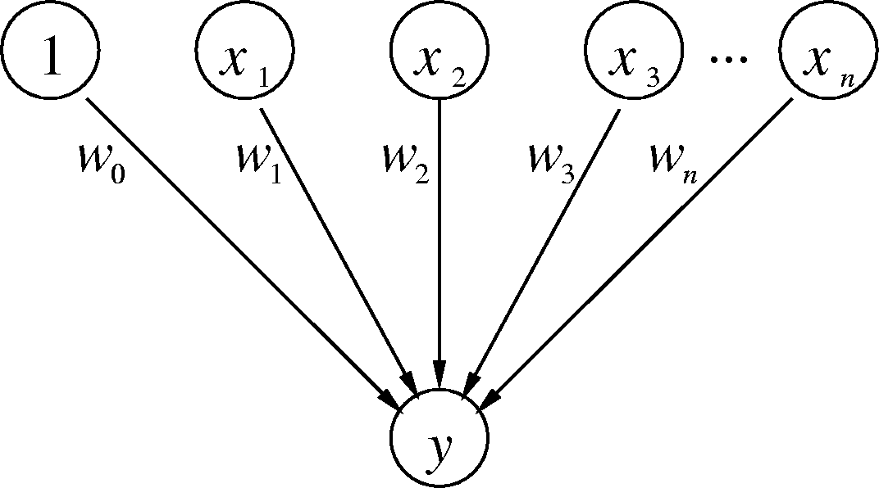
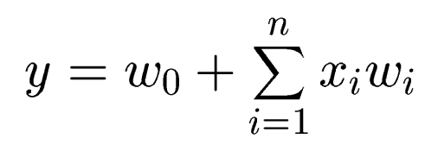
Branch-Predicting Neuron
Inputs (x’s) are from branch outcome history – taken or not taken
n + 1 small integer weights (w’s) learned by on-line training
Output (y) is dot product of x’s and w’s; predict taken if y ≥ 0
Training finds correlations between history and outcome
Dot-product computation has high latency and power

Slide 14
Input and Output of the Perceptron
The inputs to the perceptron are branch outcome histories
  Just like in 2-level adaptive branch prediction
  Can be global or local (per-branch) or both (alloyed)
  Conceptually, branch outcomes are represented as
    +1, for taken
    -1, for not taken
The output of the perceptron is
  Non-negative, if the branch is predicted taken
  Negative, if the branch is predicted not taken
Ideally, each static branch is allocated its own perceptron

Slide 15
Branch-Predicting Perceptron
Inputs (x’s) are from branch history and are -1 or +1
n + 1 small integer weights (w’s) learned by on-line training
Output (y) is dot product of x’s and w’s; predict taken if y ≥ 0
Training finds correlations between history and outcome

Slide 16
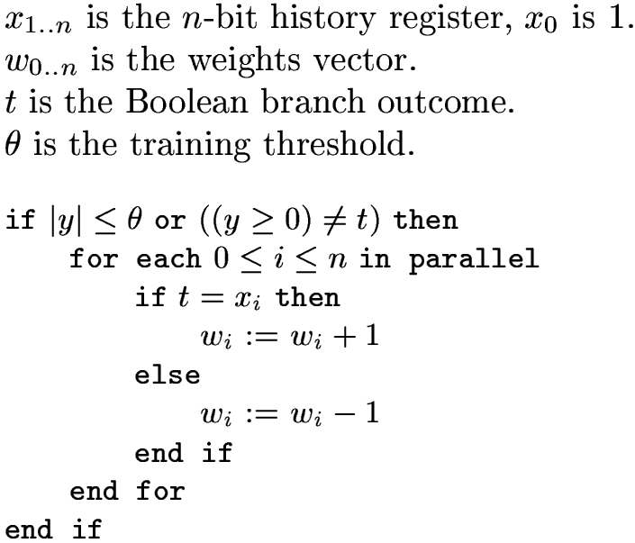
Training Algorithm

Slide 17
What Do The Weights Mean?
The bias weight, w₀:
  Proportional to the probability that the branch is taken
  Doesn’t take into account other branches; just like a Smith predictor
The correlating weights, w₁ through w_{n}:
  w_{i} is proportional to the probability that the predicted branch agrees with the i^{th} branch in the history
The dot product of the w’s and x’s
  w_{i} × x_{i} is proportional to the probability that the predicted branch is taken based on the correlation between this branch and the i^{th} branch
  Sum takes into account all estimated probabilities
What’s θ?
  Keeps from overtraining; adapt quickly to changing behavior

Slide 18
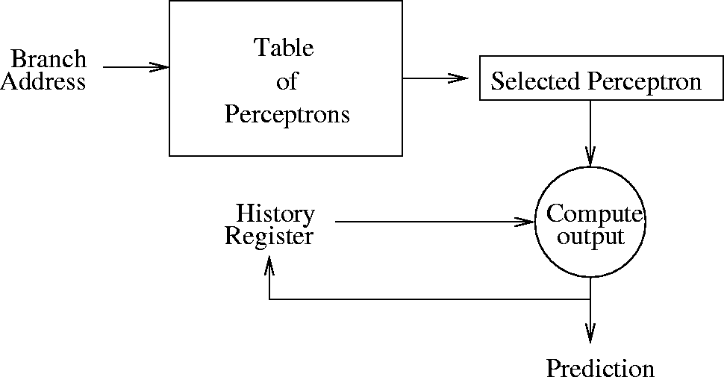
Organization of the Perceptron Predictor
Keeps a table of m perceptron weights vectors
Table is indexed by branch address modulo m
[Jiménez & Lin, HPCA 2001]

Slide 19


Mathematical Intuition
A perceptron defines a hyperplane in n+1-dimensional space:
For instance, in 2D space we have:
This is the equation of a line, the same as

Slide 20


Mathematical Intuition continued
In 3D space, we have
Or you can think of it as
i.e. the equation of a plane in 3D space
This hyperplane forms a decision surface separating predicted taken from predicted not taken histories. This surface intersects the feature space. Is it a linear surface, e.g. a line in 2D, a plane in 3D, a cube in 4D, etc.

Slide 21
Hashed Perceptron
Introduced by Tarjan and Skadron 2005
  Breaks the 1-1 correspondence between history bits and weights
Basic idea:
  Hash segments of branch history into different tables
  Sum weights selected by hash functions, apply threshold to predict
  Update the weights using perceptron learning

Slide 22
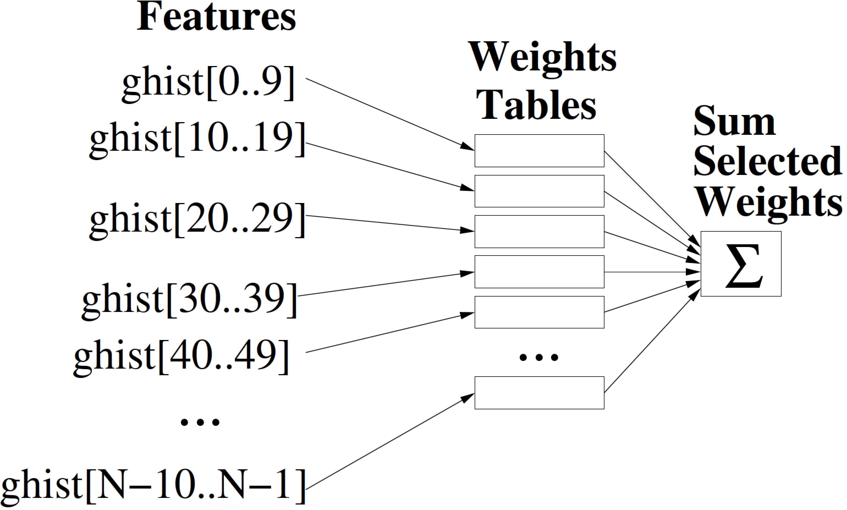
Hashed Perceptron
Features can be sections of global history
Predict taken iff >= 0

Slide 23
Improvements to Hashed Perceptron
O-GEHL uses geometric history lengths
  N tables
  i’th table indexed by interval of history from ghist[0..L(i)] where L is an exponential function
Multiperspective Perceptron Predictor
  https://www.jilp.org/cbp2016/paper/DanielJimenez1.pdf
  Use many different features to achieve improved accuracy

Slide 24
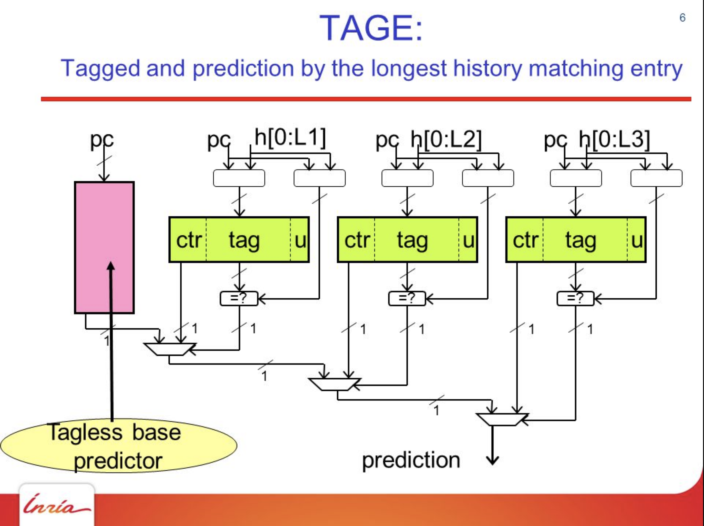
Slide from André Seznec’s
presentation

Slide 25
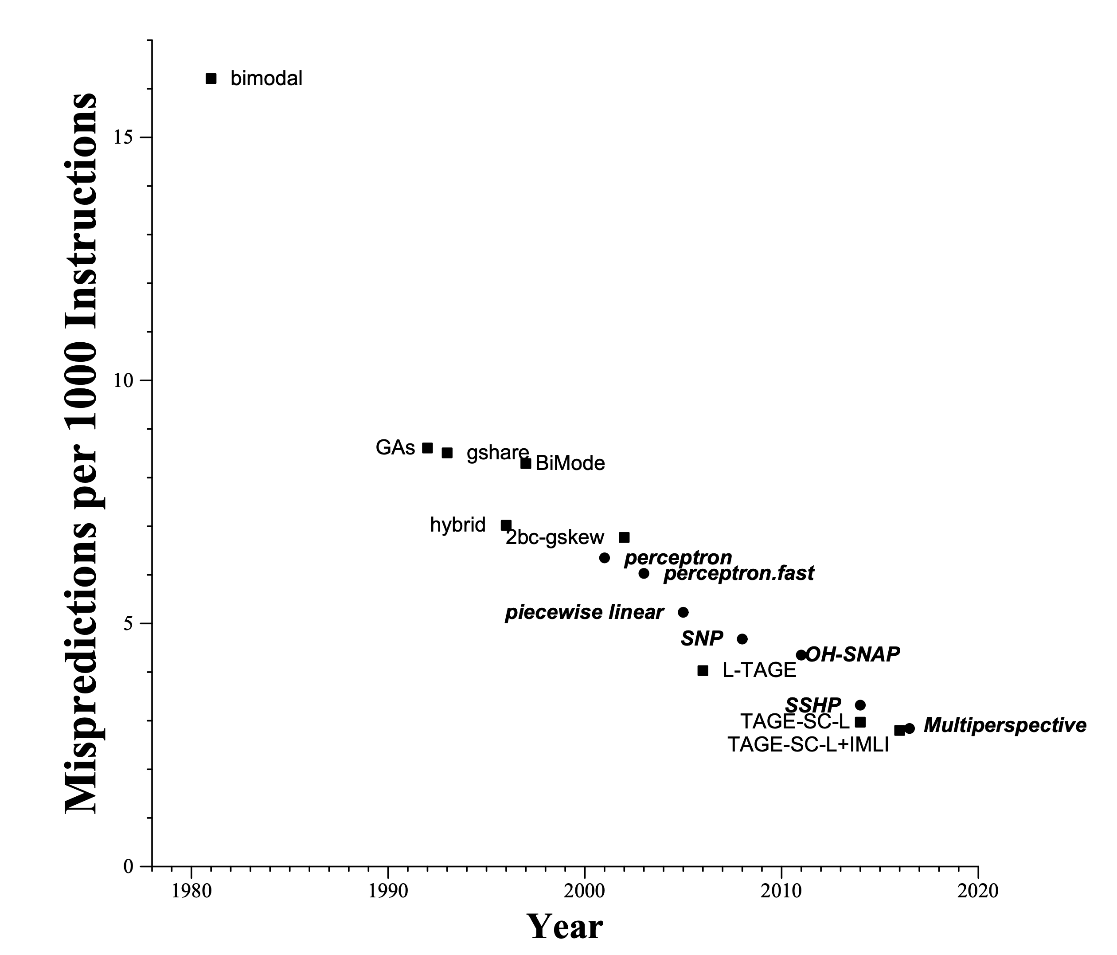
Branch Predictor Improvement

Slide 26
Branch Direction Prediction continued
These insights drive modern branch direction predictor design:
  Branch history is correlated with branch outcome
  Perceptron-based techniques (using summation) are very accurate
  Indexing tables using hashes of histories improves accuracy and latency
  Using geometric history lengths provide a good selection of histories
  Tagging multiple indexed tables improved space efficiency and enables PPM
  Combining perceptron and TAGE predictors yields very good accuracy
Modern processors
  AMD – perceptron, perceptron combined with TAGE
  IBM z14, z15 – perceptron
  Qualcomm Snapdragon - TAGE
  Samsung Exynos M1/2/3/4 – perceptron (me)
  SPARC T4/T5 – perceptron
  Other companies less willing to talk about it
    Intel – who knows? Probably TAGE+perceptron (e.g TAGE-SC-L). Seznec is a consultant
    Apple - ???
    NVIDIA - ???
    ARM – probably TAGE in the big cores, perceptron in some small ones.
    Open source processors – some garbage predictors

